Slide 1
Reach Leading Content Publishers
with Skimlinks
Pepperjam Digital Partner Day
March 25 2020

Slide 2
Agenda
Skimlinks Overview
How We Promote Merchants
Reporting Transparency
How to Optimize with Skimlinks
Skimlinks Merchant Programs

Slide 3
Who We Are
We are the leaders
We have the relationships
We help drive success
60,000 publishers, including 54% of the top 100 UK & US content publishers
50 networks giving us access to 48,500 advertisers across display, mobile and CPA/CPC offerings and a wide range of countries
Account management teams in US, EMEA and APAC that help you enhance your commerce strategy

Slide 4
Notes:
A quick tour through the ecosystem to show where Skimlinks fits in.
We’ll start with the advertisers - these are leading brands from eBay to Topshop to (local one). These advertisers all work with Affiliate Networks.
There are many Affiliate Networks available for advertisers to work with, and as Skimlinks is network agnostic, we work with most of them.
The Affiliate Networks work with different Network Partners including Loyalty and Cashback and they also work with Sub Affiliate Networks - which is what Skimlinks is.
We aggregate all the networks and advertisers into one platform that is then available to the Publishers that we work with

Slide 5
Our Publisher Network
Skimlinks connects you to over 60,000 leading content publishers globally:

Slide 6
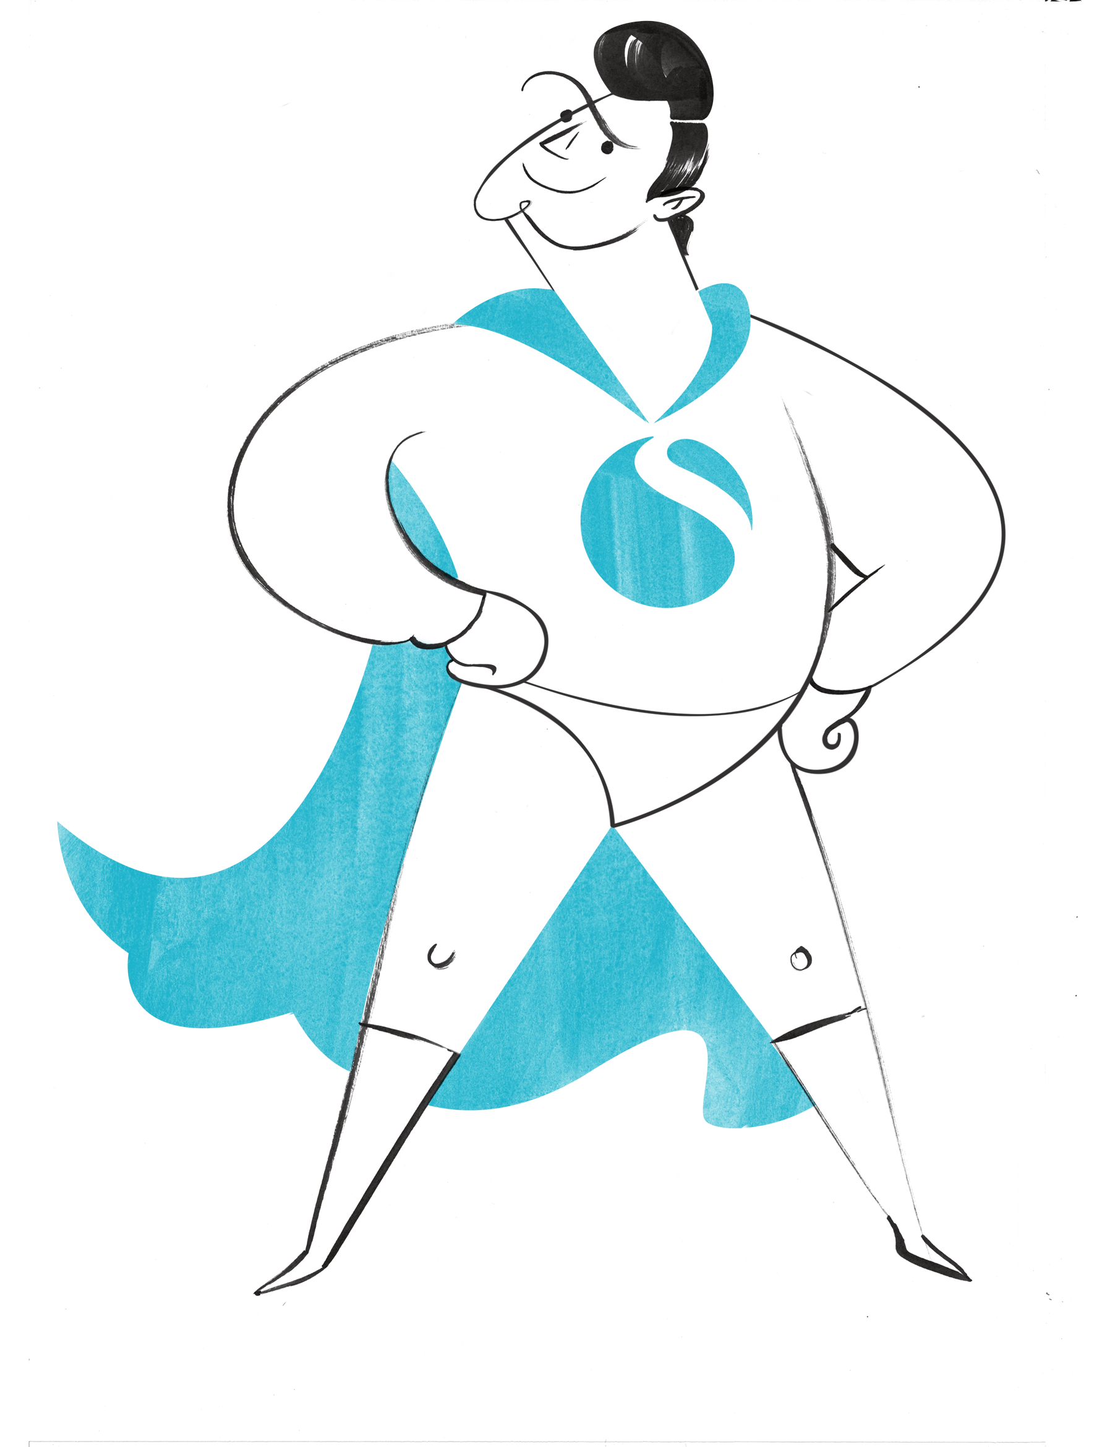
Publishers you want to work with
2,300 publishers apply to join the Skimlinks Platform quarterly
Skimlinks Network Quality team manually approves every publisher on the platform
Only 16% of Publishers who apply are accepted into the Skimlinks network
Continuous monitoring of traffic quality and adherence of our Program Policies for Publishers:
Protection of Merchant brand No bids on merchant’s brand terms No domain name with merchant trademarks
Content Guidelines
Transparency, no alterations or incentivized clicks

Slide 7
How we Promote Merchants to Publishers

Slide 8
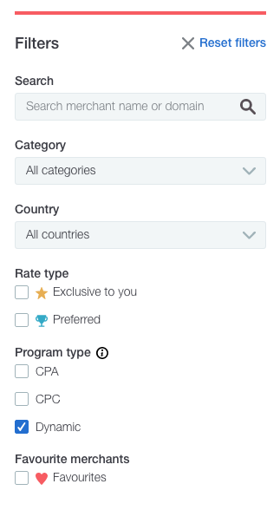
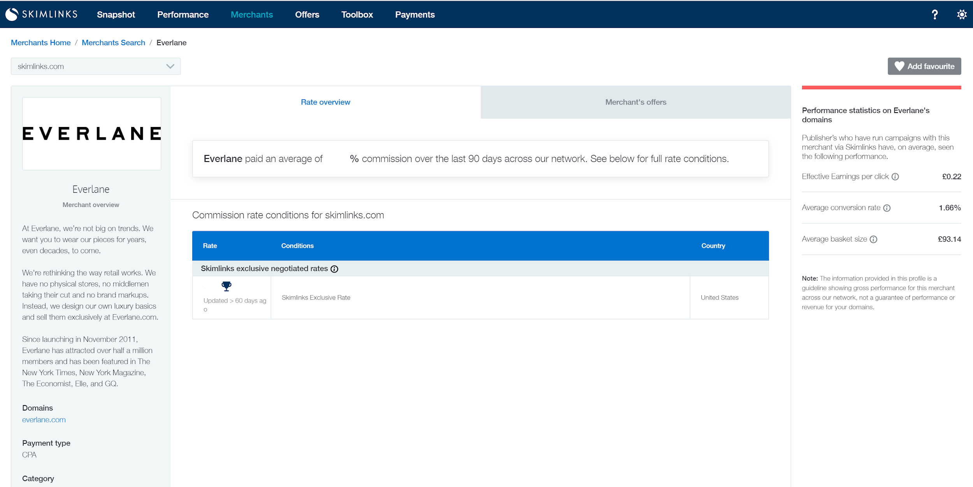
The Skimlinks Publisher Hub

Slide 9
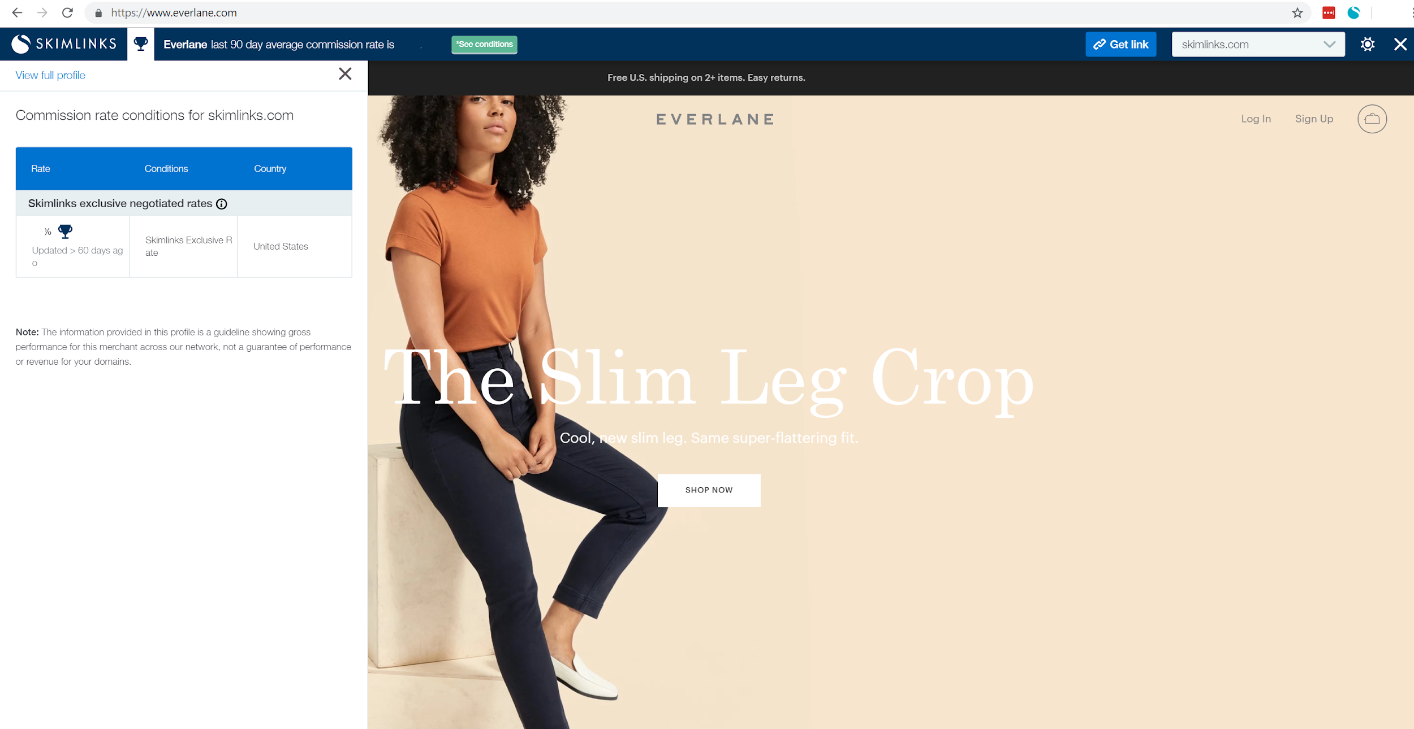
The Skimlinks Editor Toolbar

Slide 10
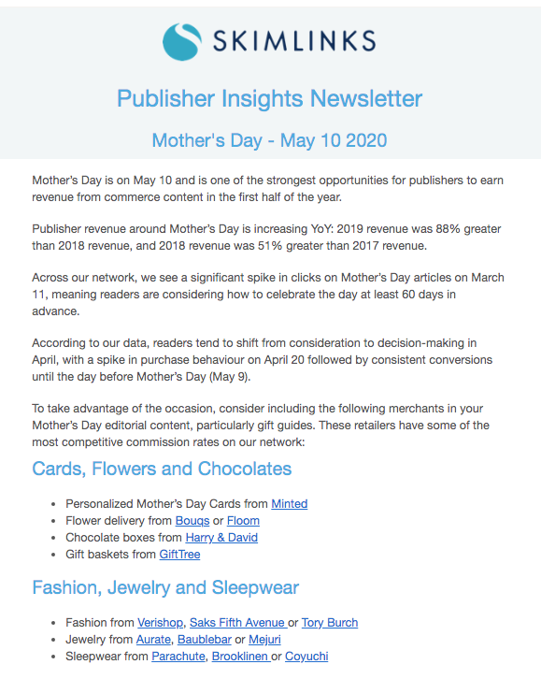
Email Newsletters
Account Management
We facilitate merchant/publisher introductions
We recommend the best merchants for publishers’ audiences
We support exclusive rate setups

Slide 11
What Transparency Looks Like

Slide 12
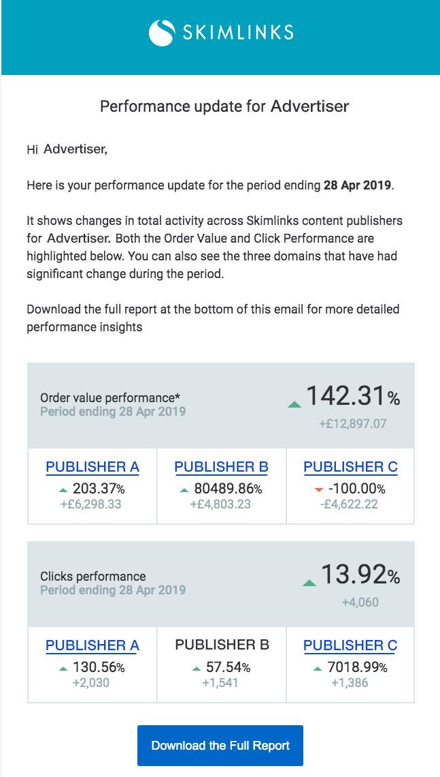
Network Transparency
Domain | Clicks | Sales | Order Value (USD)
elle.com | 67 | 4 | 45.66
today.com | 73 | 3 | 34.25
gq.com | 86 | 2 | 22.83
teenvogue.com | 29 | 2 | 22.83
bustle.com | 73 | 2 | 22.83
refinery29.com | 50 | 2 | 22.83
thecut.com | 39 | 2 | 22.83
reviewed.com | 45 | 2 | 22.83
yahoo.com | 54 | 2 | 22.83
manrepeller.com | 32 | 1 | 11.41
We provide in-depth publisher-specific performance data to all 48,500 merchants that we partner with.

Slide 13
How to Optimize Your Program: Merchant Best Practices

Slide 14
Set a Competitive Base CPA
+484%
+247%
+243%
Clicks
Sales
Order Value
Leading US bedding retailer wanted increase their share of voice in editorial content and maximize sales
The retailer increased their base CPA from 15% to 24%
Many publishers featured the brand in their editorial content and directed their readers to the retailer site
The retailer saw significant incremental growth in their coverage and conversions

Slide 15
Share Promotions
Publishers know which offers drive conversions for their audience
Give them a choice of promotions
Coupon
8.53% CR
$4.54 EPC
$53.28 AOV
Free Shipping
5.58% CR
$3.57 EPC
$64.07 AOV
Hot Product
2.10% CR
$2.13 EPC
$101.76 AOV
Sale
4.05% CR
$3.50 EPC
$86.30 AOV

Slide 16
Spotlight: Hot Product
+68%
+145%
+224%
Traffic
Sales
Order Value
Leading Retailer wanted to promote a new version of sell-out dress
Skimlinks promoted product and offer details to selected relevant publishers
Multiple publishers wrote about the product and started generating sales
Impressive Q3 YOY growth figures for the merchants program

Slide 17
Maximize on Key Events
Tailor your promotions towards key e-commerce events and public holidays
Easter
Earth Day
Mother’s Day
Black Friday

Slide 18
Working with Skimlinks

Slide 19
Skimlinks Merchant Programs
Standard
Paid
Managed
Preferred

Slide 20
Standard Merchant
Available to all merchants who work with an approved affiliate network.
Monthly scheduled email reports, with performance by publisher domain. Metrics include clicks, sales, order value and conversion rate.
Standard
A profile page in the Skimlinks Publisher Hub
Advertiser offers listed in the Skimlinks Publisher Hub
Online Support
Notes:
Add animation

Slide 21
Paid Merchant
Available to merchants who pay $140 monthly payment per month for a minimum of 3 months. In addition to the Standard program benefits, merchants belonging to the paid program receive:
Standard
Preferred Partner Status in the Publisher Hub
Paid
Higher ranking in publishers’ search results
Initial Commission rate recommendation
Weekly scheduled reports
Notes:
Add animation

Slide 22
Managed Merchant
Available to merchants who pay $1,500 monthly payment per month for a minimum of 3 months. In addition to the Standard and Paid program benefits, merchants belonging to the paid program receive:
Managed
Dedicated Skimlinks Account Manager
Standard
Exclusive Rates with publishers
Offers promoted to publishers directly
Publisher introductions
Performance Review
Competitor Benchmarking Data
Notes:
Add animation

Slide 23
Preferred Merchant
Available to merchants who increase their base CPA by a minimum of 50%. In addition to the Standard, Paid and Managed program benefits, merchants belonging to the Preferred program receive:
Standard
Preferred Publisher Status in Skimlinks Publisher Hub
Preferred
Invitations to networking events and publisher days
Publisher profile access
On-demand reporting and insights
Notes:
Add animation

Slide 24
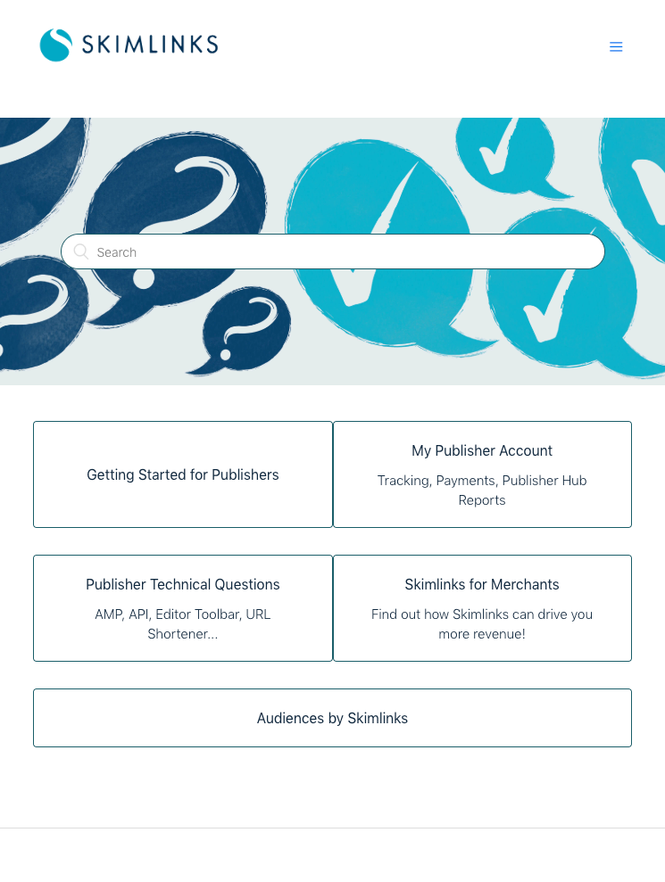
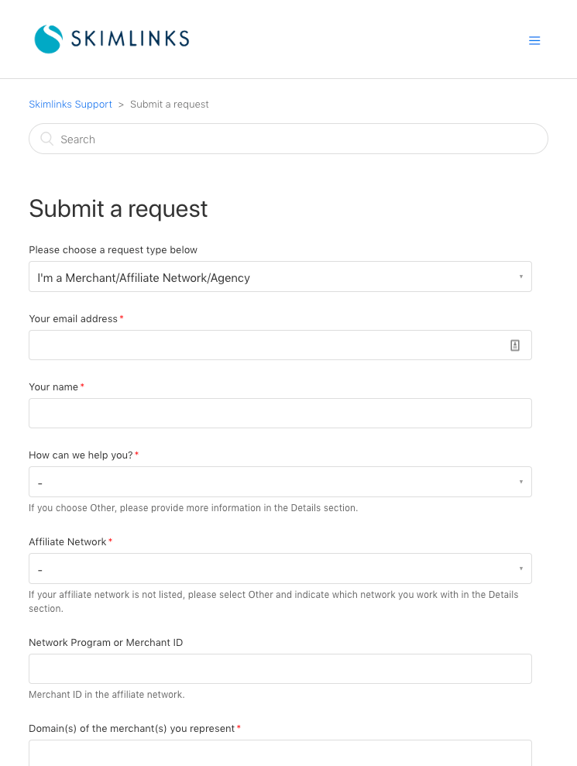
Resources for all Merchants
Getting Started Guide
Help Center
Merchant Request Form

Slide 25
Rules of Engagement
RESOURCES | STANDARD | PAID | MANAGED | PREFERRED
CONDITIONS TO JOIN | Open to all merchants who work with an approved affiliate network | $140/£99/€110 payment per month for a minimum of 3 months | Generate >£1,000/$1,500 commission per month from Editorial Content for 3 consecutive months | Generate >£1,000/$1,500 commission per month from Editorial Content for 3 consecutive months AND Increase base rate by a minimum of 50%
PROMOTIONAL OFFERS | http://skimlinks.com/offer-form | http://skimlinks.com/featured-offer | http://skimlinks.com/offer-form or send directly to your Merchant Manager | http://skimlinks.com/offer-form or send directly to your Merchant Manager
ENGAGE WITH TEAM | http://skimlinks.com/merchant-request | http://skimlinks.com/merchant-request | Send directly to your Merchant Manager | Send directly to your Merchant Manager
GETTING STARTED GUIDE | https://skimlinks.com/resource/getting-started-for-merchants/
HELP CENTER | https://support.skimlinks.com/

Slide 26
Three key actions
Check your merchant status with Skimlinks
Take steps to start increasing your exposure with Publishers
Continually review CPA, Offers, Deals, Hot Products

Slide 27
Reach Leading Content Publishers
with Skimlinks
Pepperjam Digital Partner Day
March 25 2020

