Slide 1
Pepperjam Digital Partner Day
March 25th, 2020

Slide 2
Wickfire Search Engine Marketing Services
Coupon Channel: Discount Shopper Targeting
Drives conversions for deal-sensitive shoppers
Focuses on brand+coupon and discount queries
Sends traffic to dedicated merchant page on TheCoupon.Co
Comparison Channel: Early Consumer Interest
Focuses on consumers who have shown purchase intent, but are not yet brand-committed
Compares and ranks retailers and products
Sends traffic to dynamic review content on BuyersGuide.org
Direct Channel: Branded Search Marketing
Coverage on brand and product terms
API-integrated campaigns on all major search engines
Sends traffic directly to merchant site

Slide 3
Why Wickfire? Scalable Growth and Proven Performance
Wickfire is proud to be both a Google Premier Partner and Bing Select Partner, which allows us early access and beta testing of new advertising products.
We leverage cutting-edge automated workflows and powerful, proprietary bidding software, allowing us to perform better and more efficiently than our competitors.
Our quality landing pages are optimized to convert with no links to your competitors or cross-promoting.
With decades of collective paid search experience, we pride ourselves in being responsive and compliant.

Slide 4
TheCoupon.Co Discount Acquisition

Slide 5
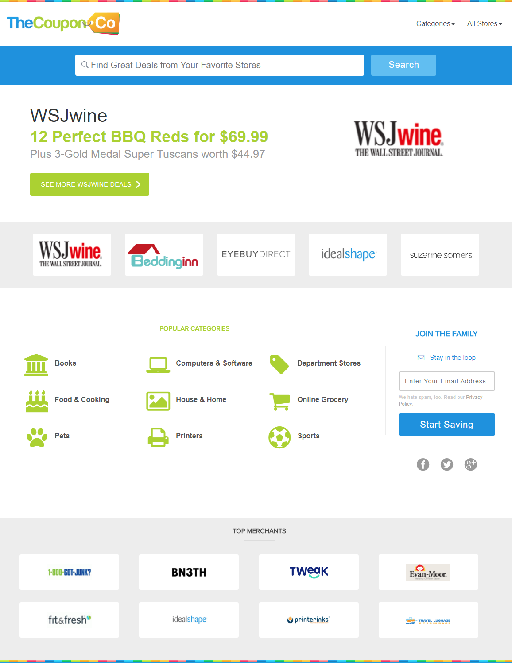
TheCoupon.Co: Overview
2019 monthly traffic averages:
230,000 unique visitors
540,000+ pageviews
Key Demographics:
Age: 57% Between 18-44
Gender: 55% Female, 45% Male
Geography: 87% North America
Device: 60% Desktop, 32% Mobile, 8% Tablet

Slide 6
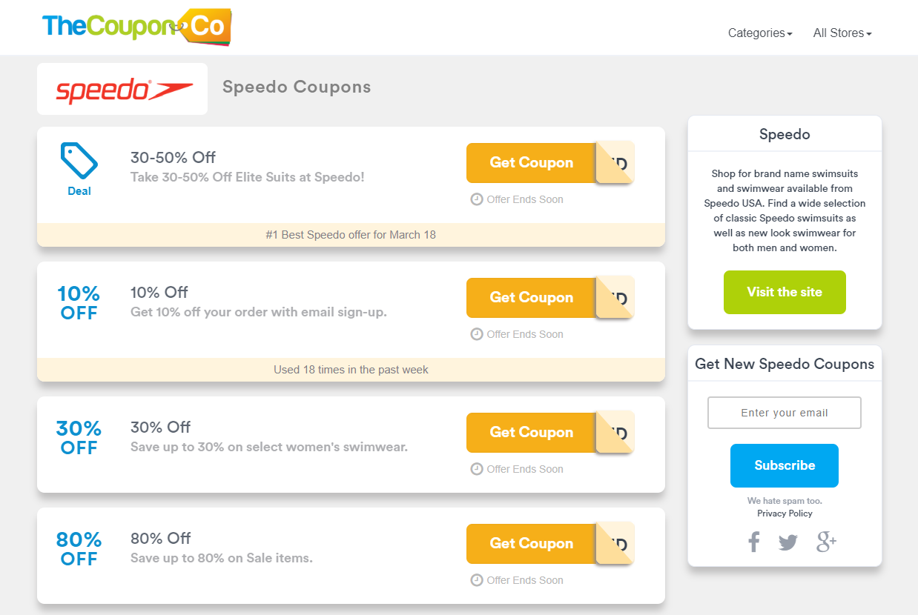
TheCoupon.Co Partnership
Wickfire runs paid search campaigns on coupon-related search queries, targeting discount-savvy shoppers
Campaign includes variations of brand name, for example: “Speedo coupon,” “Speedo promo code”, etc.
Placements direct customers to a branded merchant page on TheCoupon.Co
Focus on driving conversions, reducing shopping cart abandonment, and increasing AOV through targeted promotions
We work alongside in-house ads through bid caps to ensure we complement existing search efforts and do not drive up the advertiser’s CPCs

Slide 7
Why Should You Allow TM+ Bidding?
What is Trademark Plus (TM+) Bidding?
Bidding on your brand and product terms in concatenation with discount, deal, review, and other terms.
Examples include, “brand coupon,” “brand free shipping,” “brand review,” and “brand complaint”, etc.
Why Allow Trademark Plus Bidding?
Over two-thirds of customers abandon online shopping carts during checkout!
Consumers blame unexpected shipping costs and difficulty finding valid coupon codes
Yet 54% of shoppers report they will purchase products left in shopping carts when offered a discount
Working with affiliate partners to allow TM+ bidding ensures your competitors aren’t showing up in the top paid search spots on your brand terms (stealing your customers), and that shoppers find the best deals available, decreasing shopping cart abandonment.

Slide 8
Benefits of Partnering with TheCoupon.Co
Google’s research of coupon-related search behavior:
Shoppers who clicked on a coupon ad were 2x more likely to convert on a merchant's site
94% of coupon users were NOT already on the retail site prior to searching for a coupon
Consumers become more loyal to brands they save with
Merchants saw +5% more revenue per coupon user when compared to general shoppers over a 6 month period
Source: Google and comScore “Value of a Coupon Searcher” study, 2018

Slide 9
Coupon Research Tool
Let us do the coupon performance research!
We can work with you to test new coupons and provide metrics to see which coupons perform best.
Brands can use this data to only serve the most frequently used coupons on their other marketing channels.
Our proprietary system dynamically resorts coupons daily to ensure the highest performing coupons appear at the top of the coupon list.

Slide 10
Coupon Personalization Opportunity (Q2)
Wickfire is in the process of developing technology to serve dynamic landing pages highlighting personalized offers for new customers.
Within 30 Days:
Personalized coupons targeted to specific countries, states, and/or zip codes
Personalized offers for mobile users
Email retargeting with new personalized offers at regular intervals
Within 90 Days:
Personalized coupons if user is new to the merchant page on TheCoupon.Co
Personalized coupons if user has recently viewed a competitor's page on TheCoupon.Co

Slide 11
TheCoupon.Co Next Steps
Looking to launch a campaign?
We can run a TM+ coupon campaign for any advertiser, all we need is TM+ approval!
Already running a campaign with us but looking to optimize?
Please reach out to us directly and we can put together a recommended optimization strategy.
In exchange for commission rate increases, specialized offers or exclusive bidding rights, we can offer added value placements ranging from placements on TheCoupon.Co to blog posts on our review site, BuyersGuide.org.

Slide 12
BuyersGuide.org Review Acquisition

Slide 13
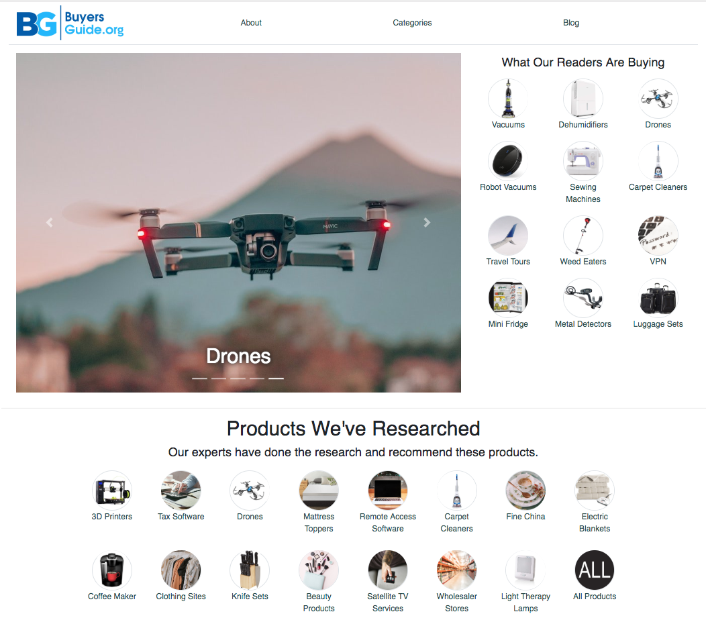
BuyersGuide.org - Overview
Stats at a Glance:
3M unique visitors/month:
98% North American
54% female/46% male
45% mobile, 45% desktop, 10% tablet
100+ review verticals highlighting 1,500+ products
Why is review content important for your brand?
90%
31%
Shoppers who report positive online reviews influence their buying decisions.
Additional spend customers are willing to invest on a business with excellent reviews.
Source: Qualtrics.com, “20 online review stats to know in 2019”

Slide 14
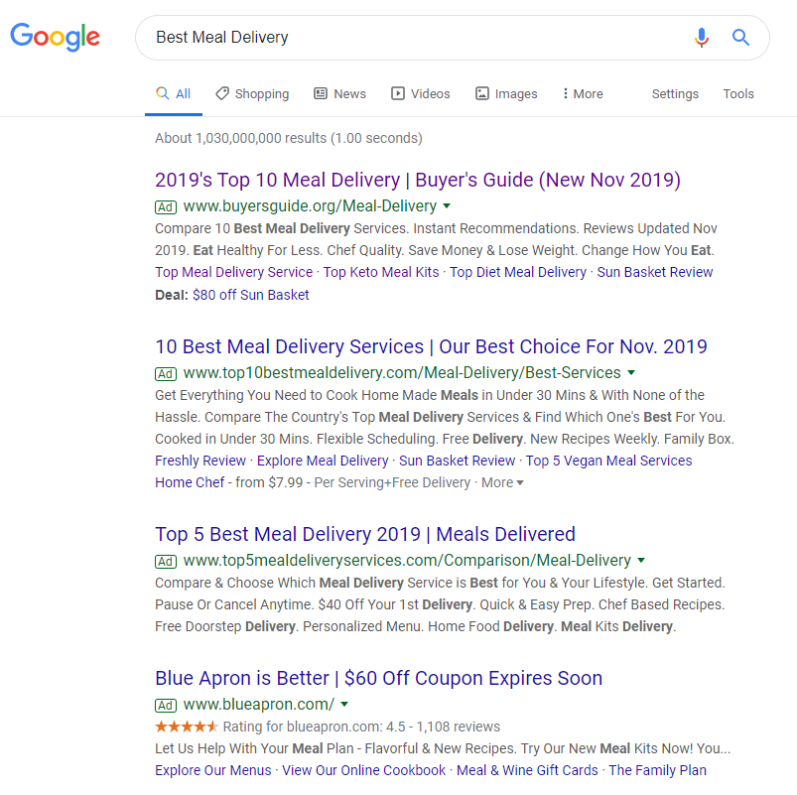
BuyersGuide.org - Overview
Campaigns focus on early consumer interest keywords, targeting new-to-brand customers
75-85% of paid search traffic comes from generic, non-branded ad campaigns
Merchants are ranked according to Wickfire’s proprietary Review Merchant Index, which takes into account user engagement, conversion rate, and CPA for each brand, among other factors
Optional: Brand reputation search traffic (TM + review) is directed to a review page featuring advertised brand in the #1 position over all competitors
Helps control review messaging and displace competitors bidding on branded terms

Slide 15
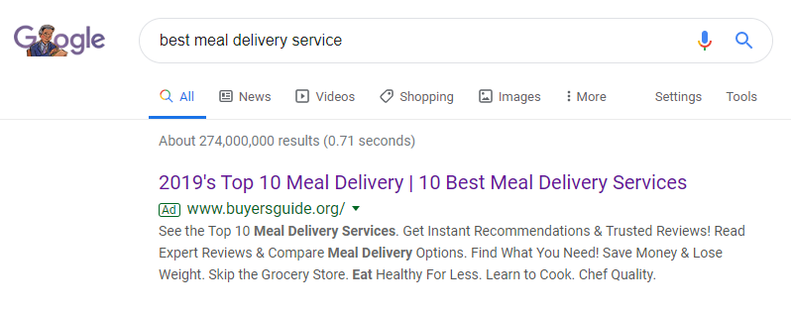
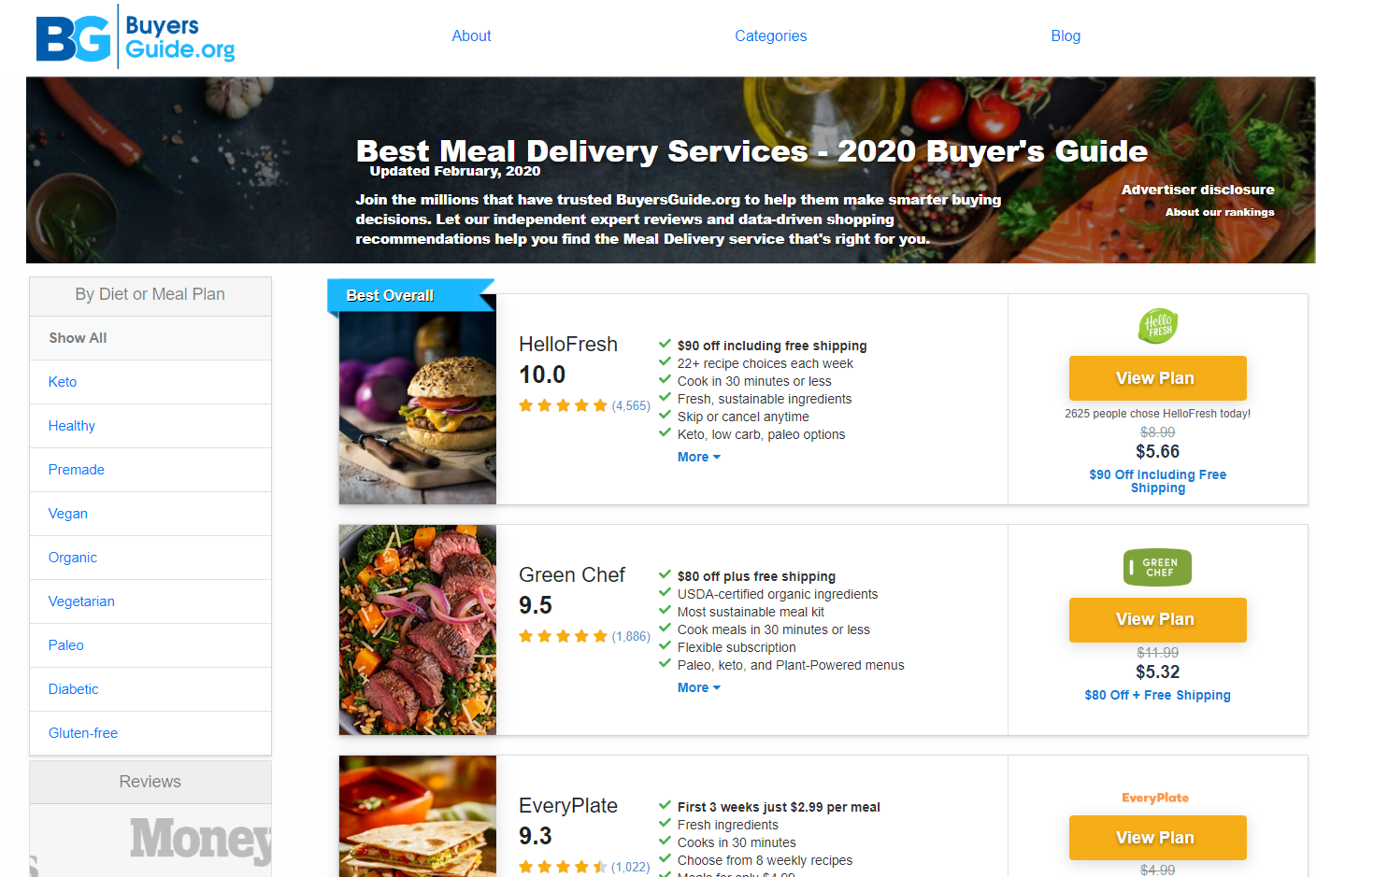
BuyersGuide.org - Purchase Funnel
and is taken to a review vertical optimized to drive sales and customer education
Customer types in search query, clicks on a detailed Buyer’s Guide ad

Slide 16
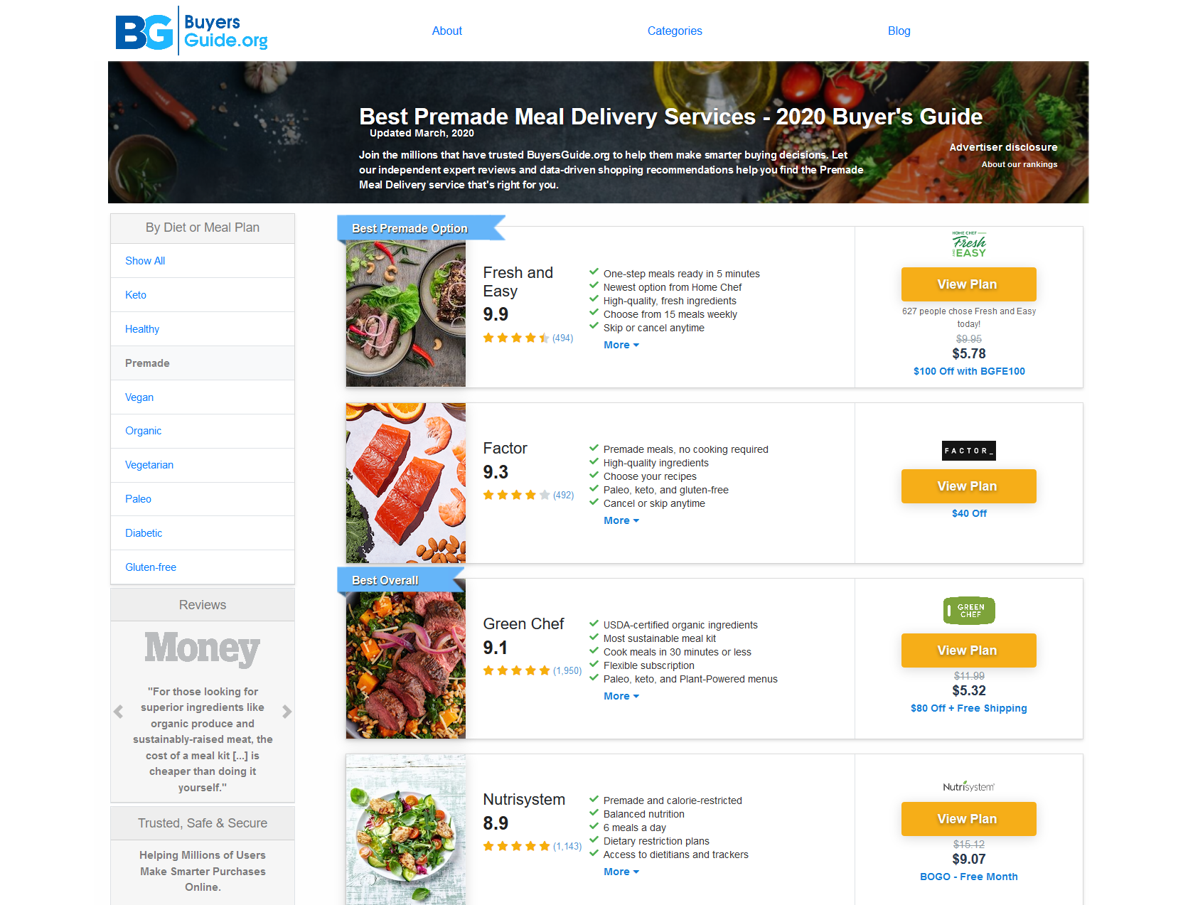
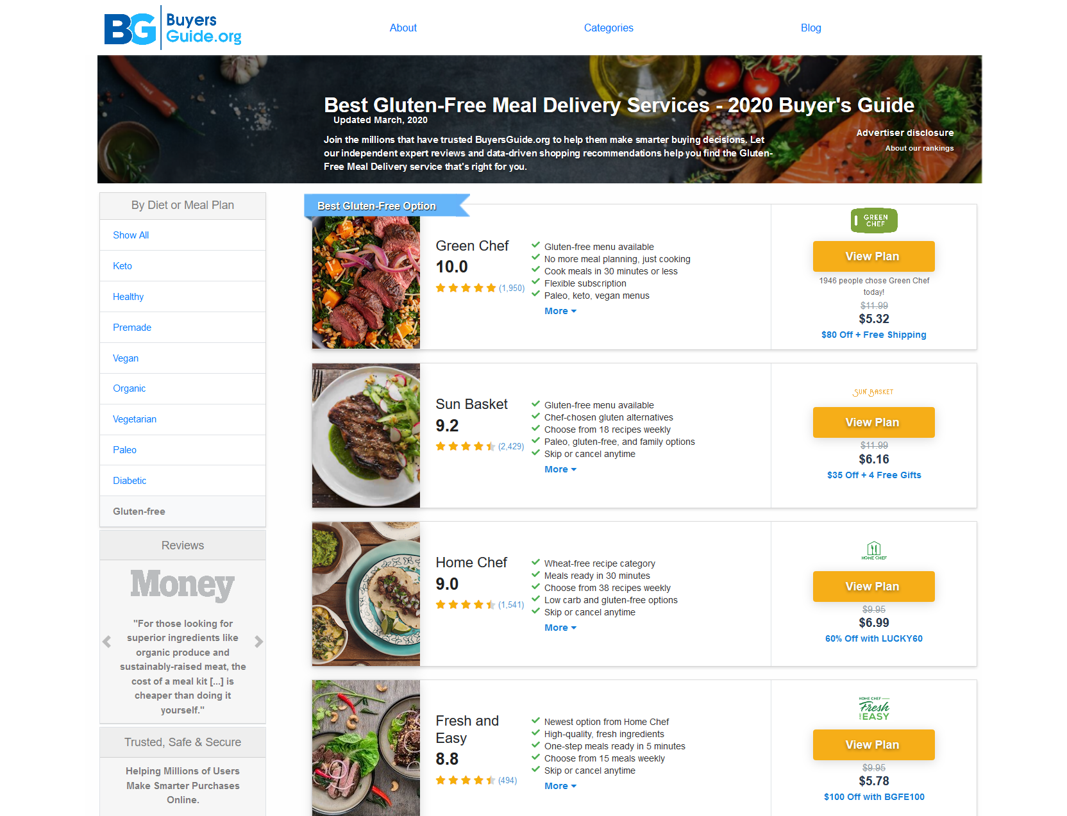
BuyersGuide.org - Vertical Templates
Each vertical can have as many as 20 individual templates to allow for brand exposure in the keywords most relevant for our strategic brands.

Slide 17
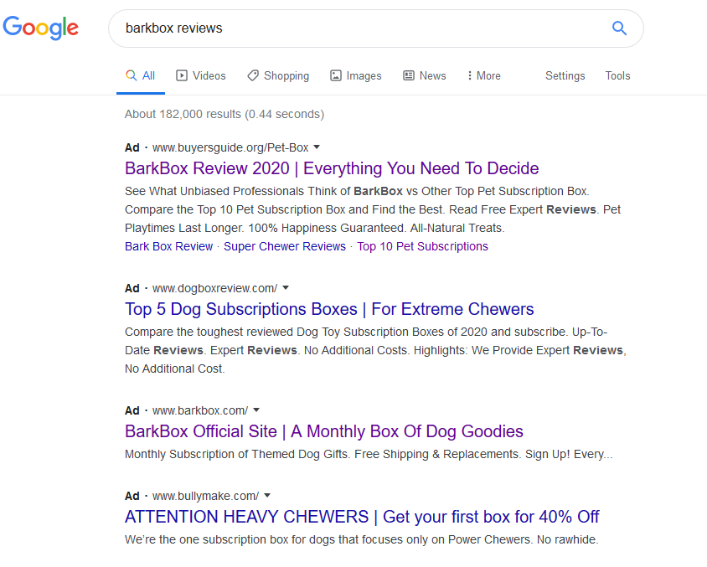
BuyersGuide.org - Brand Reputation
As an added benefit, we can run advertising on review- and comparison-related search queries, targeting shoppers in the research phase of the shopping funnel
Notes:
ONLY INCLUDE IF CURRENT SERPS ARE UNFAVORABLE TO BRAND AND WE ARE PITCHING TM+ REVIEW

Slide 18
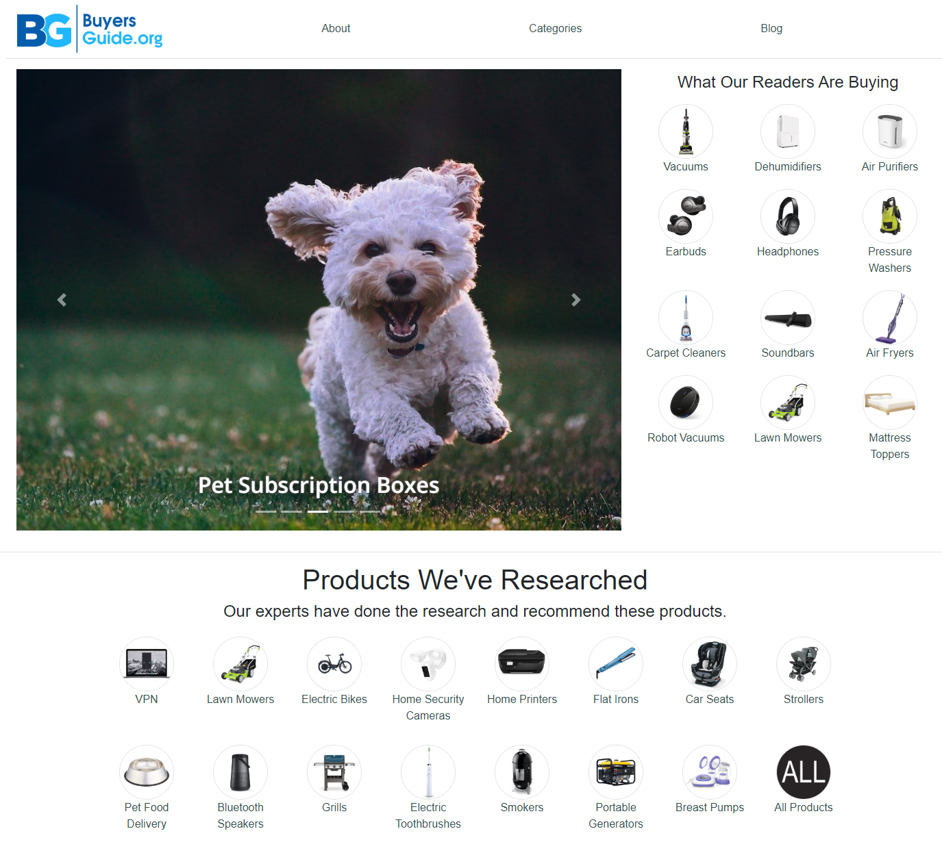
BuyersGuide.org - Top Verticals
Top Review Verticals:
Accounting
Antivirus Software
Beer of the Month Clubs
DNA Testing
Emergency Food Supply
Identity Theft Protection
Invisible Braces
Language Learning Software
Mattress
Meal Delivery Kits
Personal Loans
Pet Food Delivery
Pet Toy Box Subscriptions
Pet Insurance
Virtual Phone Systems
VPN Software
Wine Clubs
Website Hosting

Slide 19
BuyersGuide.org Next Steps
Looking to launch a campaign with existing vertical?
Please reach out to us directly and we can put together a proposal based upon our existing volume and competition.
Entry level CPAs typically run 3x - 6x the default payouts, and premium positions can be anywhere from 5x - 10x.
If you do not see your vertical in our existing categories, but think it could be a fit, let us know and we will review for opportunity!
Already running a campaign with us but looking to optimize?
Please reach out to us directly and we can put together a recommended optimization strategy.
Increases to CPA, optimizations in the purchase flow, and brand reputation campaigns will all be accounted for in the merchant index, impacting positioning on the core Best template, as well as the other campaign templates.

Slide 20
Our fees are based entirely on our performance.
You don’t pay anything unless we generate sales.

Slide 21
Contact Wickfire
BG
TCC
Liz Silvermaster
e. liz@wickfire.com
c. 805-456-9931
Matthew Wiedle
e. matthew@wickfire.com
c. 818-439-5580
Chelseah Murphy
e. chelseah@wickfire.com
c. 310-647-7515
Brian Nemes
e. brian@wickfire.com
c. 407-492-2415
Elias Grossmann
e. elias@wickfire.com
c. 628-280-8724

