Slide 1
+
“Driving Performance Together”
Notes:
UpSellit Intro who we are

Slide 2
UpSellit at a glance
Founded in 2005
Based in Agoura Hills, CA
50 Employees
In-House Technologies
3,000+ Partners
25+ Countries
Privately Funded
Pinnacle Award 2019
Notes:
With properly executed and personalized solutions, we can increase your profitability in 3 distinctive ways:
Maximizing conversions with your site’s existing traffic
Boosting AOV’s
Increasing customer LTV
The next few slides will walk you through a real-life scenario using examples from our client, Samsung.

Slide 3
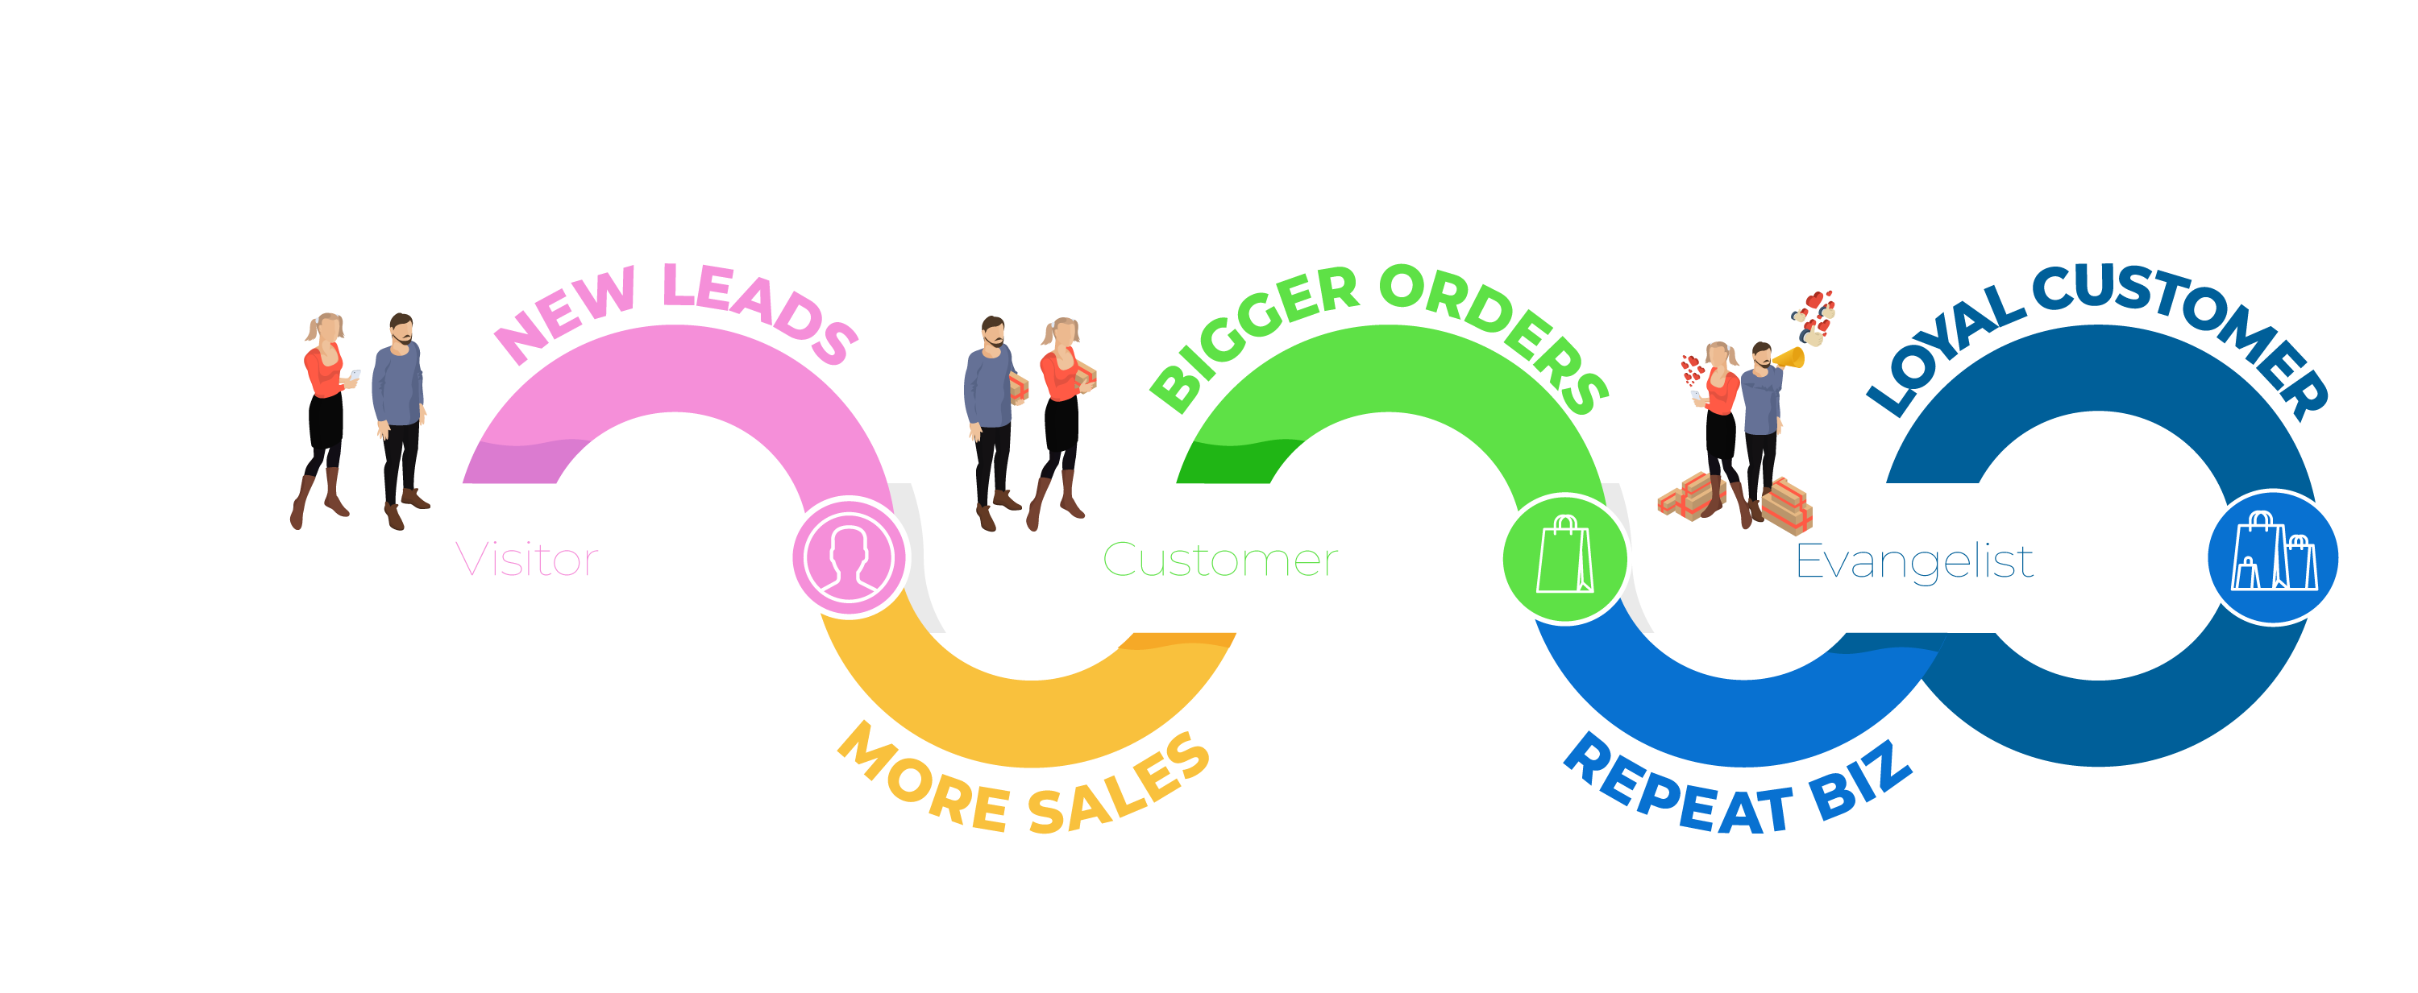
Tell us your goals and
we’ll help you reach them.
Notes:
With properly executed and personalized solutions, we can increase your profitability in 3 distinctive ways:
Maximizing conversions with your site’s existing traffic
Boosting AOV’s
Increasing customer LTV
The next few slides will walk you through a real-life scenario using examples from our client, Samsung.

Slide 4
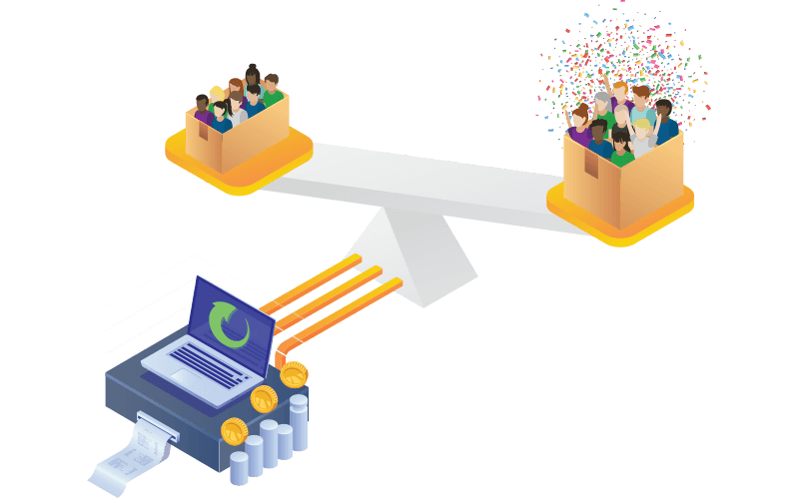
Data Driven Approach
We can prove incrementality with control groups, which are random segments of traffic not eligible for UpSellit's solutions.
We run A/B tests of different messaging and strategies to continually optimize campaigns for performance
Let numbers/performance speak for itself
Notes:
We do a lot of things right, but a primary reason our clients love us is our turn-around times. I pulled a few testimonials and you’ll notice one consistent message from all of them – we’re easy to work with.

Slide 5
In-House Considerations
ROI?
Incremental lift
Cost of errant engagement
Opportunity cost
Deployment?
Timeline
Experience
Ease
Optimization?
Release cycles
Segmentation
Assistance
Error Resolution?
Notes:
ROI
Our clients ask us all the time, “how do I know I am getting incremental sales and not sales I would have gotten on my own?”
14 years of rules, logic and the ability to adjust them ensures the right users are engaged.
And, we have done incremental lift tests and won, how can you prove the logic behind your in-house solution will do the same?
You want to take one of your most expensive employees (a developer) and have them experiment with a side project that does not guarantee profitability?
Deployment
Are your developers busy? Willing to make changes as often as you need them to?
Do they have experience creating segmented marketing engagements that react to user behavior and visitor details?
Are your developers easy to work with? Eager to bring your ideas to life?
Optimization
How quickly and regularly does your development push updates? Will their release cycles align with the frequency of updates you’ll need to quickly adjust to your test data?
Are you going to build engagements that target visitors by where they came from, what they did, where they’re leaving from?
How are you going to judge your campaign’s performance? Industry benchmarks? Who can you ask for assistance?
Error Resolution
How long will it take you to realize that there’s an issue with your campaign?
Will your developers drop everything and fix a problem?

Slide 6
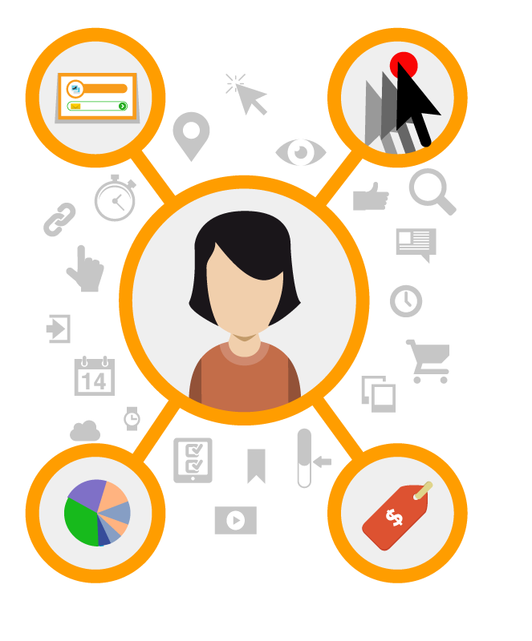
Precision Targeting
Session Data
Click Path
Entrance Page
Pages Visited
Page Abandoned
Time on Page/Site
Items in Shopping Cart
Behavior During Previous Visits
Shopping Cart Value
Previous Conversions
Visitor Details
Screen Resolution
Device Type
Web Browser
Traffic Source
Language Preference
Geo Location
Local Time/ Day/ Season
Search Terms Used
Local Weather
Notes:
With properly executed and personalized solutions, we can increase your profitability in 3 distinctive ways:
Maximizing conversions with your site’s existing traffic
Boosting AOV’s
Increasing customer LTV
The next few slides will walk you through a real-life scenario using examples from our client, Samsung.

Slide 7
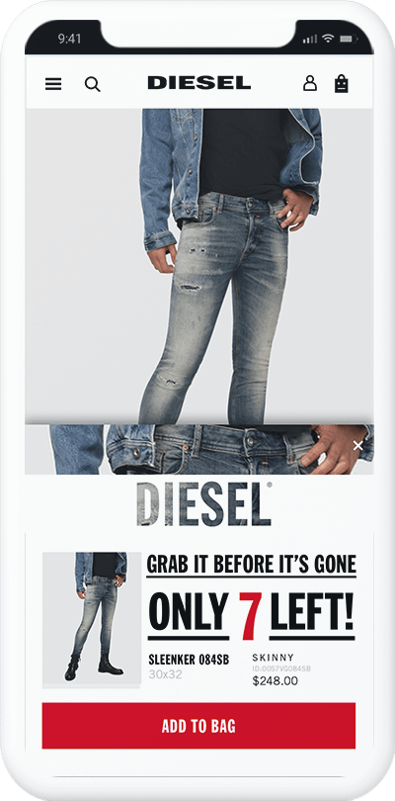
Targeted Tactics
LOW STOCK ALERT
Monitor Product Availability
Track Product Popularity
Create Urgency to Purchase
Notes:
Create urgency with dynamic on-site alerts.
Get customers to purchase without the need for an incentive.
Create FOMO (fear of missing out) by reminding customers at abandonment that they’ll miss out on specific products if they wait.

Slide 8
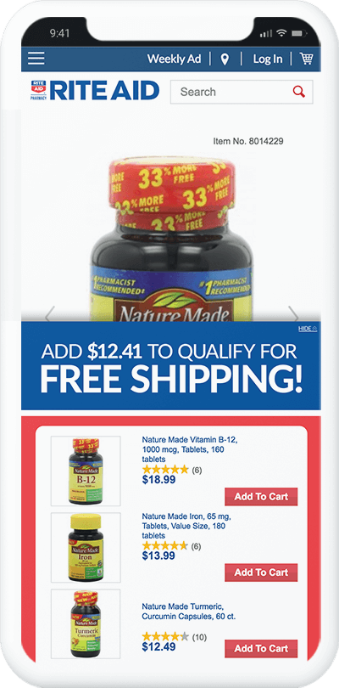
Targeted Tactics
PRECISE PROMOTION
Abandonment Detection
Dynamic Minimum Orders
Strategic Recommendations
Notes:
We can set dynamic incentives that are dependent on product(s) in the cart or the cart value.
By offering the promotion an order value that’s 20-50% higher than the shopper’s current cart value, you can boost AOV’s and reduce cart abandonment.
With UpSellit’s recommendation engine, we leverage data from thousands of previous purchases to provide optimal recommendations that will meet the minimum order value for the promotion.

Slide 9
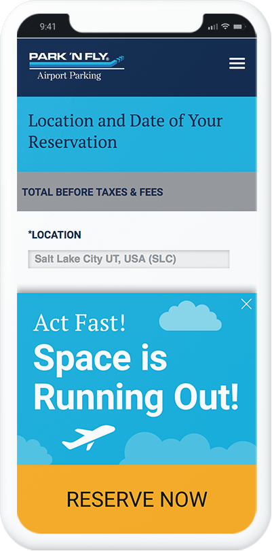
Targeted Tactics
WATERFALL TIMER
Abandonment Detection
Create Urgency to Purchase
Notes:
Create dynamic visual that represents time left to act on purchase, deal, or incentive
Induces urgency to purchase and reduces consideration periods
Less invasive than standard timers and create the same effect with customers

Slide 10
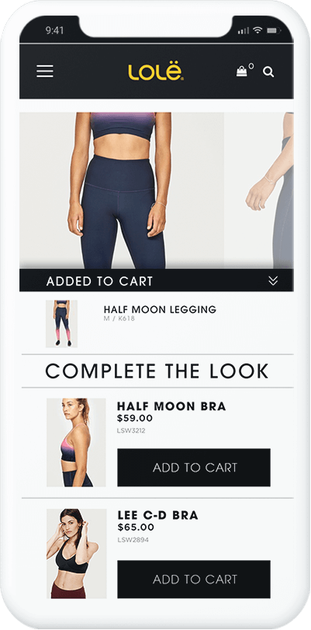
Targeted Tactics
MINI CART
Enhanced Shopping Cart
Behavior-Based Tactics
Seamless Site Integration
Notes:
Enhances advertiser’s shopping carts to effectively increase sales and engagement
Mini carts meet daily quotas and KPIs by proactively adjusting campaigns to:
Recommend specific products and accessories that will increase AOV.
Gamify minimum order value thresholds to engage customers and boost conversion rates.
Leverage ‘Save Your Cart’ messaging to collect more emails and new-to-file leads.
Acts as an all-in-one, dynamic solution that compliments the customer and purchase journey from the moment customer hits “ADD TO BAG/CART”

Slide 11
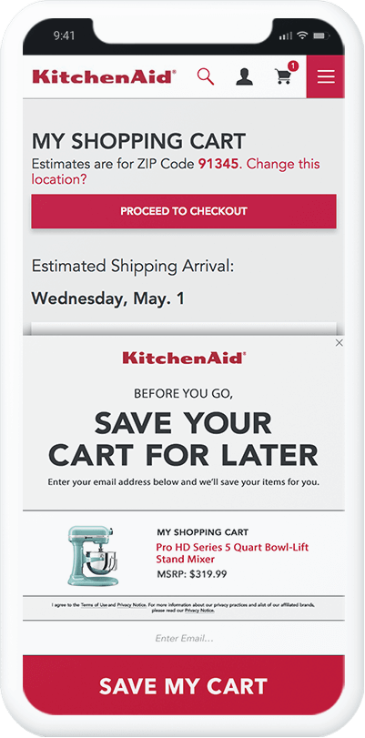
Lead Capture
CART REBUILDER
Abandonment Detection
Email Remarketing
Cross-Device Shopping Carts
Notes:
We have several proprietary technologies, but Abandonment Detection is one of our most advanced. We monitor hundreds of different behavioral data points to determine the exact moment of site abandonment
With our Cart Rebuilder strategy, we engage visitors who abandon their carts by offering them the opportunity to save their cart for later. We can segment based on cart value, cart contents, time on site, or any number of other variables.
Once the email is collected, we deliver a remarketing email with the user’s cart contents to their inbox. Our Cart Rebuilder technology packages up the user’s cart contents into a unique link that allows the user to click through the email on any device, picking up exactly where they left off with their cart rebuilt.

Slide 12
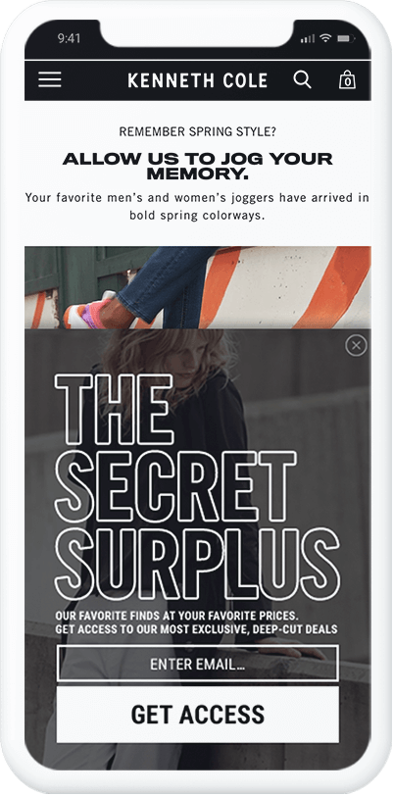
Lead Capture
INBOXED INCENTIVE
Proactive Engagement
Compelling Video
ESP Integration
Notes:
In this example, we’re engaging unrecognized direct-traffic on entry, and we’re rewarding these anonymous visitors with exclusive access to discounted items.
Our design team pulled video from the advertiser’s YouTube page and incorporated it into a dynamic engagement that collects emails and adds them to the advertiser’s email database and UpSellit’s remarketing platform.

Slide 13
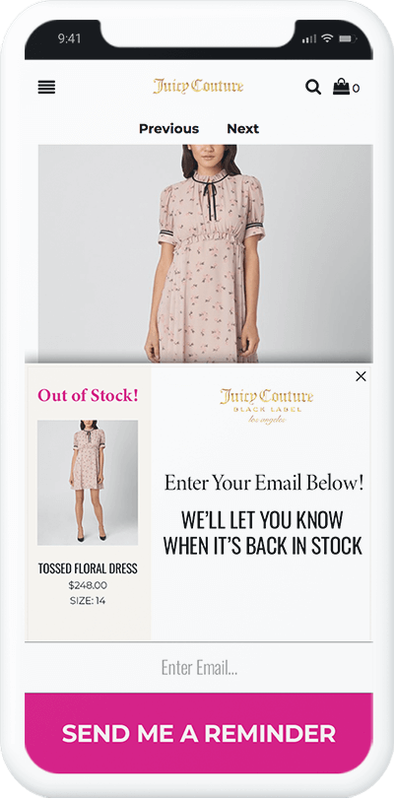
Lead Capture
AVAILABILITY ALERT
Identify Shopper’s Sizes
Auto-Detect Out-of-Stock Items
Remarket Back-in-Stock Items

Slide 14
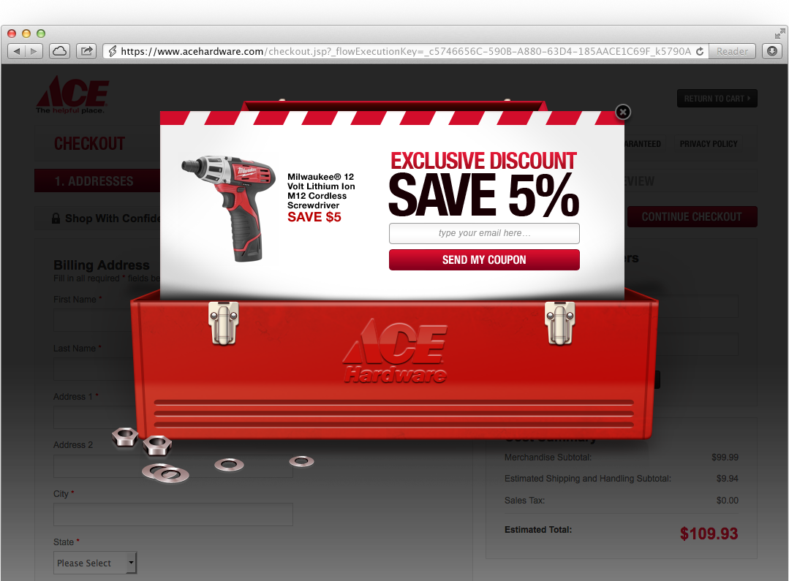
Lead Capture
INBOXED INCENTIVE
“Outside the box” creativity
Capture leads and drive conversion
Offer can be redeemed onsite or via email
Notes:
In this example, we’re engaging unrecognized direct-traffic on entry, and we’re rewarding these anonymous visitors with exclusive access to discounted items.
Our design team pulled video from the advertiser’s YouTube page and incorporated it into a dynamic engagement that collects emails and adds them to the advertiser’s email database and UpSellit’s remarketing platform.

Slide 15
Email Remarketing
PRICE DROP ALERT
Store Shopper Interests
Auto-Detect Price Adjustments
Deliver Real-Time Emails
Notes:
Allow customers to receive real-time alerts when items drop in price
Keep price and budget-conscious customers shopping with you as they know they’re getting the best deals available
Continues the conversation even after they’ve left your site
Great Lead Capture strategy and generates new-to-file leads in exchange for price monitoring alerts or remarket to shoppers who have already provided their contact info.

Slide 16
Email Remarketing
PRECAPTURE
Collect leads in real-time
US CAN-SPAM compliance
GDPR-compliant strategies
Notes:
UpSellit’s Precapture Technology can monitor and scrape form field entries such as first name, phone, and email during checkout or from lead forms without the user to hitting tab or submitting through to the next step
Remarkets to customers with personalized emails containing cart contents or abandoned forms
Opt-in tech widget for regional compliance laws/regulations such as GDPR → GDPR opt-in demo link: https://us.upsellit.com/opt-in-test-19/

Slide 17
SMS Remarketing
INBOUND INCENTIVE
Collect mobile phone numbers
Deliver personalized messages
Re-engage at every stage
Notes:
We can collect mobile numbers in the same way we collect email addresses or we can allow users the ability to tap to text. In this example, users tap to text.
We are able to auto-populate text messages in iOS and Android that automatically opt users in to receive SMS remarketing messages.

Slide 18
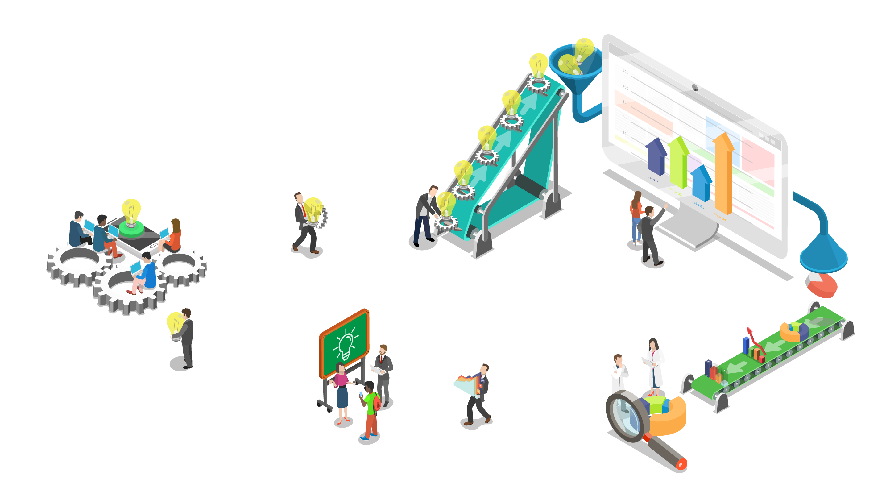
Notes:
UpSellit has been converting online shoppers since 2005.
We know what works and how to build it right the first time.
We build it fast and get our products up and running in 2-3 weeks time.
We never stop working for you. We’re continually testing and optimizing your campaigns.
Our entire team, from copy to QA, is under the same roof; allowing us to work very quickly and efficiently.
And now we’ll get into the specific solutions themselves.

Slide 19
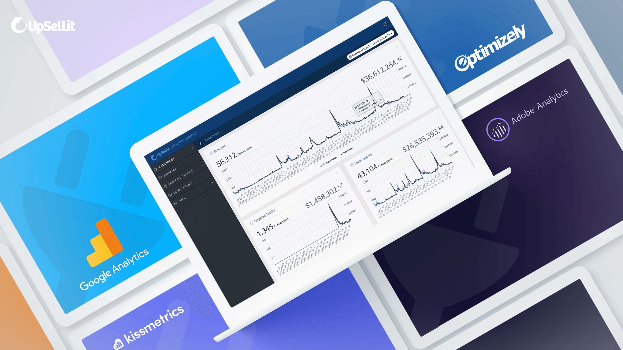
Notes:
We track, monitor, and report everything in-house.
Campaign monitoring is left to us so you can focus on driving business.
We take care of optimizing campaigns and make data-driven recommendations based on the solutions and rulesets that will drive the highest conversion rates, AOV’s, and profits.

Slide 20
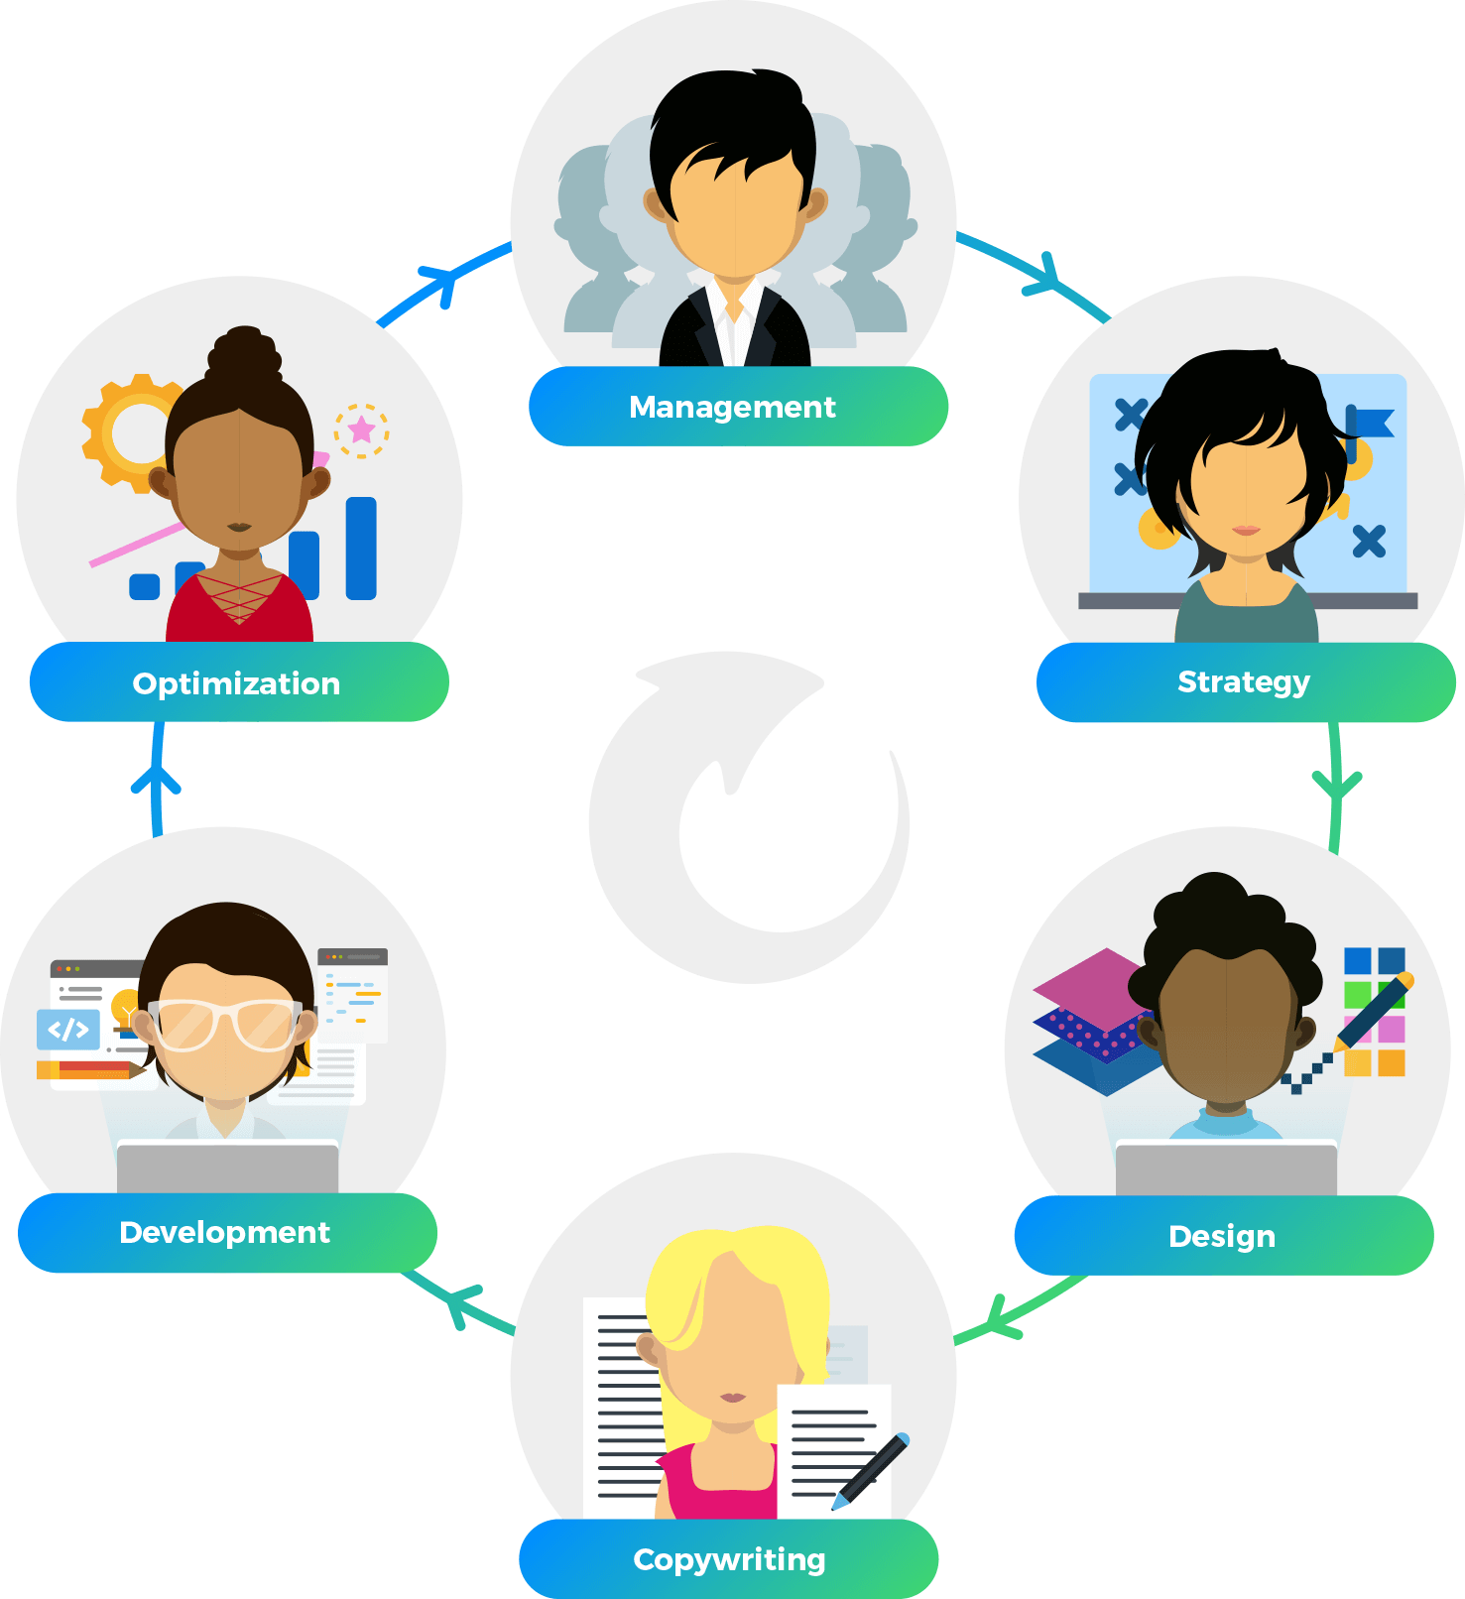
We make your job easy.
Working with UpSellit means:
- 5%→15% increase in revenue
- Turnkey Integration with Pepperjam’s Ascend™ platform
- Detailed performance reports
- Continuous strategy optimization
- Flexible Pricing (Performance or SaaS)
- No setup fees
- No long-term contracts
- Live campaigns in 2-3 weeks

Slide 21
Q&A
Notes:
With properly executed and personalized solutions, we can increase your profitability in 3 distinctive ways:
Maximizing conversions with your site’s existing traffic
Boosting AOV’s
Increasing customer LTV
The next few slides will walk you through a real-life scenario using examples from our client, Samsung.

