Slide 1
//Commerce
for Merchants
//Commerce provides retailers with a range of tools
to maximize clicks and sales.

Slide 2
//Commerce for Merchants
Increase sales and site traffic by leveraging the influence of trusted publishers

Slide 3
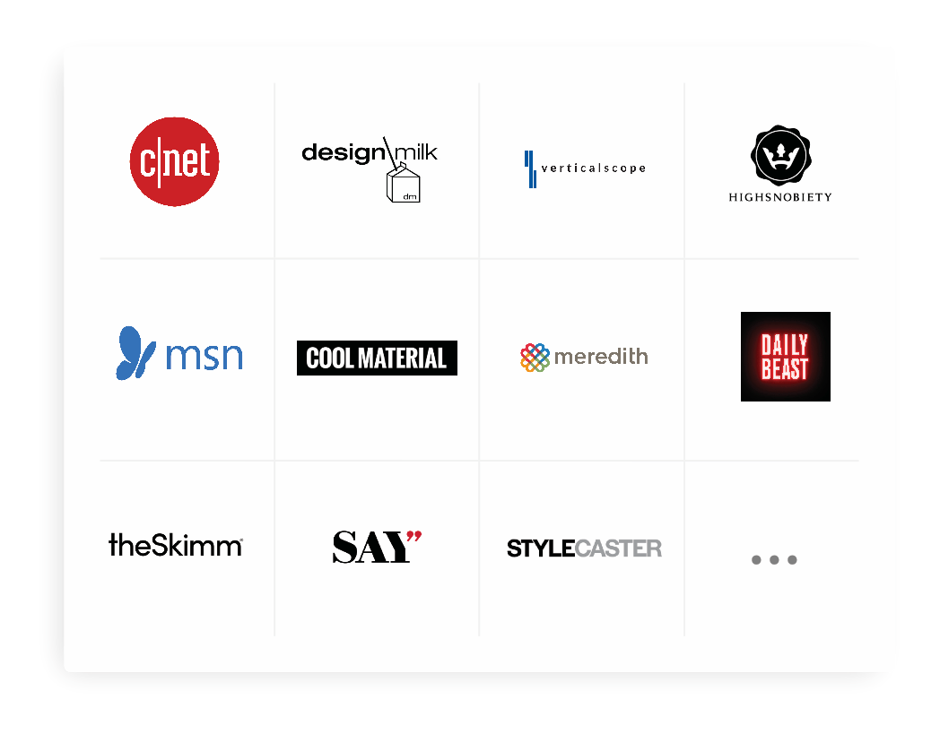
//Commerce for Merchants
//Commerce seamlessly connects
you to 2M+ publishers

Slide 4
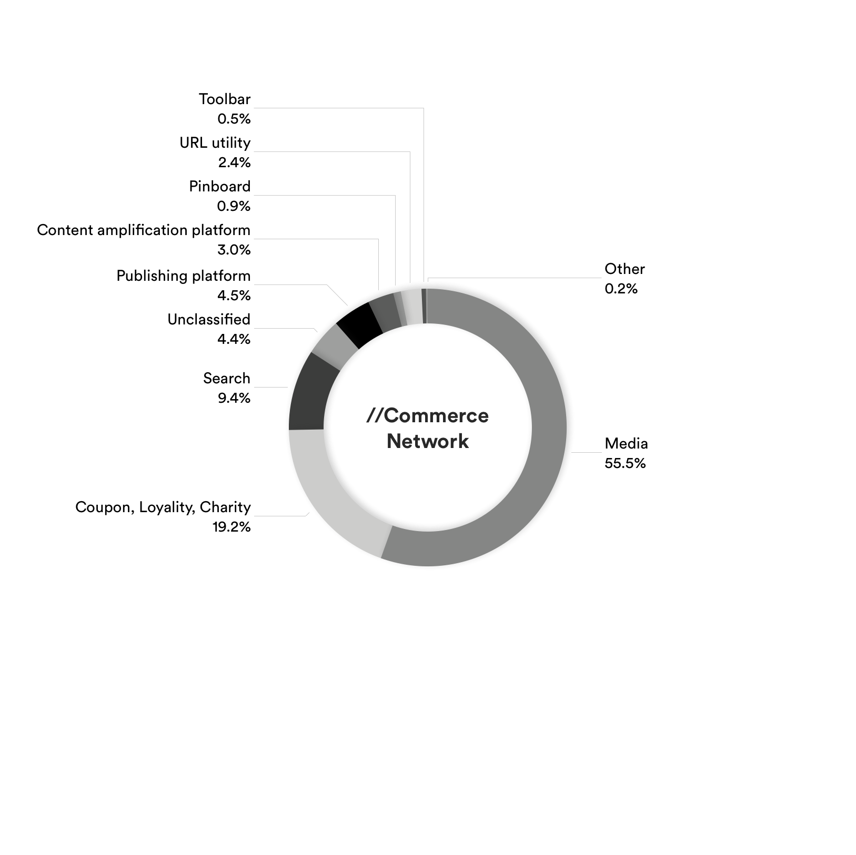
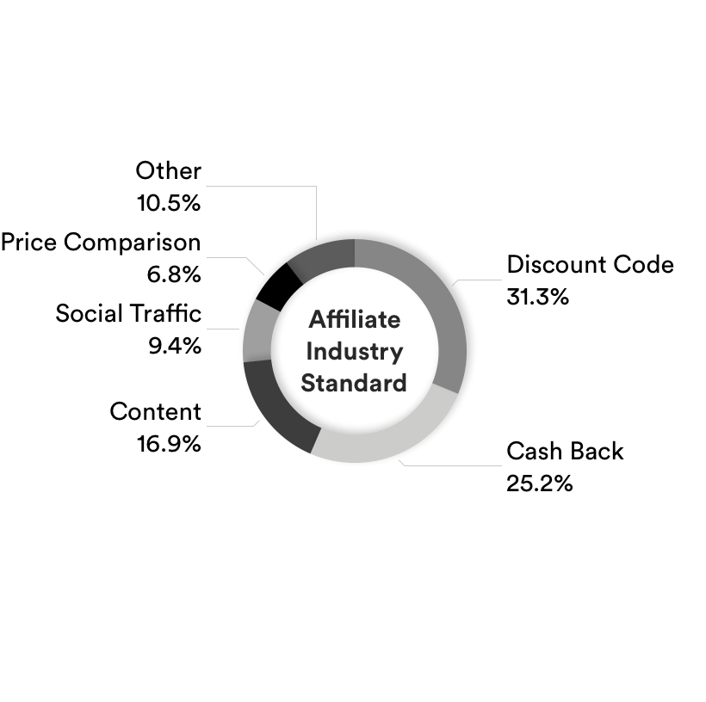
//Commerce for Merchants
//Commerce Network Breakdown vs Industry Standard

Slide 5
//Commerce for Merchants
//Commerce
Product Suite
Convert
Automatically convert existing links to affiliate links.
Insert
Creates and inserts new affiliate links by detecting relevant product and brand mentions.
Increase ROI while driving sales and clicks
Our unique product suite allows publishers to generate revenue directly from their content without disrupting the user experience. With //Commerce’s monetization solution, you’ll drive sales — even if visitors are using an ad-blocker.
Anywhere
Generates monetized links compatible with Twitter, Facebook, emails, RSS feeds, and more.

Slide 6
Product Suite Overview
//Commerce for Merchants
Convert
//Commerce Convert makes it easy for publishers to earn from existing links to your site. When top publishers generate revenue through your competitive commission rates, they will be more likely to link to your site and drive future sales. By being a //Commerce merchant, you incentivize 2M+ publishers to link to you.
Publishers who utilize //Commerce Convert include:

Slide 7
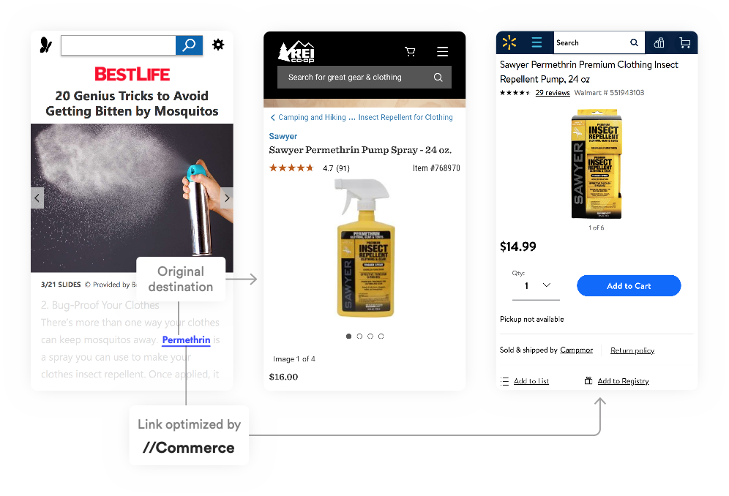
Product Suite Overview
//Commerce for Merchants
Enable Optimize
+ We have over 87,000 publishers opted in to Optimize, with more opting in daily.
+ To drive competitive traffic to your site, //Commerce will use product mapping to replace your competitor’s link with your link - this occurs if our system considers that the publisher will earn more revenue from your site than from your competitor’s
+ What do you need to benefit from Optimize?
With a competitive ePC, which can be achieved by increasing your program rate
Provide a product mapping that will help our system know whose retailers’ links can be replace with your links

Slide 8
Product Suite Overview
//Commerce for Merchants
Insert
Insert transforms the unlinked product mentions in publishers’ content into monetized links. Win the traffic for a given keyword or product within influential content by bidding a competitive ePC (Earnings Per Click). Even if publishers haven’t manually linked to your site, participating in our programmatic auction means you can be the destination of every desired term.
Publishers who utilize //Commerce Convert include:

Slide 9
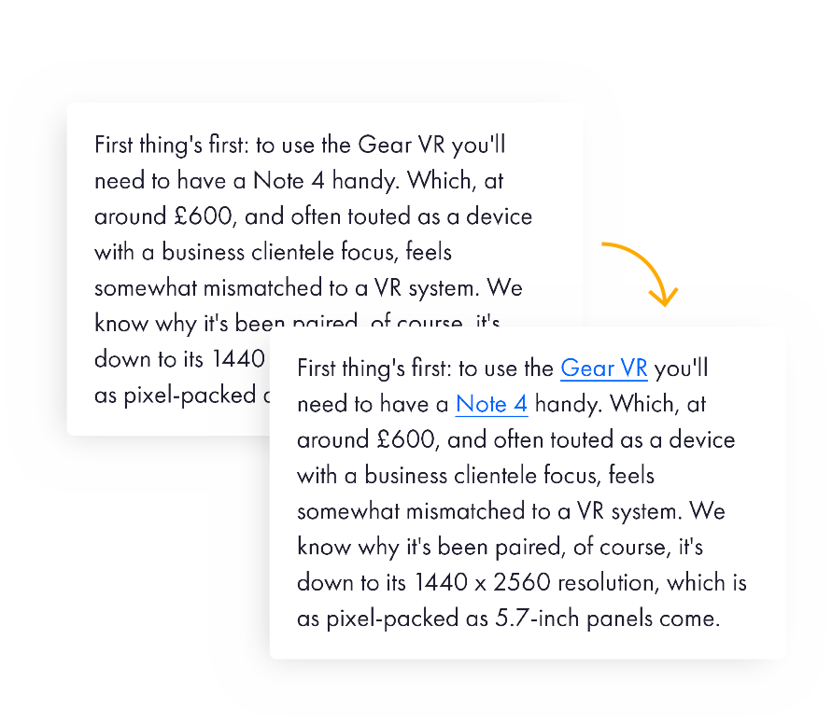
Product Suite Overview
//Commerce for Merchants
Participate in our Insert auction
+ Participate in our programmatic Insert auctions by providing us with a list of ~1000 keywords and their intended URL destinations.
*To ensure that your EPC is competitive on your targeted keywords, an increased CPA may be required.
+ Win all the traffic for a given keyword across our sites by bidding into our system with a CPC rate.
+ Example: Our technology recognized the keywords “Gear VR” and “Samsung Galaxy Note 4” and immediately linked them to retailers who sold those products.

Slide 10
Product Suite Overview
//Commerce for Merchants
Anywhere
With //Commerce Anywhere, publishers can easily create and share affiliate links across their social networks and leading publisher platforms. //Commerce Optimize is now enabled for Anywhere meaning you can drive traffic away from your competitors on influential social platforms.
Publishers who utilize //Commerce Convert include:

Slide 11
Customization and Reporting
Customization and Reporting
Analytics and Insights to engage top publishers

Slide 12
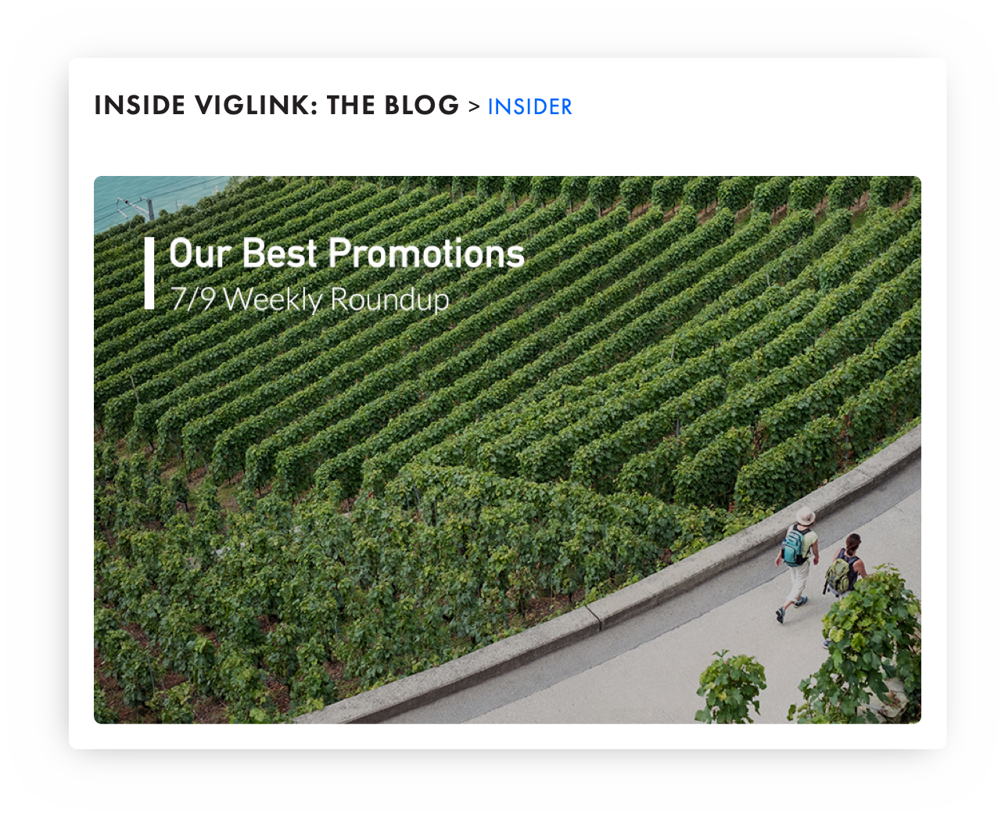
Customization and Reporting
//Commerce for Merchants
Preferred Partner Program
Influence through //Commerce marketing
Simply increase your commission rate by 25% to become part of this ROI stable investment channel. No additional integration is needed and your increased rate will reach //Commerce publishers through blog posts and email campaigns.
Option A: 25% CPA increase for 6 months.
Exposures: blog post mention, merchant explorer star mark, merchant explorer premium placement and CPA increase NL inclusion
Option B: 50% CPA increase for 6 months.
Exposures: dedicated email to premium relevant publishers, in addition to the exposures provided in Option A.

Slide 13
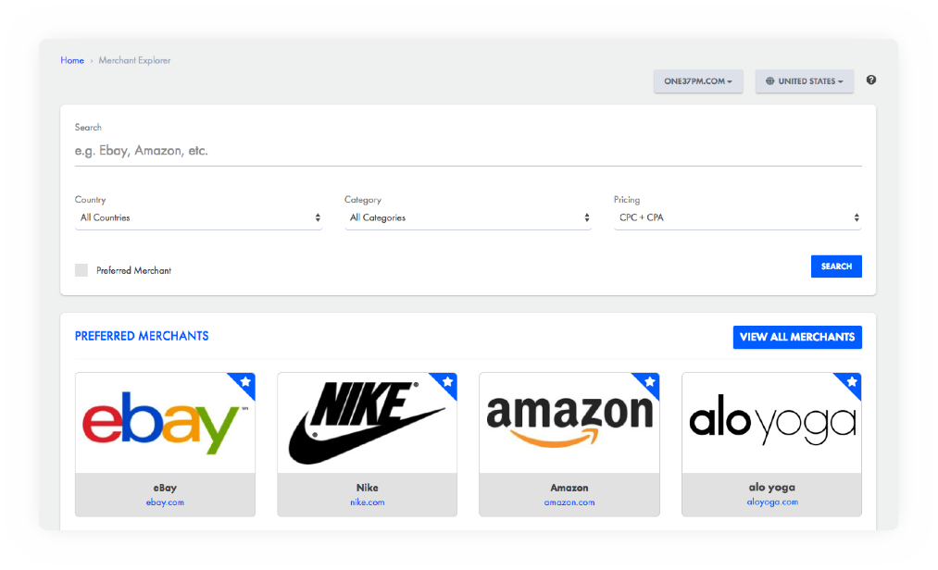
Customization and Reporting
//Commerce for Merchants
Merchant Explorer
Easy exposure to top publishers
With the //Commerce Merchant Explorer, publishers can effortlessly research merchants and create content based on commission rates and affiliation status.
+ Easily increase page visibility by participating in our Preferred Partner Program.
+ 30+ categories help publishers quickly find your merchant page and request program approval.
+ Display commission rates, countries you accept traffic from, trending products, and more.

Slide 14
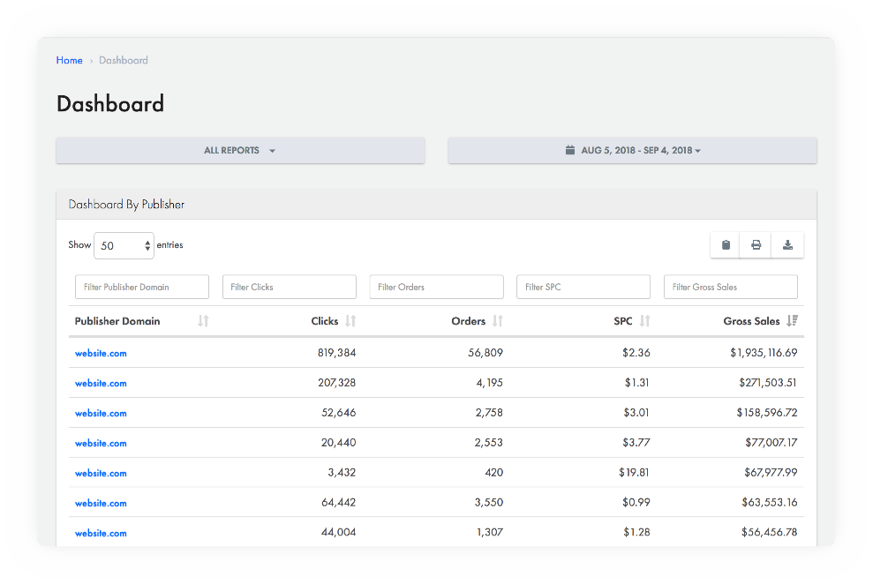
Customization and Reporting
//Commerce for Merchants
Merchant Dashboard
Use the //Commerce Merchant Dashboard to understand the performance metrics that are most important to your marketing strategy. View all the traffic drivers to your program anytime in our user-friendly, self-service interface.

Slide 15
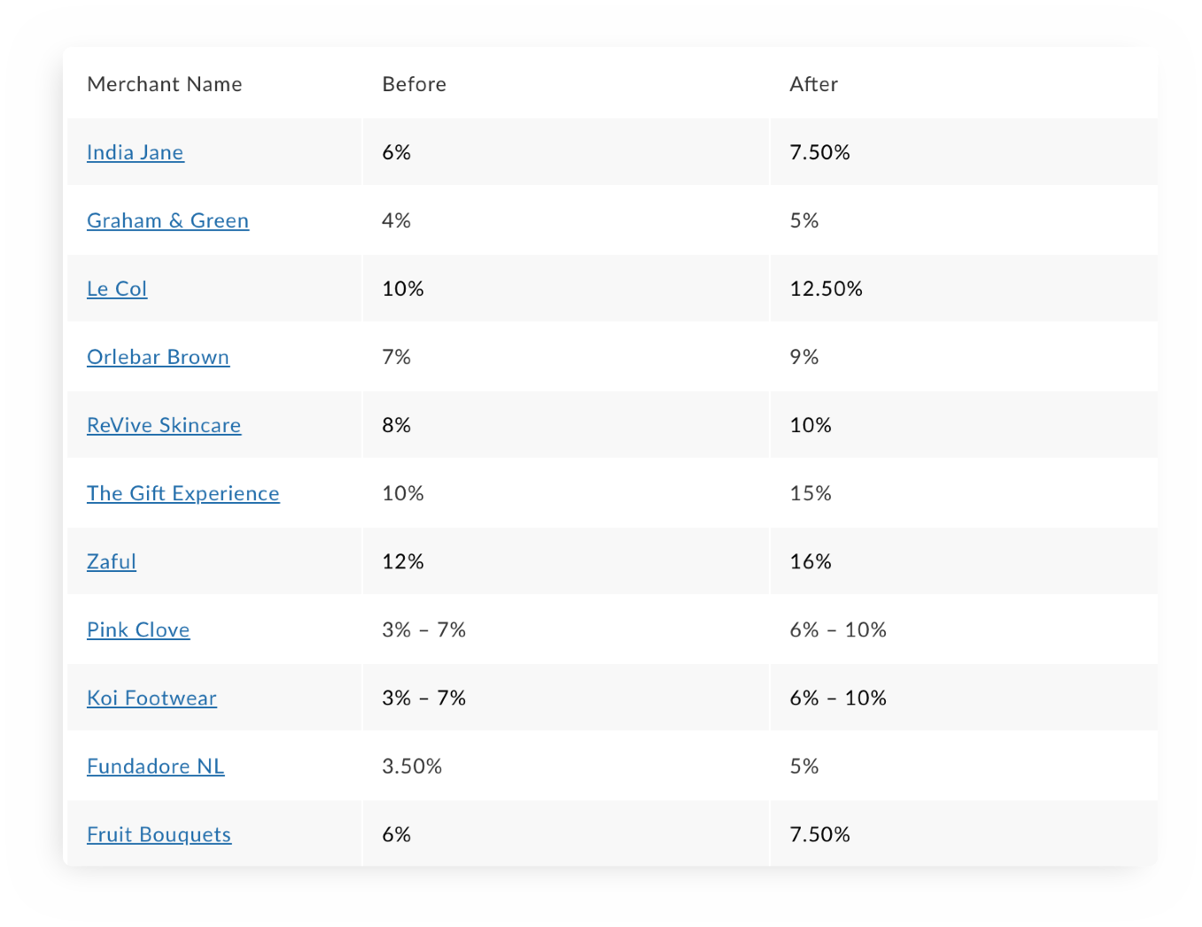
Customization and Reporting
//Commerce for Merchants
Exclusive rates to
premium publishers
As publishers have thousands of merchants to choose from when linking to products, providing a higher commission rate to our high value content partners will allow your brand to gain higher visibility by millions of shoppers monthly.

Slide 16
Additional opportunities for exposure
Whether you want to position your brand for higher exposure, or get coveted placement for your promotions on one of our premium publisher’s websites, //Commerce can help you get the word out.

Slide 17
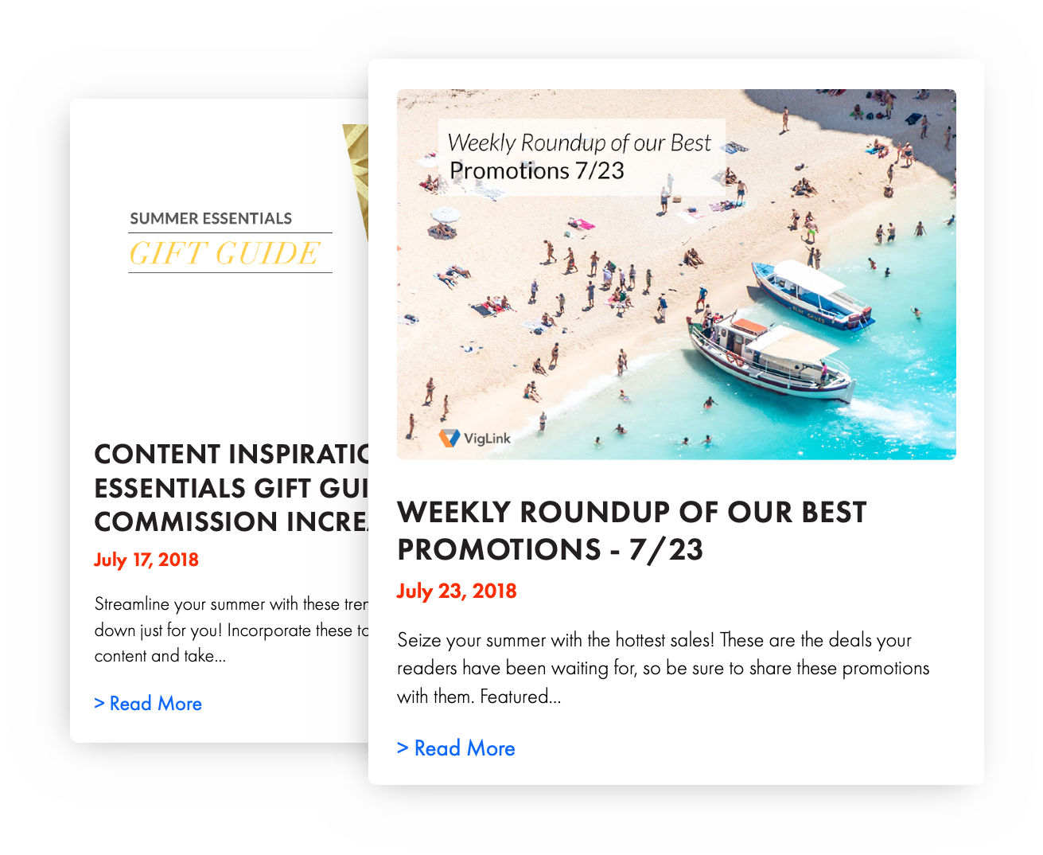
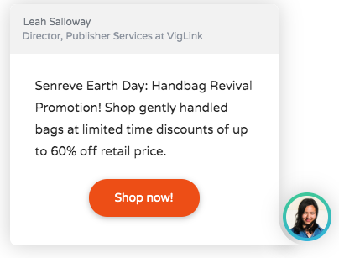
Additional Exposure
//Commerce for Merchants
Paid Placement
Market to the best of our 2M publishers
Natively incorporate your brand into outreach that goes to the top 100,000 of our 2M+ publishers. Based on previous success in such marketing programs, merchant participants typically see a minimum 20% sales lift.

Slide 19
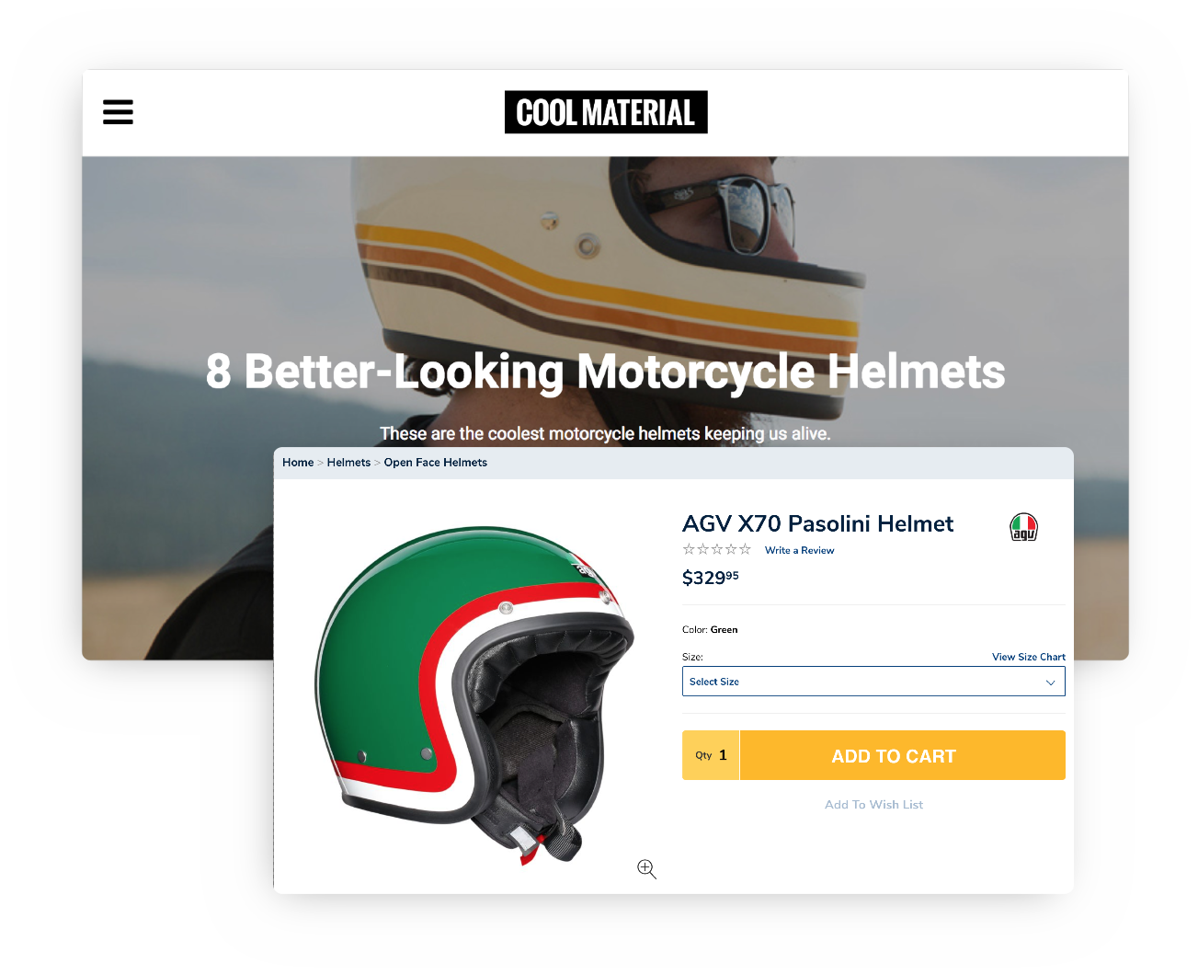
Additional Exposure
//Commerce for Merchants
Sponsored Content
Sponsored content best practices
Select one of our highly influential publishers to feature your brand in their content for a flat fee. Sponsored content is a fantastic way to reach a new customer segment and boost your brand’s exposure and drive incremental sales.

Slide 20
Examples
Sponsored Content
CNN - https://www.cnn.com/2018/11/02/cnn-underscored/grafomap-review/index.html
DailyBeast - https://www.thedailybeast.com/gift-this-custom-map-to-the-person-who-has-everything

Slide 21
Thank you!
Merchant Team
We’d love to hear from you! For inquires, please email us.
merchants@sovrn.com
Kranjan@sovrn.com
EScudder@sovrn.com
For more information, please visit:
www.sovrn.com/publishers/commerce
Our Offices

