Slide 1
BY THE DAILY BEAST

Slide 2
Who we are
Daily Beast
+
Scouted

Slide 3
Who it’s for
Edit launch: September 2018
People who are curious and highly-opinionated
People who are willing to invest in quality
What
Scouted
Does
What We Are/Do
An opinionated discovery resource focused on elevated practicality
Embrace the idea that anyone can be an expert
Focused on experience and value over function and specs
How we do it
Lean into real-life use cases
Embrace personal perspectives
Notes:
launched September 2018 when Jill came on board
2019 was a foundation year
now that we understand what our readers like, we’re ready to focus our editorial lens
WHO IT’S FOR
People who are curious and highly-opinionated
Driven by what we already see in Daily Beast reader DNA – opinion pieces conversion rate membership
Readers look to the Daily Beast to understand why things are happening in the world and why they matter so they can form their own opinions
We want them to look to Scouted for the same why behind the what with products we choose to recommend.
People who are willing to invest in quality
We started with this idea of “elevated practicality”, focus on products that help people upgrade or improve something in their lives with products that are somehow a cut above the rest, or elevated.
In other words: We’re providing lasting, important, real life solutions regardless of the price point.
Expensive items like mattresses, headphones, cameras
Everyday inexpensive but purposeful products like nose hair trimmers and flu swabs
Our opinionated and accessible coverage helps them have the confidence to invest in their purchases
WHAT WE ARE / DO
An opinionated discovery resource focused on elevated practicality
This is shown in the products we choose and the voices we highlight
It means we have multiple recommendations in the same product category to let readers choose what speaks to them most
These opinions are from people who actually experienced the products themselves, in their own lives — rather than just experts
Embrace the idea that anyone can be an expert
Research on competitors in the commerce space from Suz
Very specific, formulaic reviews with a detailed, objective process and hard set of criteria ie. wirecutter//bf reviews,
While others have a hyper-focused lens on curation like The Strategist — podiatrists, dermatologists, chiropractors
But even with The Strategist, we saw reviews from real people — According to Hyperenthusiastic Amazon Reviews — tended to be the most successful in building trust with readers
We are the in-between
We have our own opinions but allow our readers to have their own as well.
We’re not afraid to stake a claim or even have differing opinions about a product.
Focused on experience and value over function and specs
Scouted is for people who don’t want to be told what to buy but rather why something could be valuable to them.
We’re talking about why something is worth the investment and the actual human experience — not just the product specs
HOW WE DO IT
Lean into real-life use cases
Embrace personal perspectives

Slide 4
What
Scouted
Is
!
We Are
A discovery resource
Highly opinionated
Obsessed with experience
Value and voice first
Accessible
We Are Not
A buying guide
Overly structured
Super focused on specs
An exhaustive testing facility
Exclusive

Slide 5
New Franchises
SCOUTED EDITORIAL
Name | Cadence | Definition
The Case For | 3-5 per week | Single product reviews
I’m Looking For... | 8 per week | Roundup based on interests, hobbies, or product categories
What’s the Difference | 2 per month | Educating through questions
New Kids on the Block | 2 per week | New product and brand launches
What’s Your Perfect | 2 per month | Q&A format with ‘experts’ and experts
Scouted Gift Picks | Seasonally | Gift guides and one-off gift picks

Slide 6
Shopper Snapshot
Dailybeast readership
60
%
28.9MM
Dailybeast audience
AGES 25-54
45
%
$100K+ HHI
54
%
male
46
%
22.6MM
SITE VISITS
3.5MM
SOCIAL
2.2MM
APPLE NEWS
354K
NEWSLETTERS
112K
AUDIO
55K
APP
feMale

Slide 7
Q2 Scouted Packages
Paige Hart-Smith
02.27.20

Slide 8
What’s your most important KPI?
What’s your content goal?
We recommend
Goal
Solution
Evergreen | Article
Timely | Cheat
Longform | Article
Shortform | Cheat

Slide 9
Q2 Content Opportunities
The Daily Beast
The Daily Beast can help showcase your brand’s unique and must-see products through holiday-themed Cheat Sheet packages or custom gift guides that are aligned with key Q2 shopping moments.
Q2 Tentpoles
Spring Cleaning
Easter
Earth Day
Cinco de Mayo
Mother’s Day
Memorial Day
Kick off to Summer
Father’s Day

Slide 10
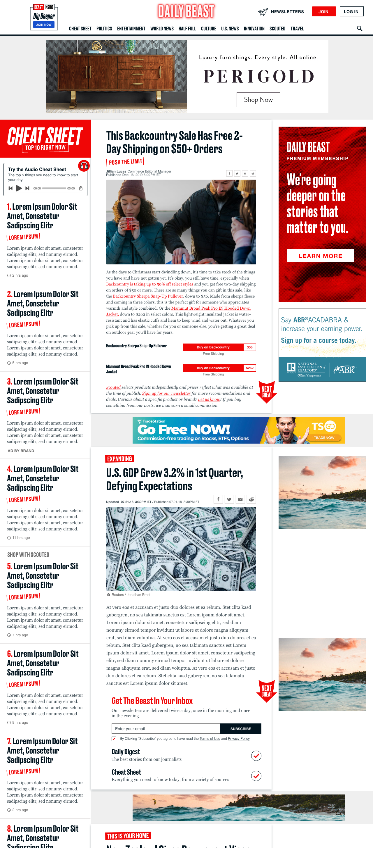
Branded Cheats
The Daily beast
The Cheat Sheet gives a speedy, smart summary of all the news you need to know. Prominently placed on our homepage, it drives an average of 21 million page views each month and 27% of homepage clicks.
Branded Cheats are written by the Daily Beast staff and positioned to resonate with our readers. We will work with your brand to align on a concept, then the Daily Beast handles all production and promotion, ensuring your content reaches its audience.
New conversion cards

Slide 11
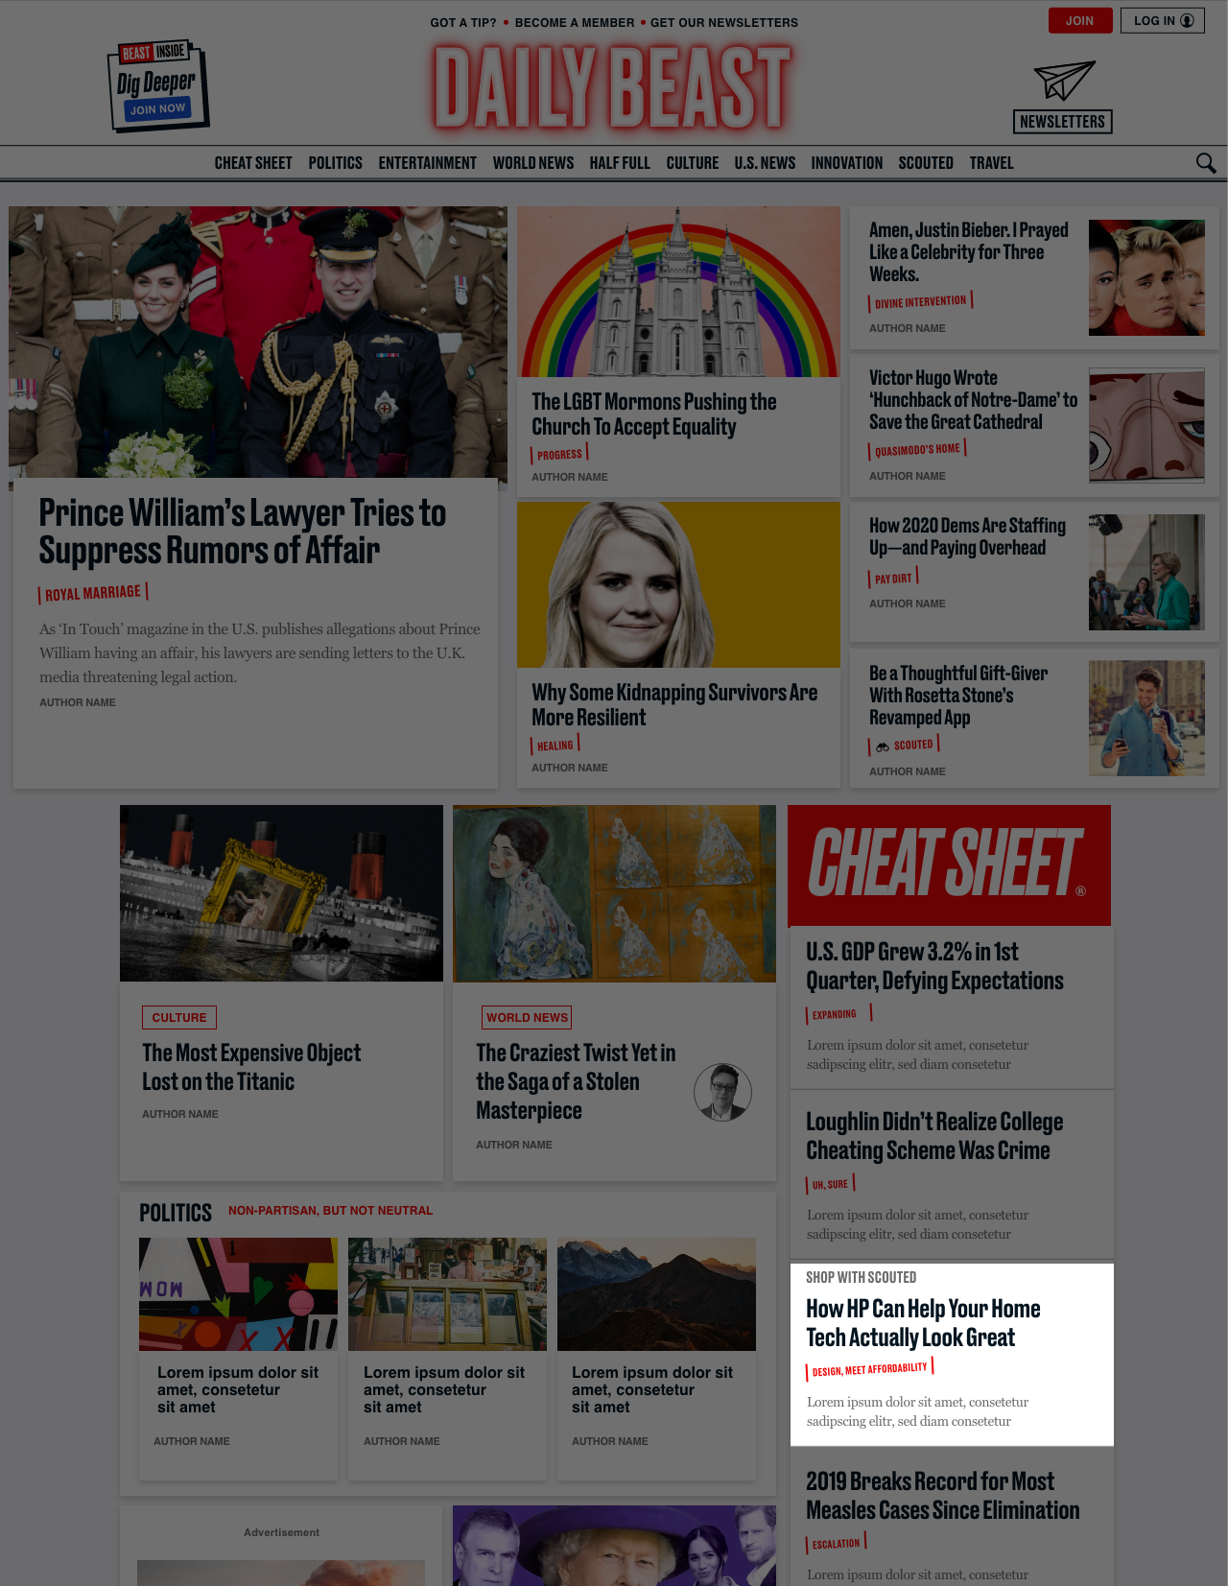
Cheat Sheet Packages
HOMEPAGE PLACEMENT: CHEAT SHEET, 3rd SLOT
The Daily Beast
Your brand can tap into our engaged audience with a Branded Cheat, driving readers to your brand with quick, ~200 word holiday-themed blurb, highlighting a few products from or offering a quick explainer of your brand.
How It Works
Base Package
1 sponsored post, ~200 words
1-day Cheat Sheet placement: 3rd Slot
Commitment: $5,000
Plus Package:
1 sponsored post, ~200 words
2 days of Cheat Sheet placement: 3rd Slot
Dedicated email send
Commitment: $7,000
‘Own the Day’ Plus Package
1 sponsored post on a Q2 specific holiday, ~200 words
2 days of Cheat Sheet placement: 3rd Slot
Dedicated email send
Commitment: $10,000

Slide 12
Branded Article
HOMEPAGE PLACEMENT: TOP BOX, 7TH SLOT
Content Offerings
Branded editorial articles run approximately 700 words, allowing Daily Beast staff to dig deeper into your brand’s origins, offerings, or value proposition to readers.
Our writers will propose an angle created to resonate with our readers and to deliver on your KPIs: user education, SEO ownership, or CTR. You’ll sign off on the concept and review the article, providing feedback that will be incorporated in the final version.
Branded articles live in perpetuity and repromotion is available to purchase.

Slide 13
Gift Guide Package
HOMEPAGE PLACEMENT: TOP BOX, 7TH SLOT
The Daily Beast
To create a big splash on gift-giving holidays like Mother’s Day and Father’s Day, the Daily Beast can create a brand exclusive custom gift guide.
Your brand’s gift guide will be located prominently on the top of our homepage within the Top Box –where our most loyal readers visit multiple times each day to find the next big story. This custom gift guide will feature 6 to 7 of your products, messaging, and click-outs to your brand’s O&O.
How It Works
1 gift guide
2 days of Top Box placement: 7th Slot
4 Digest Newsletter integrations
Commitment: $10,000

Slide 14
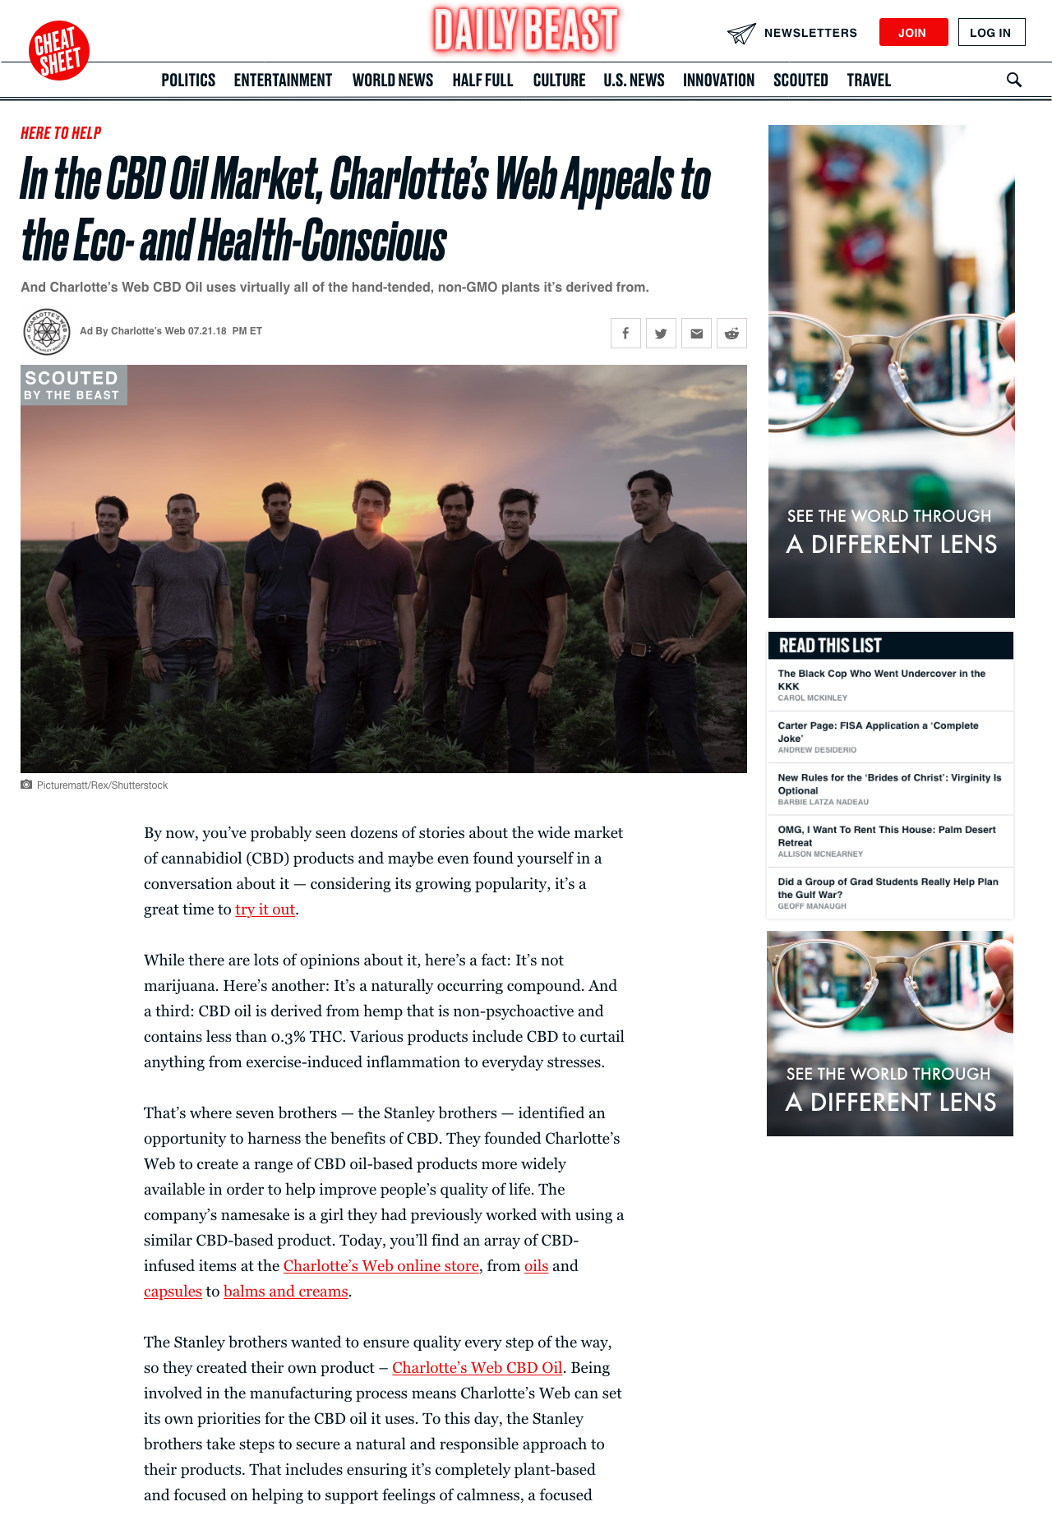
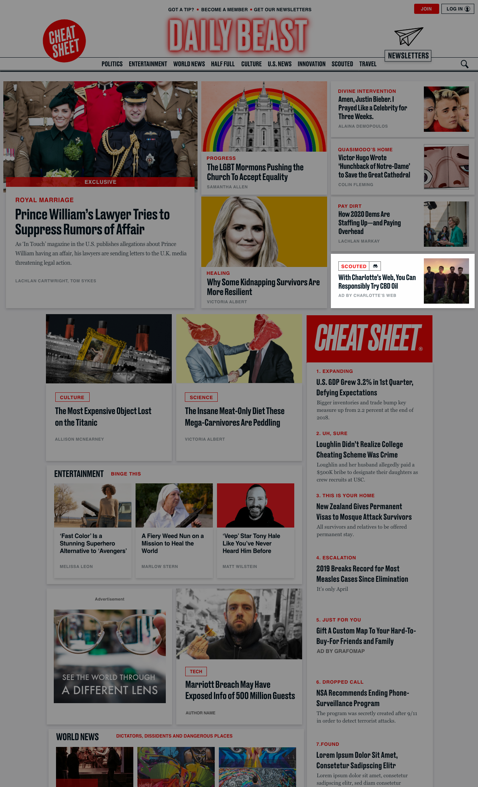
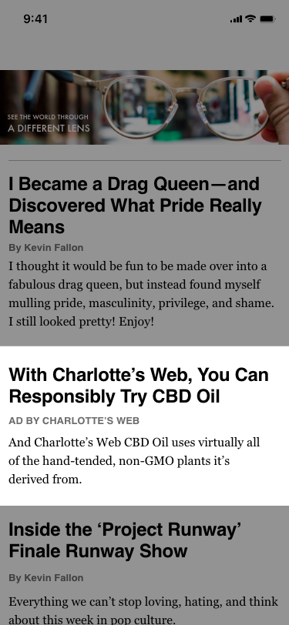
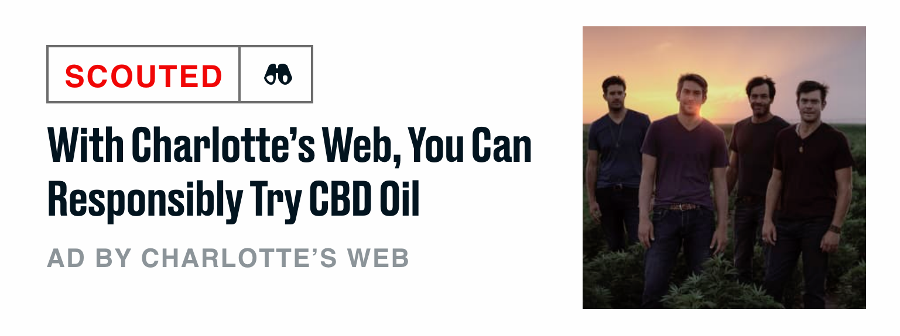
Top Box Package Placements
Sponsored Post
Homepage Placement: Cheat Sheet, 3rd Slot
Newsletter Placement
BEAST DIGEST

Slide 15
PremiumLuxury Brand
!
Content Overview
Engagement Overview
116K
32K
Pageviews
Clicks*
86K
$115K+
Uniques
A luxury fashion brand found success in a short form, sale alert themed Branded Cheat.
Gross Sales, 23X ROI*
Source: Google Analytics *Source: Rakuten

Slide 16
CBD HEMP BRAND
!
Content Overview
Engagement Overview
137K
19K
Pageviews
Clicks*
5:08
$50K+
Average time spent
A CBD hemp brand found success in a long-form, SEO focused Scouted article located in the TB7 slot of the homepage.
Gross sales,10X ROI*
Source: Google Analytics *Source: Rakuten

Slide 17
Getting STarted
Choose Package & Select Date(s)
We’ll provide options and put holds on those dates.
Provide IO Details
Name, email, billing address. Platform payments are accepted.
Sign the IO
Let’s get started!
Share Messaging Points
Image assets can be client-provided or publisher-created.
We generally allow for five business days from IO signature to launch, but we can certainly turn around creative quicker than that if necessary.
Review & Approve Post
Up to two rounds of feedback.
Launch!
We’ll send live links and screenshots.

Slide 18
Lindsey Jaffe
lindsey.jaffe@thedailybeast.com
P.212.445.4856
THANK YOU
Kiera Haley
kiera.haley@thedailybeast.com
P. 914.424.2800
Emily Herzig
emily.herzig@thedailybeast.com
P. 516.680.0659
Paige Hart-Smith
02.27.20

Slide 19
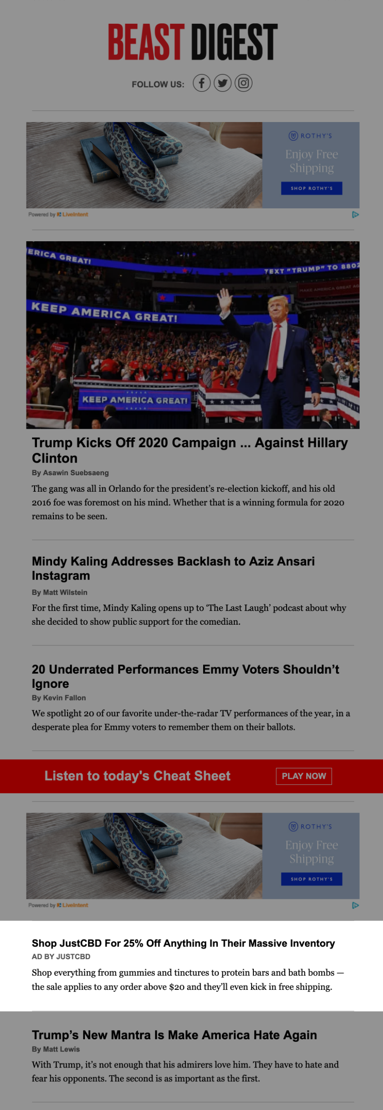
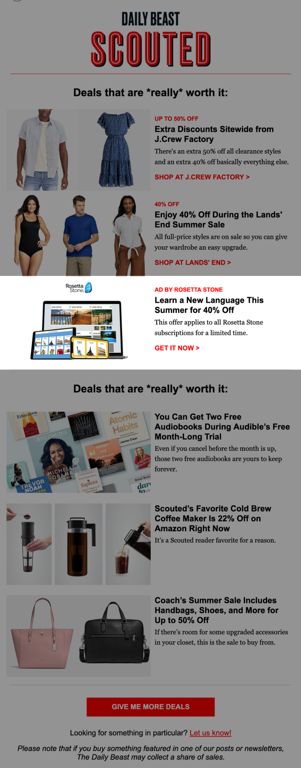
Newsletter Integration
PAID PLACEMENTS
The Daily Beast’s most loyal users are also our newsletter subscribers. These readers have built our stories into their weekly inbox routines — and your brand can be a part of it. Placements driving to sponsored posts or clicking directly out to your brand’s site are available in these newsletters.
Newsletter | Send time | Frequency | List size | Open rate | CTR
AM Cheat Sheet | 7:30am | M-F | 147.9k | 32.2% | 6.6%
PM Cheat Sheet | 4:30pm | M-F | 114.1k | 30.9% | 5.7%
AM Digest | 10:30am | M-F | 160.5k | 30.9% | 7.1%
PM Digest | 6pm | M-F | 126.5k | 30.3% | 7.3%
Weekend Digest | 12pm | Su, Sa | 141.1k | 31.8% | 8.2%
Entertainment Digest | 1:30pm | M, W, Sa | 73.3k | 28.4% | 5.3%
Scouted | 11am | M, Th, Sa | 14.4k | 16.7% | 2.1%

Slide 20
January
february
march
April
CES: Gadgets to Get Now Super Bowl Savings | Valentine’s Gifts: Your Heart in Your Cart President’s Day Deals | International Women’s Day: Week of Women-Owned Brands Spring Cleaning Essentials | Sleep Week: Dreamy Products Eco-Living: Go Green + Spend Green
Summer Must-Haves Mother’s Day Gifting School’s Out: Graduation Gifting Memorial Day Deals | Pride + Proceeds: Brands Supporting LGBTQ Causes Father’s Day Gifting Sweat Week | Independence Day Deals Prime Day Deals | In Session: Back to School Sales
Labor Day Deals | Halloween: All Treats, No Tricks | Themed Gift Guides Singles’ Day (11/11) Deal Week (Black Friday, Cyber Monday) | Holiday Survival Guide New Year, New You: Realistic Resolutions
May
June
July
august
Editorial highlights
September
October
november
december
RECURRING FRANCHISES
The Case For // These Are My Everyday // We Tried It // New Kids on the Block // You Should Know About // What’s the Difference // On Amazon
Editorial in development and subject to change

