Slide 1
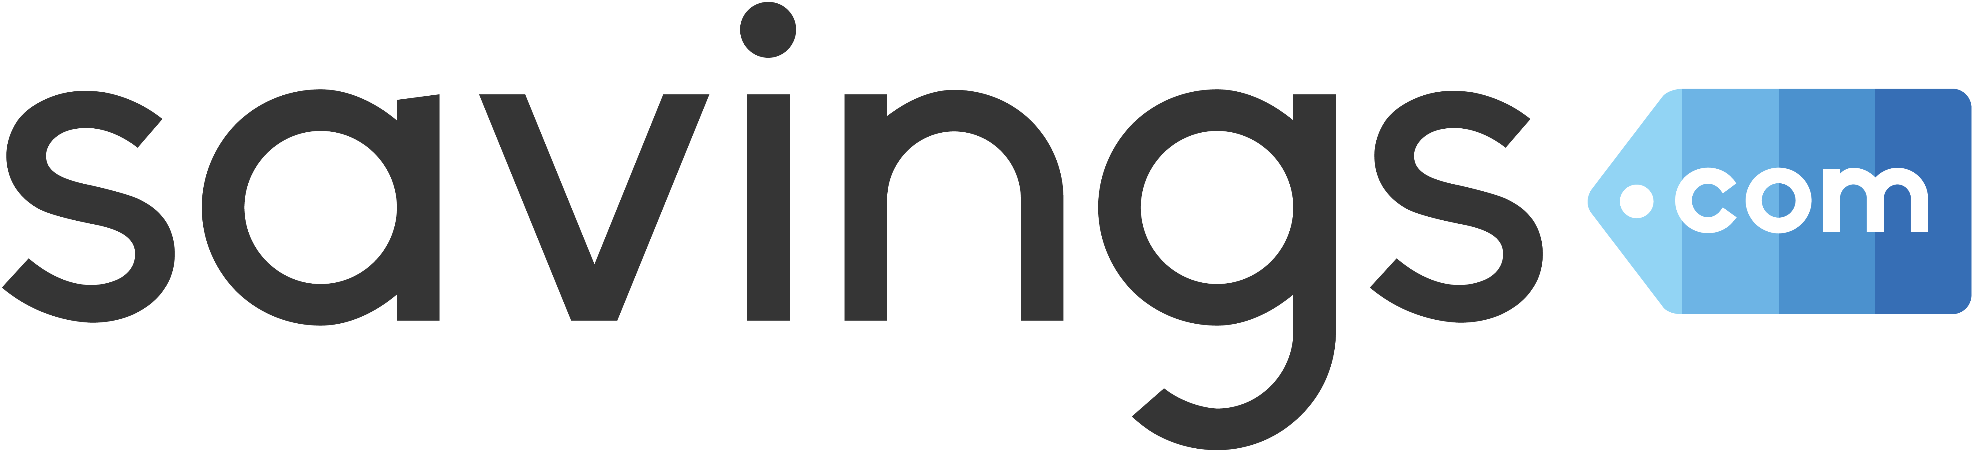





Slide 2
Savings.com’s Reach & Audience
    Demographic
      Age 25 – 44
      66% Female
    Household
      40% earn over $75k/year
      65% have children
        24% have 3 or more
    By Region
      20% - West
      21% - Midwest
      26% - Northeast
      33% - South
    Top Categories
      Retail / Apparel
      Electronics
      Travel
      Beauty & Personal Care
    Reach
      5mm unique visitors / month
      1mm email subscribers
      36K Twitter Followers
      Facebook
        409K Likes
        396K Followers

Slide 3
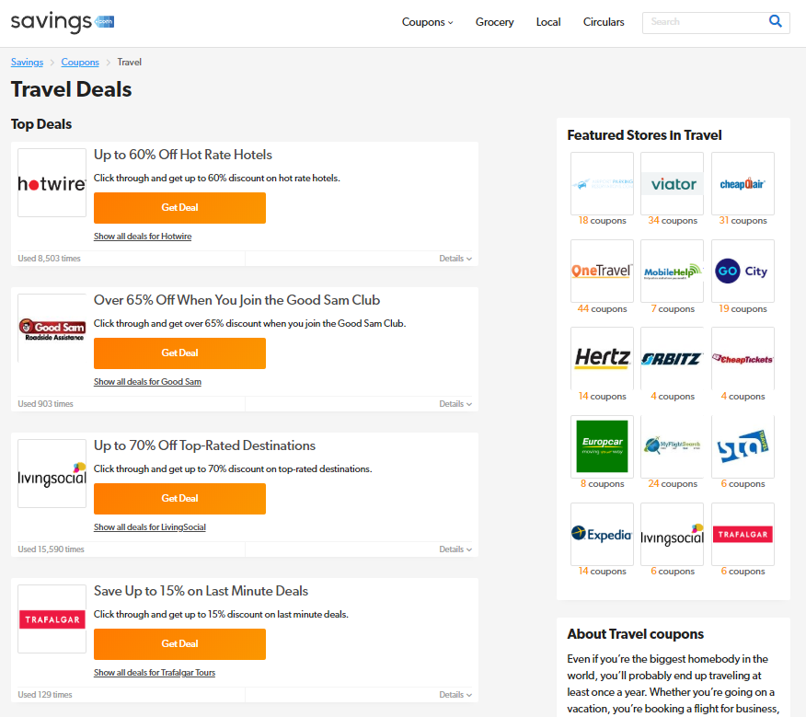
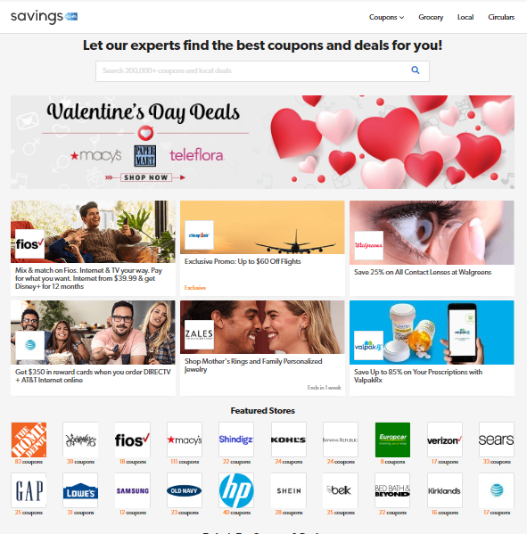
Placement Opportunities
    Homepage
      Banners
      Featured Logos
      Deal Listings
    Categories
      Featured Advertisers
      Top Deal Section
    Seasonal
      Holiday Pages
      Interactive Gift Guides
    Email
      Dedicated Solo Mailing
      Newsletter Banner
      Newsletter Featured Offer

Slide 4
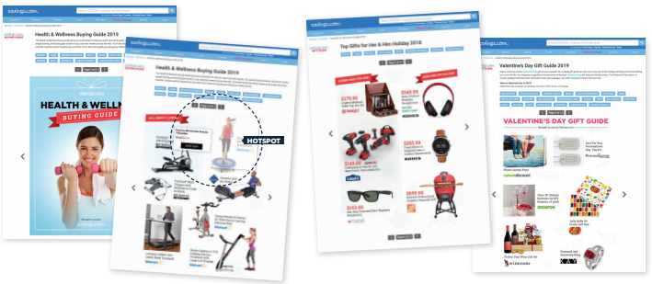
Interactive Gift Guides
Advertisers can pay to participate in our seasonally hosted gift guides, or create
their own guide and feature a suite of products
User Experience
Catalog of product and lifestyle images with prime areas hot-spotted
Mouse over to reveal more information
  Key features, pricing, discount, etc.
Clicks drive straight to the product page on the advertiser’s site
Links/Products/Pricing are available to be updated on a daily basis
Promoted Via
Partners / Influencers
Email
On-site
Social Media
Google Ads
2019 Stats
223 Promoting Partners
15mm Emails Delivered
57mm Impressions
900K Referrals
11,262 Conversions
$2.3mm in Sales

Slide 5
Our Offline Marketing Solution

Slide 6


Direct Mail Options
Valpak offers a host of offline opportunities to reach their audience of 38 million households nationwide
    Insert inside the envelope
      Bar code option for in-store redemption
      Drive users to convert online
    On-Pak placement
        Banners available on front & back panels
        QR Code scanning directly to advertisers’ site
    Solo postcard
        Stand alone, advertiser-branded card with custom targeting by household
        Mails for less than the price of a stamp

Slide 7





Find Your Ideal Customer
We invest in the premier data providers to identify household-level opportunities for advertisers to reach new and existing customers
Geographic Targeting
Target using a mile radius, drive time, carrier route, ZIP code, county, markets, state level or a custom geography.
Demographic Targeting
Identify and target key demographics within the Valpak audience by NTA.®
Consumer Behavior Profiling (via PRIZM NE)
Find consumers with a higher likelihood of purchasing your product or service
Purchase Power
Identify households that are estimated to spend more than the average household on your product or service.
Advertiser Provided Household List
Data is run through NCOA and CASS, merged/suppressed to target unique segments and optimize postage

Slide 8
Our Content & Influencer Network

Slide 9




Expand Your Audience
Over 1,200 influencers across all verticals specializing in content creation and brand awareness
Site Reach
  Monthly Unique Visitors: 82,000,000
  Monthly Pageviews: 198,000,000
Social Reach
  Facebook: 47,000,000 Likes
  Twitter: 13,000,000 Followers
  Instagram: 8,600,000 Followers
  Pinterest: 16,000,000 Followers
  YouTube: 4,200,000 Subscribers

Slide 10

Customize Your Content
Leverage our team of influencer marketing experts to plan content creation and campaign strategy
  Sponsored Blog Posts
    Product reviews
    Brand experiences
    Deal/Sale promotion
  Sweepstakes
    Product giveaways
    Gift card prizes
    Email address collection
      Re-target with new offers
  Online Events
    Coordinated Twitter Parties
    Facebook Q/A
    Hashtag promotion & post sharing
  Track Everything!
    Links to all posts generated
    Full engagement statistics
    Volume over time

Slide 11


Search Marketing: Trademark Plus

Slide 12
Why Affiliate TM+
Protect Your Trademark
  Merchants should not allow 3rd parties to bid on their Trademark, URL, etc. by itself. These users are looking for you and not searching for deals
  However, it is important for merchants to optimize the way they reach consumers who will only convert with a “great deal”
Increase Efficiency
  Paid search TM+ landing pages are optimized for conversion, unlike organic listings which mainly drive clicks
    Google’s organic results often contain generic headlines that don’t reflect the latest offers
  Half of all search result clicks come from the top 4 spots
    It is critical that publishers in these positions are accurately representing your brand

Slide 13
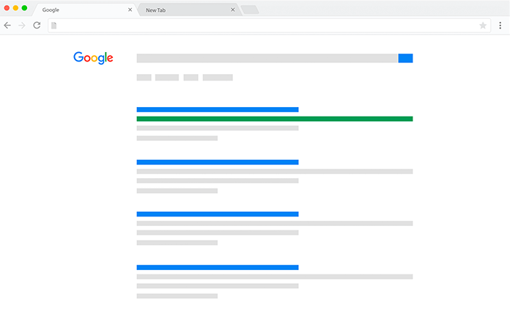
Why Affiliate TM+ (cont.)
Whether TM+ is allowed or not, SEO will push affiliate sites to the top of branded coupon terms
TM+ Gives the Advertiser Control
  Only show users approved ad copies and deals
  Actively managed SEM campaigns increase conversion rate
  TM+ partners can police your landscape and flag illegal bidders
Best Practices for a Healthy Landscape
  Lowered cost means more $ for optimizations and placements
      Limit the number of partners
      Leverage bid caps and position assignments when needed
      Google benefits from competitive bidding, not the advertiser
  Choose the Right Partners
      Quick to respond and optimize
      Proactive communication
      Shared insights and transparency

Slide 14

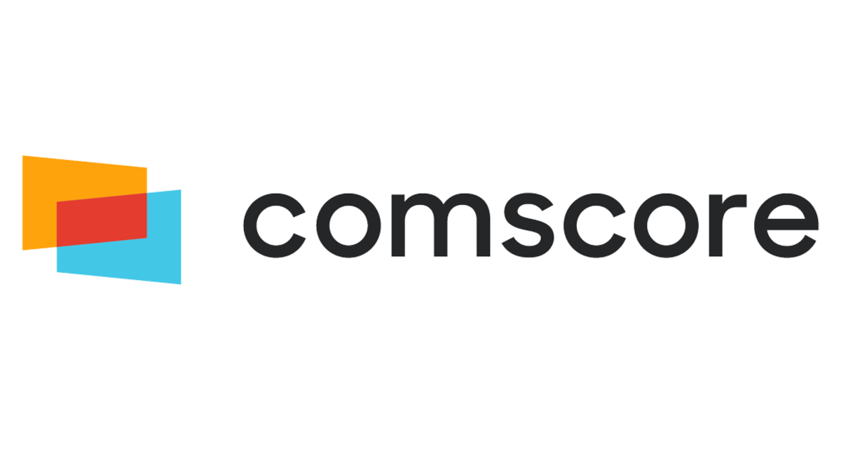
Affiliate TM+ by the Numbers
94%
Number of transactions driven by coupon affiliate paid search ads, where the purchaser was NOT already on the retailer’s site before entering the sales funnel
2X
Shoppers who clicked on a coupon ad before going to the retailer’s site were more likely to convert by…
26%
Percentage that coupon users are more likely to purchase again from the same brand within 6 months of their first transaction
2X
Coupon site visitors are more likely to search for a specific brand in Google by…
*Data taken from Google & comScore’s “Value of a Coupon Searcher” case study in 2018

Slide 15


Why Savings.com?
Annual TM+ Volume
Over $250MM in
Client Sales
Currently partnered with
1,000+ Advertisers
50+ Fortune 500 cos.
Prev. Rakuten Award Winner:
Publisher of the Year
Prev. CJU Award Winner:
Publisher of the Year
Experience
  The pioneer of the affiliate TM+ space, with over a decade of experience managing successful campaigns and a fully dedicated staff of SEM specialists
Technology
  We have a custom integrated system in-house, which allows us to sync our performance data with SEM interfaces to make automated, real-time optimizations to bids, ad copies and landing pages
Growth Beyond SEM
Any profit margin generated through search campaigns is treated as a revenue stream that we re-invest back into other channels and opportunities

Slide 16
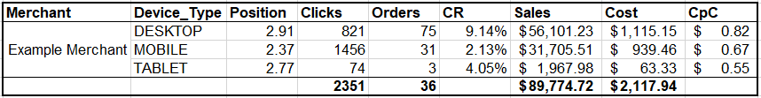
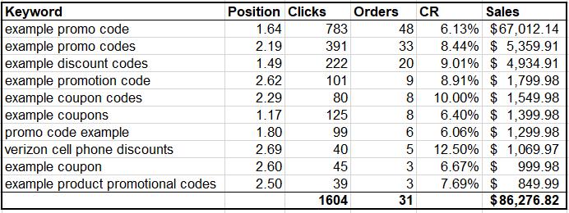
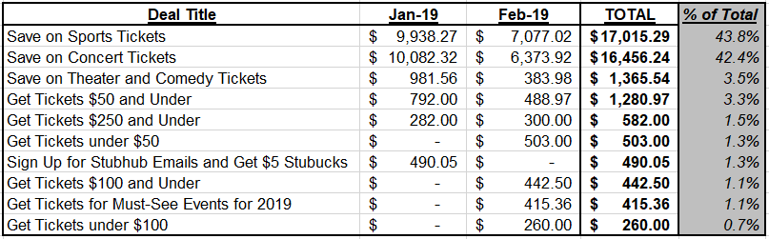
Reporting Capabilities
    SEM (Savings.com Reports)
      Breakdown by Device & Engine
      Top Deal performance
      Ad copy performance
      Keyword performance
    SEM (Google Reports)
      AdWords
        Performance and bids by keyword
      Auction Insights
        Who’s bidding?
        How often?
        Position and Outranking shares
    OVERALL PROGRAM
      Channel and Deal Performance
      MoM / YoY trends
      Competitive Analysis

Slide 17
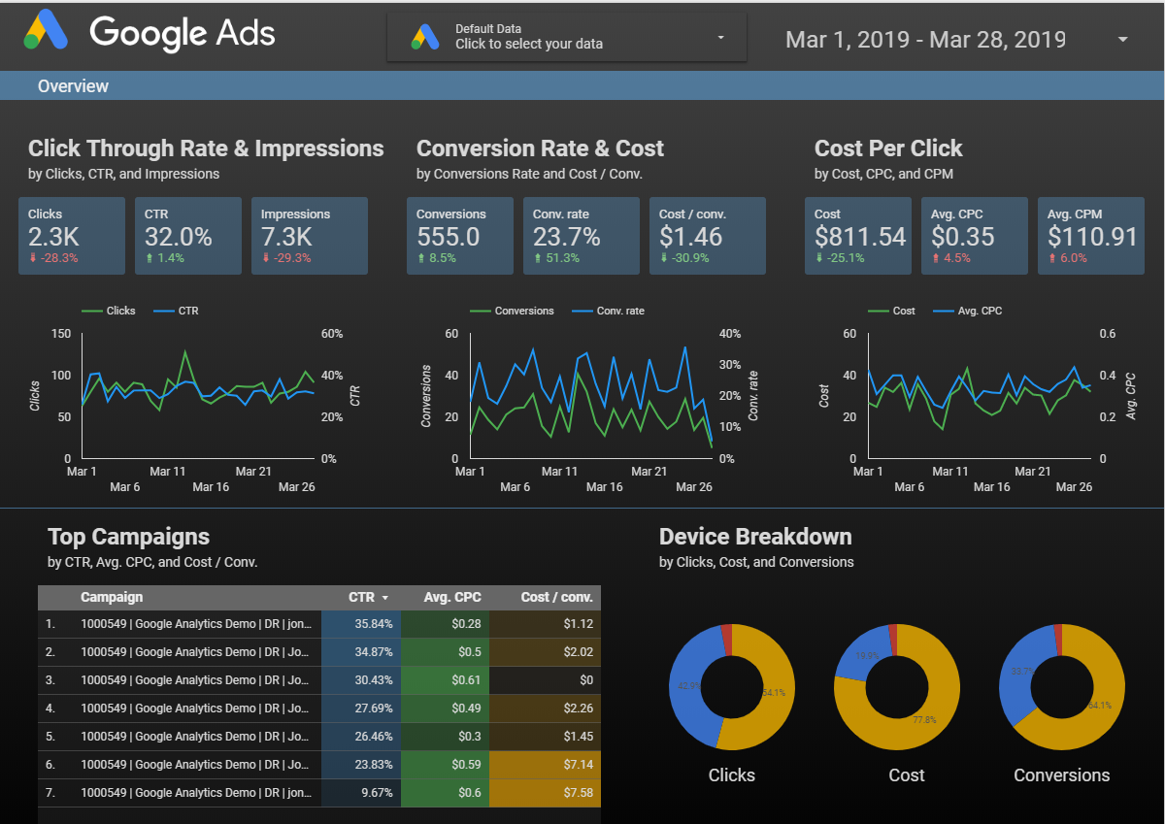
Data Studio Tool
    Able to create custom reports with SEM trends and insights
    Data collected and synced from:
    Google AdWords Reports
      Device breakdown
      Keyword performance
      CPC costs
    Google Auction Insights
      Impression share
      Position ranking
      Landscape snapshot
    Savings.com Internal Reports
      Deal performance
      Cross-channel insights
      Performance over time

Slide 18

APPENDIX:
Influencer
Campaign
Case Studies

Slide 19
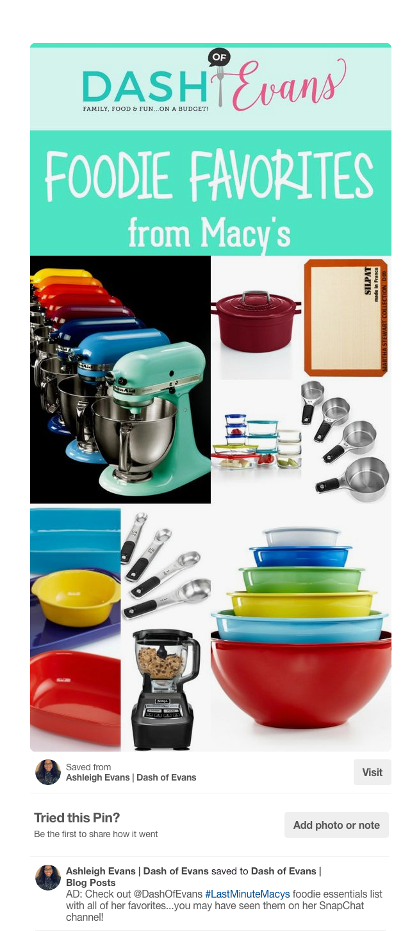
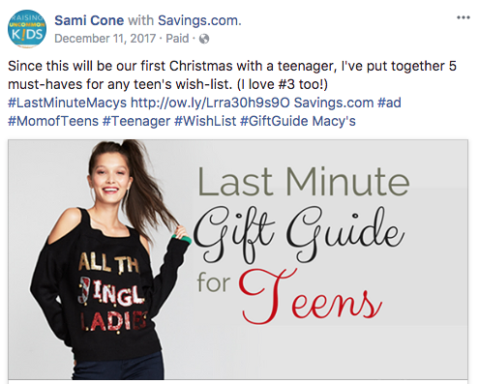
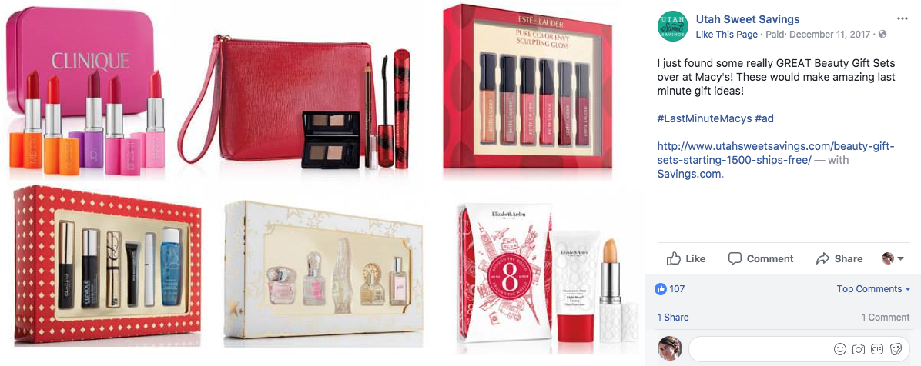
DEALPRO CASE STUDY:
GIFT GUIDE CAMPAIGN
Overview
  We worked with influencers to create unique, curated, last-minute
  holiday gift guides using items from the client’s website. A picture and
  a deep link to each item were included.
13 high-quality, visually interesting gift guides
Impressions on campaign hashtag: 12.6MM
Sales: $58,000+
Results
Reasons for Success
  Hand-selected participants who perform well for client
  Engaging, personalized content
  Seasonally relevant

Slide 20
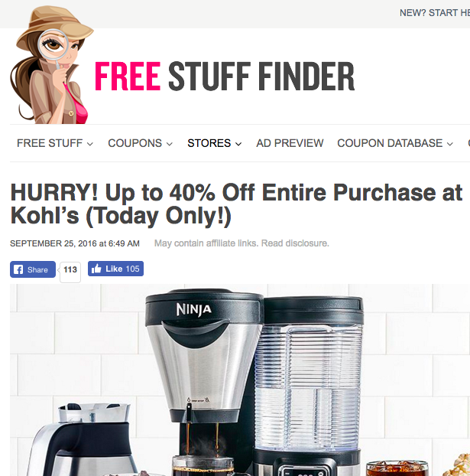
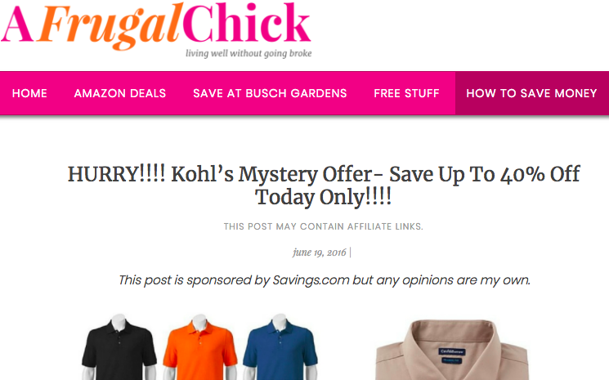
DEALPRO CASE STUDY:
UNIQUE COUPON CODES
Overview
  On a single day, over 40 DealPros partnered with us to distribute
  over 14,000 unique coupon codes. They wrote blog posts highlighting
  sale items, then directed them to get the code and shop. The posts
  were also shared via their social media channels.
Clicks:
26,587
Orders:
988
Sales:
$90,947
Results

Slide 21
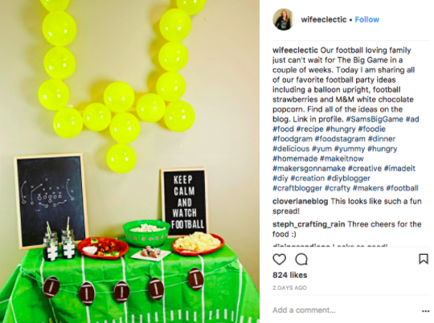
DEALPRO CASE STUDY:
GIVEAWAY/TWITTER PARTY
Overview
  Influencers were engaged to write sponsored blog posts
  (with social shares), to promote a gift card giveaway and
  to co-host/promote a Twitter event
  Giveaway entries:
  16,900
  Impressions on campaign hashtag:
  86MM
Results
  18 high-quality blog posts

