Slide 1
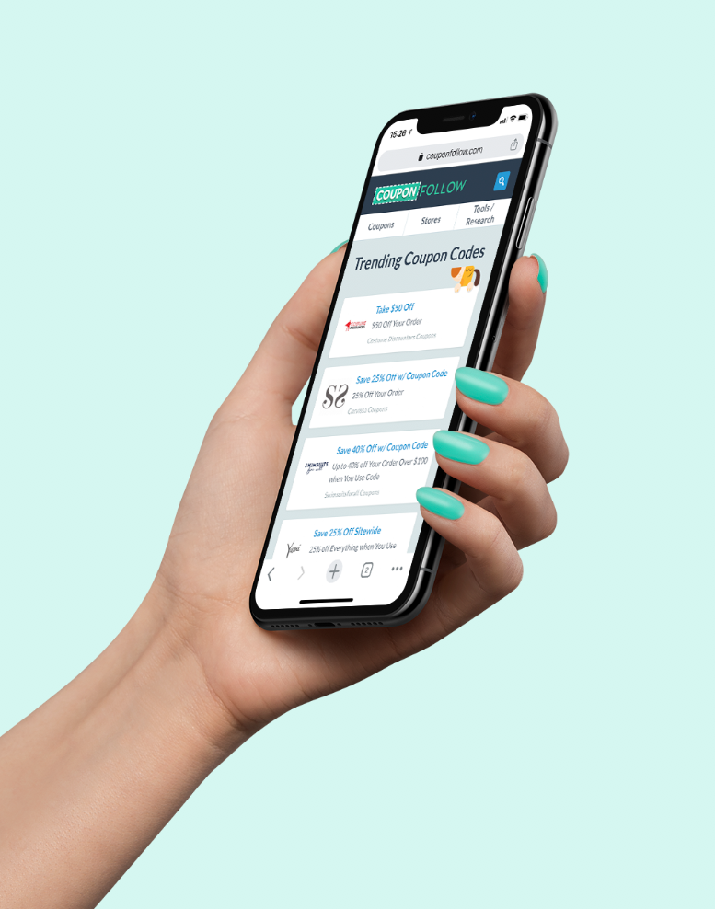
CouponFollow
Coupons, Cashback, and more.

Slide 2
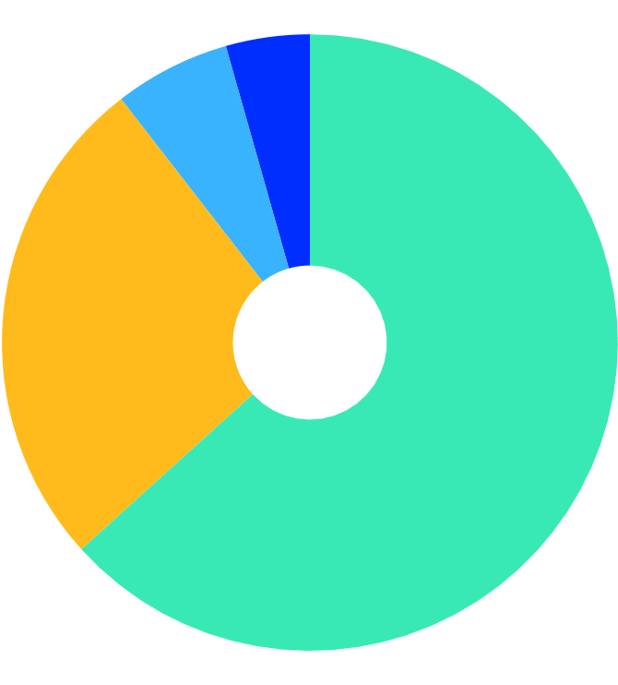
1.7 Million
Email Subscribers
5-6 Million
Unique Visits Per Month
$105 Million
Sales Volume in 2019
33% YoY
Revenue Growth 2018-2019
US
63.3%
UK
26.2%
57% YoY
Q4 Growth 2018-2019
Canada
6.1%
Other
4.4%

Slide 3
OUR DIFFERENCE
The CouponFollow Difference
With partnerships stretching over 15 years, we’ve achieved recognition in top tier affiliate networks with networks and advertisers alike.
Rapid response from a dedicated Affiliate Manager, offering response time for offer corrections within hours.
Strict compliance with affiliate regulations - no expired or invalid codes here!
We work WITH advertisers to provide performance insights and optimization of brands.

Slide 4
OUR PRODUCTS
Cently
Includes Rewards, Savings, and Amazon Best Price Tool
250,000 members - and growing!
80% of Cently users return to buy again
$1.5 Million in sales from Cently alone

Slide 5
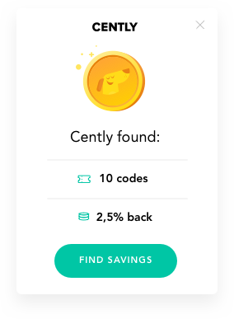
OUR PRODUCTS
Cently Savings
Cently supports thousands of popular stores like Macy’s, Nike, Walmart, Groupon, and more.
Consumers never need to leave your site.
Cently only shows approved affiliate codes.
5 Star Rating in Chrome App Store!

Slide 6
OUR PRODUCTS
Cently Cashback
Consumers get 70% of our CPA.
Cently Cashback gives members a free $5 reward just for signing up.
Launched in late 2019, we’ve already seen 32,000 member signups.
Users have earned $170,000 in Cashback!

Slide 7
MEDIA
Exposure
We work with top tier publications and journalists to increase exposure for our Advertiser partner promotions.
We’ve worked with or been cited on Newsweek, Today.com, USA Today, NBC News and more!

Slide 8
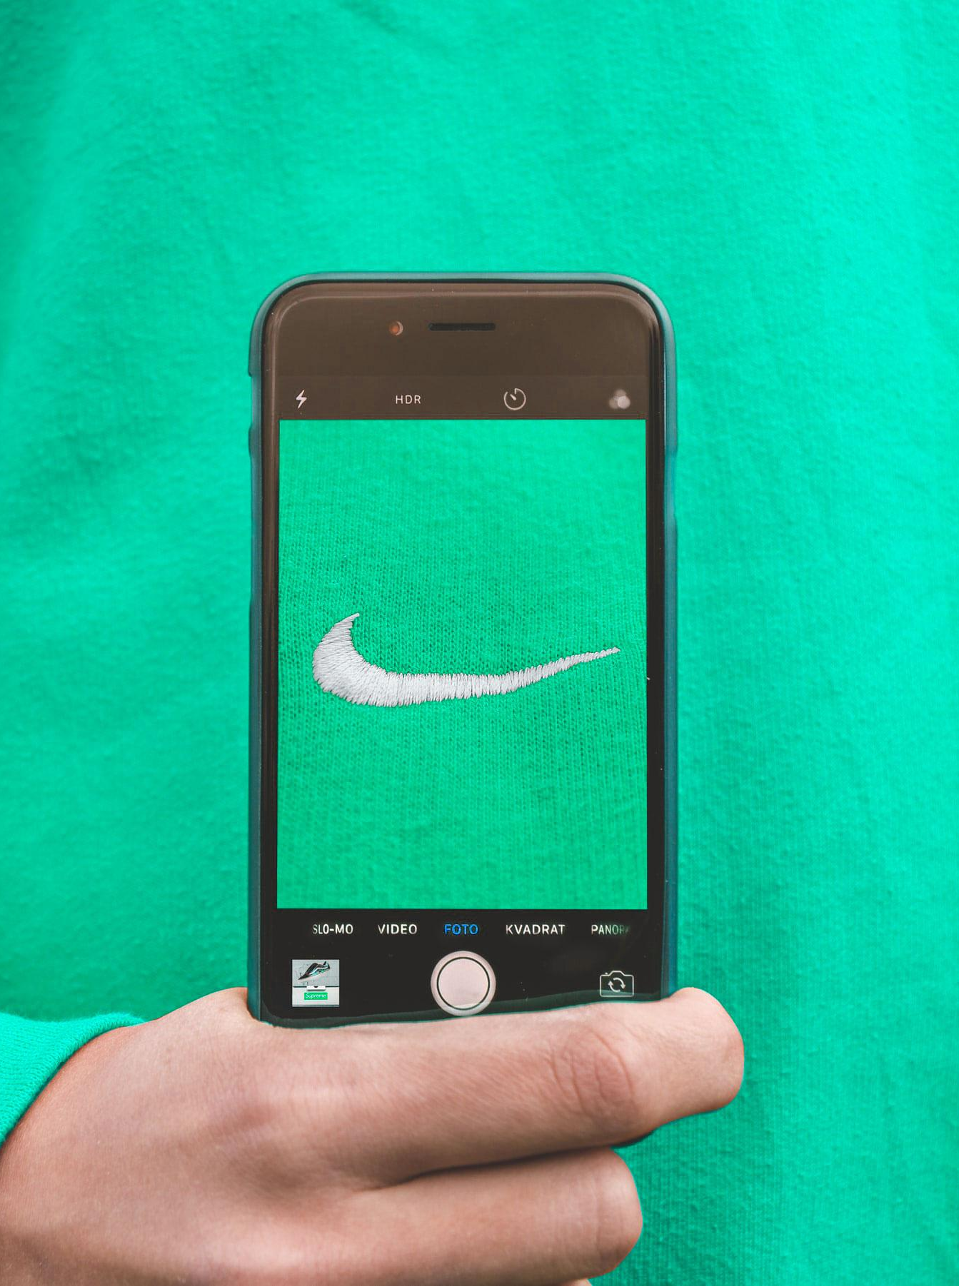
PLACEMENTS
Placements
Flat fee, CPA increase, and hybrid available
Homepage
Newsletters
Cently Cashback
MORE coming soon!

Slide 9
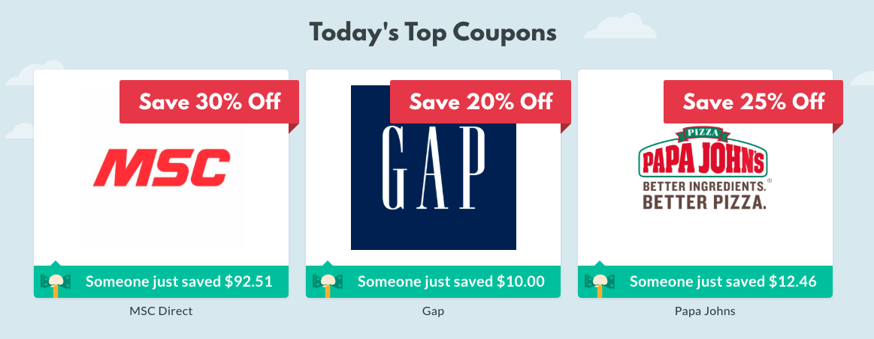
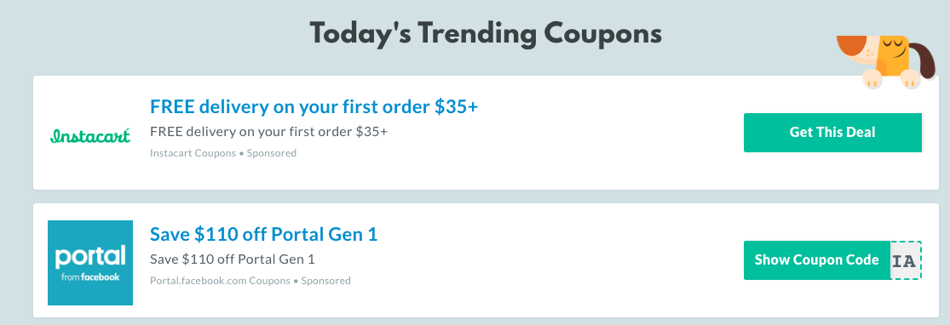
PLACEMENTS
Homepage
Starting at $350/week
27,000 viewers/day
56% Female
25% aged 25-34

Slide 10
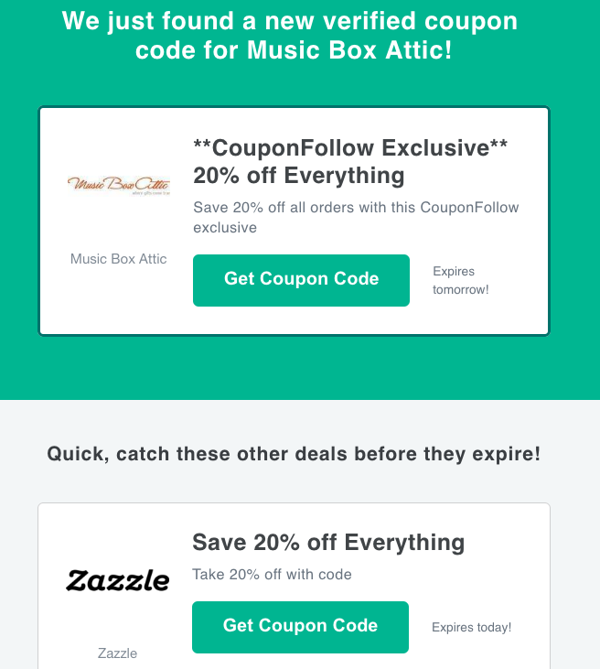
PLACEMENTS
Newsletters
Starting at $500
1.7M subscribers
Target specific categories
Solo sends available

Slide 11
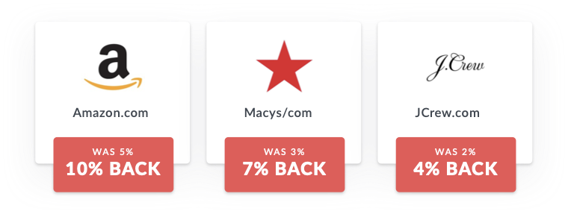
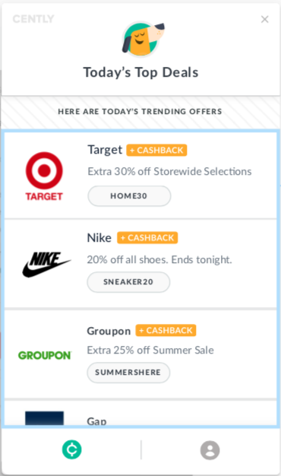
PLACEMENTS
Cently
Members only portal and/or extension
Showcase new cashback rates
Flat Fee or CPA increase placements available

Slide 12
HIGHLIGHTS
Case Study #1
Featured a popular fashion and home goods brand within Cently portal, within holiday-specific newsletters, and added exclusive coupon codes.
4,000% increase in clicks YoY
3,000% increase in orders YoY
2,000% increase in sales YoY

Slide 13
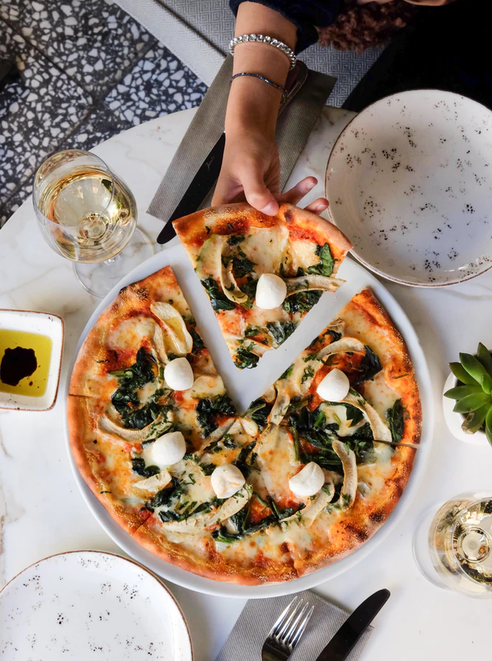
HIGHLIGHTS
Case Study #2
Featured a food delivery brand with ongoing homepage placement under Today’s Trending Coupons.
415% increase in sales YoY
250% increase in clicks YoY

Slide 14
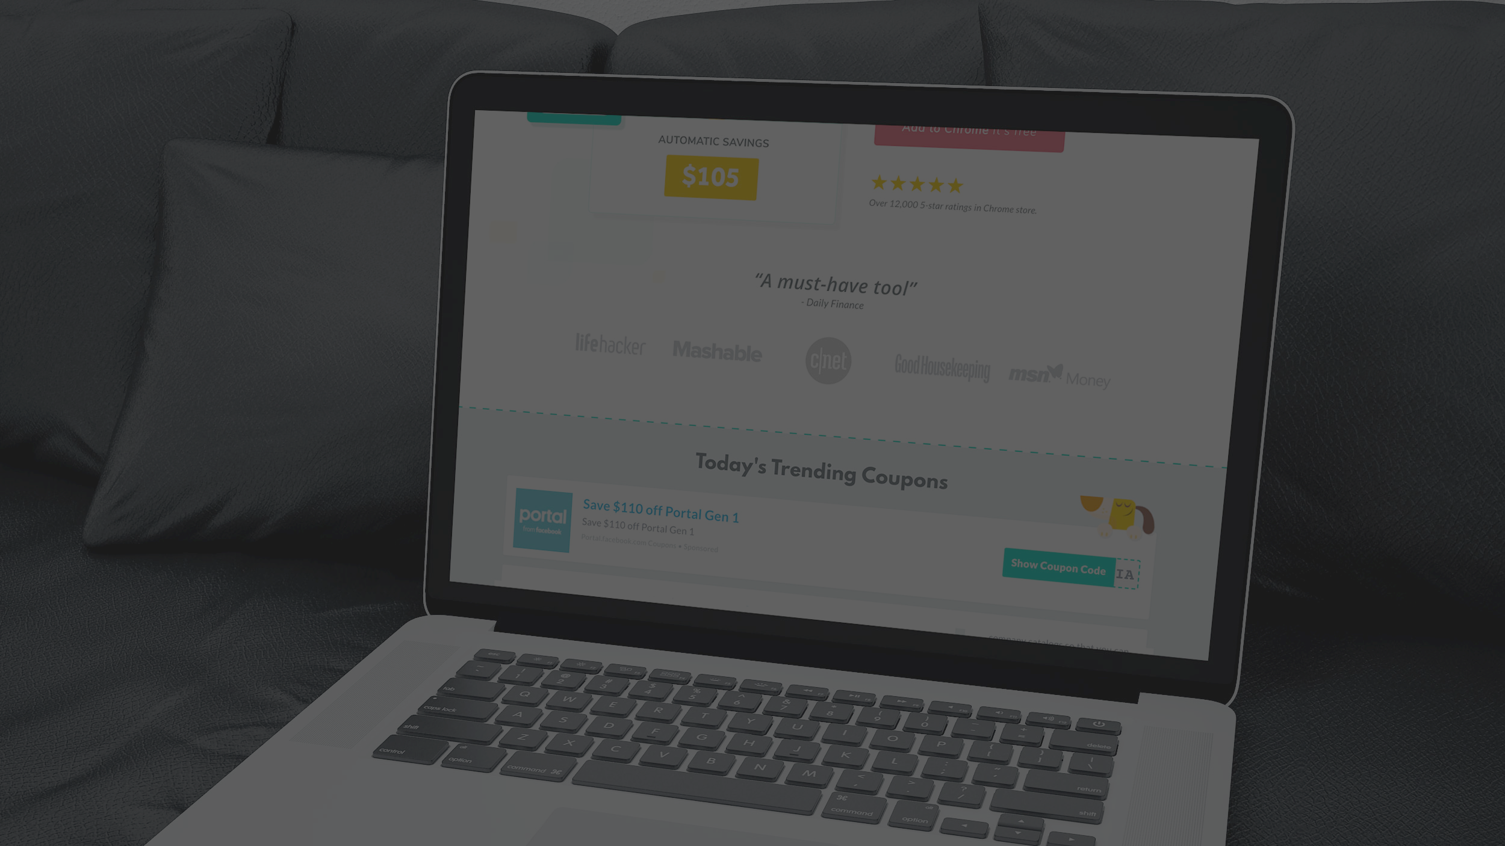
Thank you.
Tiara Rea-Palmer (657) 206-0960 tiara@couponfollow.com PJID 36590

