Slide 1
Pepper Jam Digital Day
Cartera Overview & Opportunities
March 25, 2020

Slide 2







About us
Cartera is the leading shopping solution for brand loyalty programs. We make shopping more rewarding by empowering businesses to extend their brands and by helping members EARN rewards.
5 of the 6
5 of the 10
Largest domestic airlines
Largest credit card issuers
70MM+
$1 billion
Network Audience
In annual purchases
1,100+
100+
Online merchants
In-store merchants

Slide 3



















Cartera Offer Platform
70+ million
Network Audience
Merchants
Platform & Products
Programs
Merchant Funded Offers
Hosted Shopping Solutions
Mobile apps & integrations
Browser extension
In-store rewards
Email marketing

Slide 4
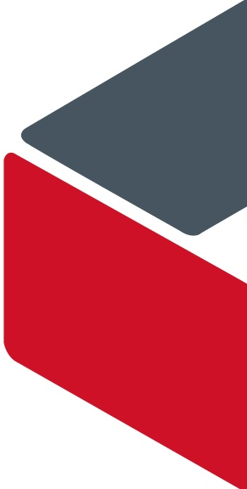
Cartera Rewards
How do we split up our commission with members, partners and Cartera?
Member Reward
5% or 5pts/miles
Client Split
2.5%
Cartera Revenue
2.5%
Rewards in form of miles, points, cash-back, etc.
Contractual obligations determine pass-back
Reward members as soon as we receive transactions (no pending status)
Affiliate network requirements
  Flat commission terms
  Correct start and end dates of terms
  Last-click attribution
10% Gross
Commission
Notes:
Add example – UA nch

Slide 5
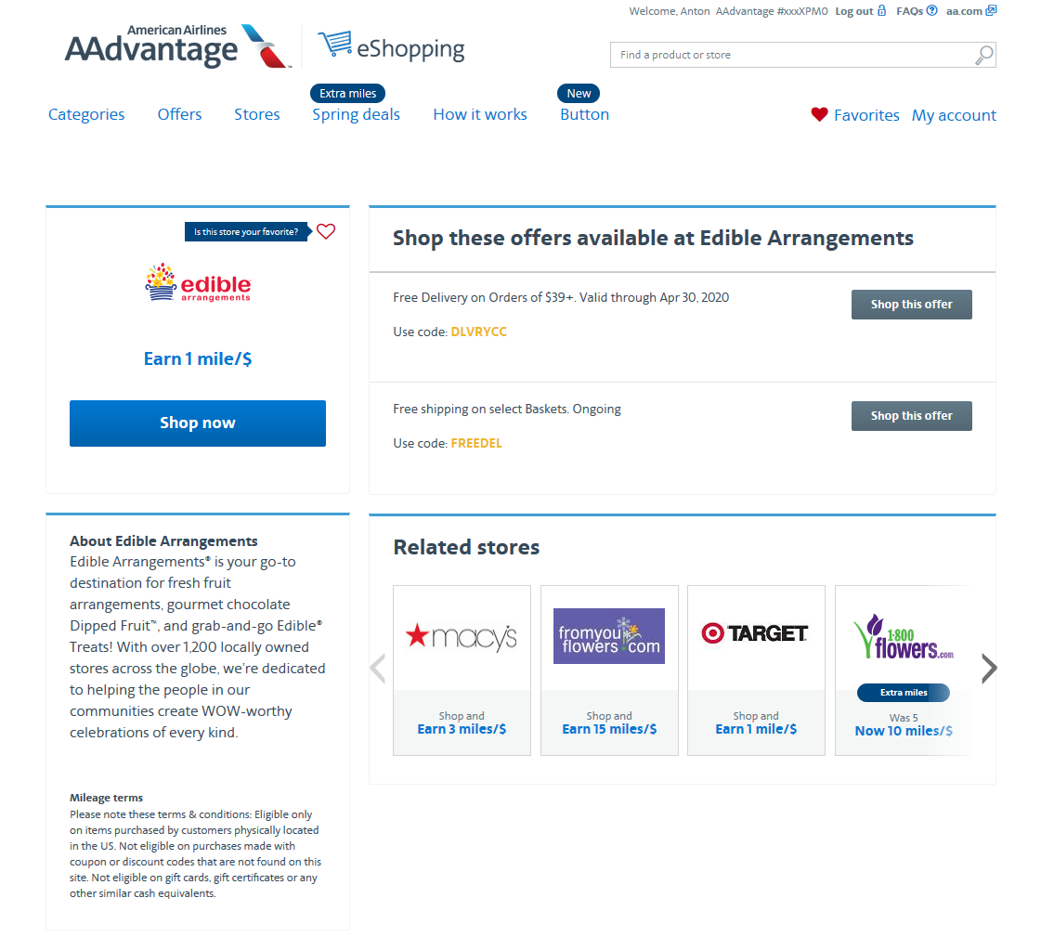
Merchant Details
What is included as part of Merchant’s offering?
1
1
Merchant Logo
Reward Earn Rate
Affiliate Approved Coupons/Offers
Merchant Brand Description
Terms & Conditions for Earning
2
3
4
5

Slide 6
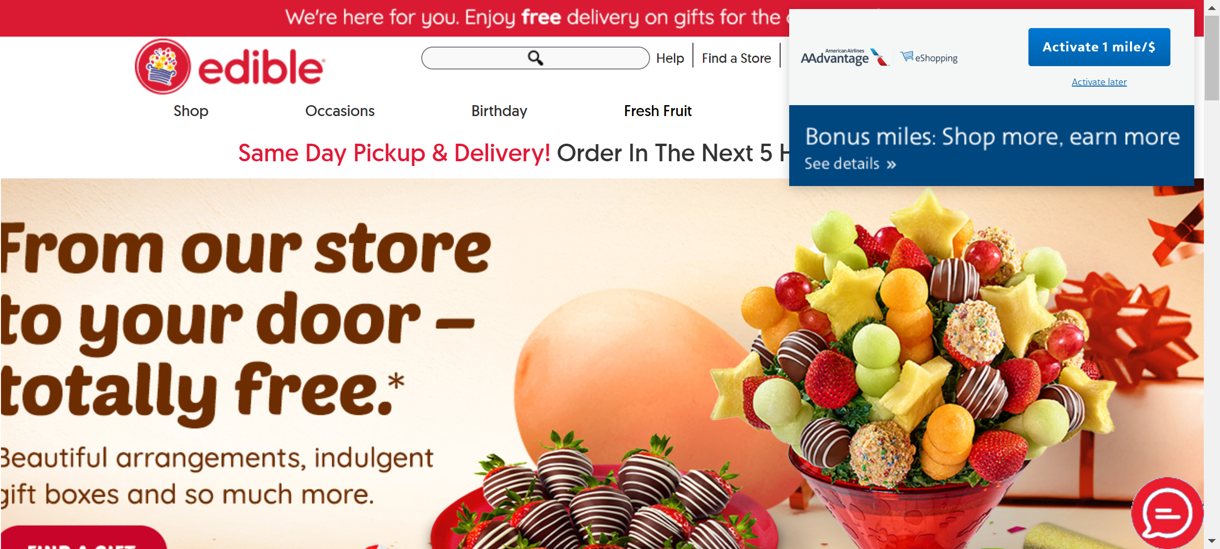
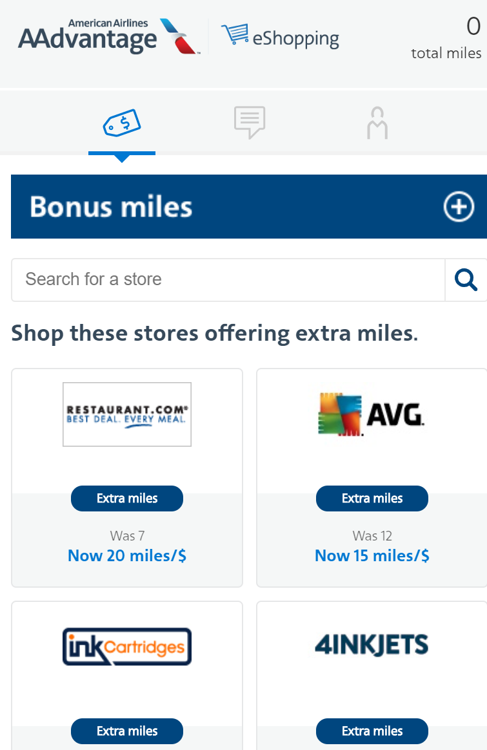
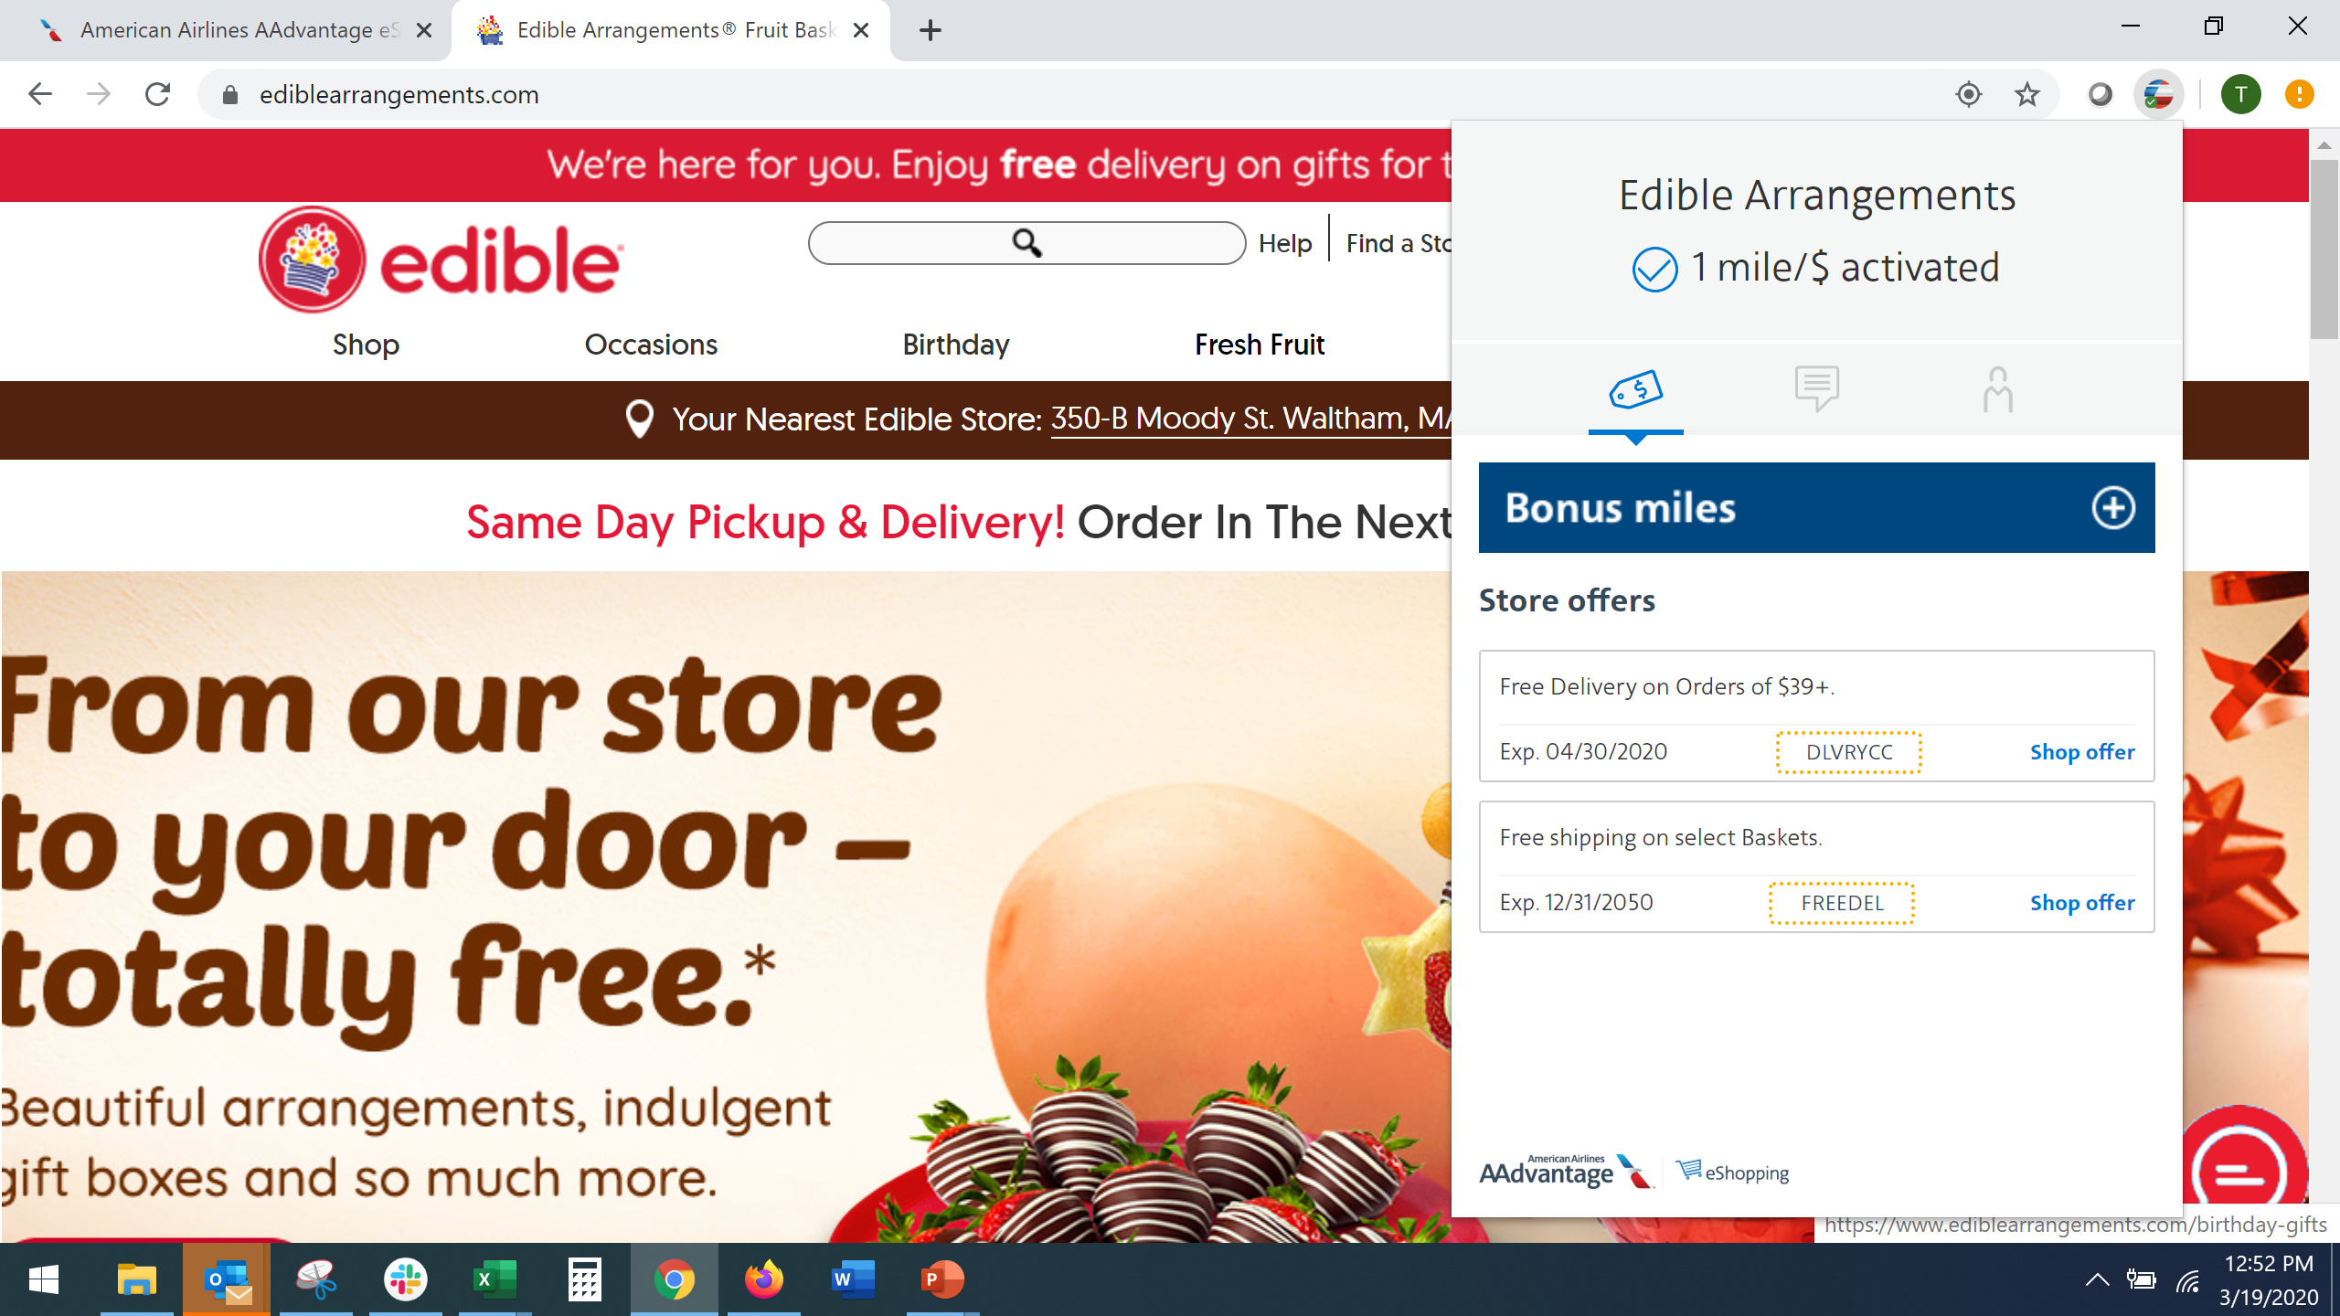
Button
Browser Extension is live for six Cartera clients
2
Marketing Communication vehicle
  My Account information
  Participating merchants and earning
  Bonus & Sweepstakes messaging
  Additional Marketing opportunities
Customers are reminded to always shop earn with participating retailers
Coupon Magic applies coupons helping to reduce cart value
1
3
5

Slide 7
Integration & Migration
What are the costs and processes involved with integration and migration?
Integration
One-time set up fee to integrate
  Includes launch marketing
  Initial set up on Cartera’s network
Integration Packages
  Gold - $10,000
  Silver - $9,000
  Bronze - $8,000
  Launch Only - $6,500
Migration
Offsets the manual effort required to:
  Set up merchant on the new network
  Migrate links
  Ensure commission rates & terms are correct
  Place test transactions on desktop and mobile
  Validate order processing
  Additional testing and review as needed
Migration costs
  Jan – October = $2,500
  Nov & Dec = $5,000

Slide 8
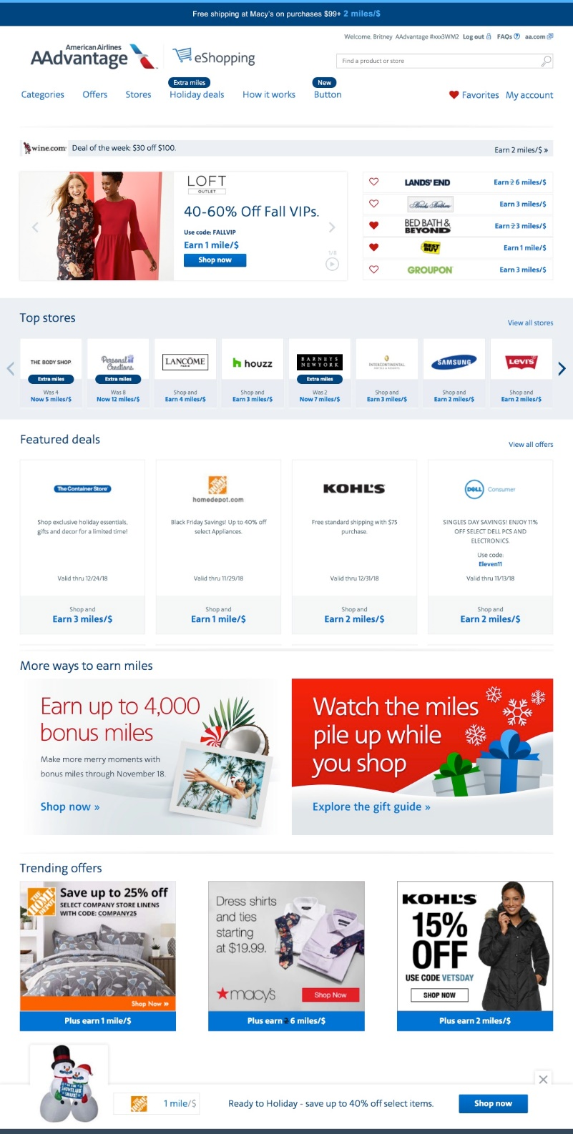
Homepage Opportunities
1
Homepage media opportunities are available on specific client programs.
2
3
^{Placement Opportunity}
1. Daily Deal
2. Deal of the Week
3. Rotational Letterbox
4. Top Stores
5. Featured Deals
6. Trending Offers
7. Sticky Footer
4
5
6
7

Slide 9
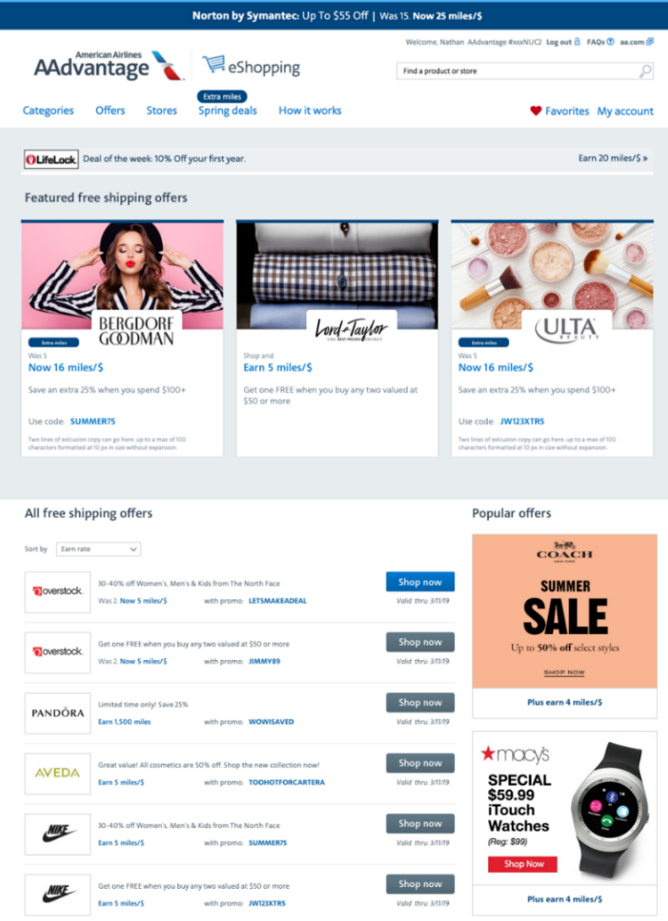
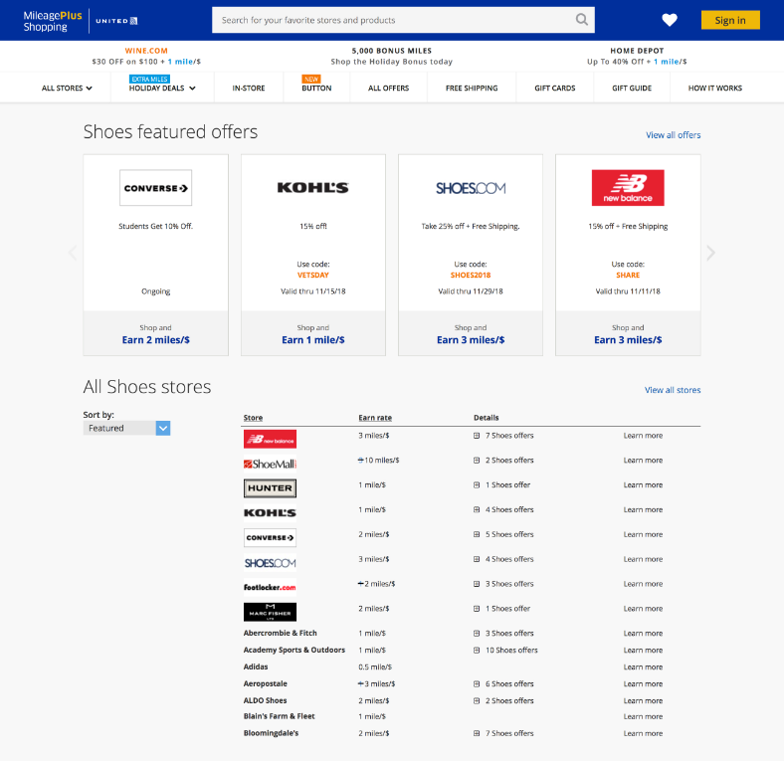
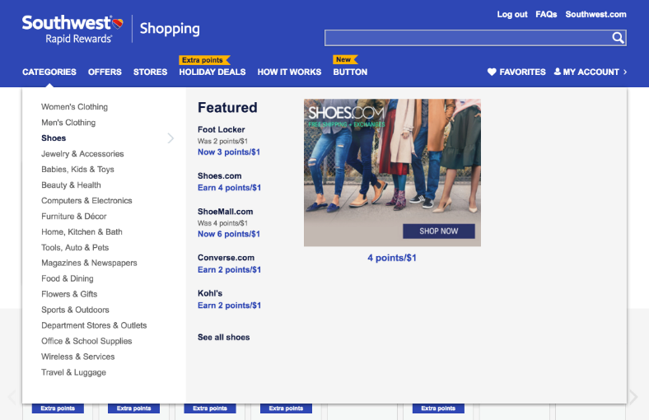
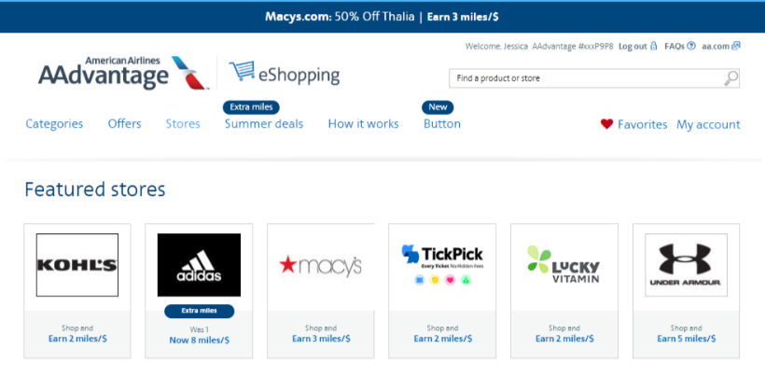
Network-Wide Opportunities
Network-wide media opportunities are sold across all participating programs.
11
Network-Wide Placements
8. Category Featured Store Rates
9. Category Premium Listing Rates
10. Navigation Category Fly-out Rates
11. All Offers / Free Shipping Featured Offers Rates
12. Popular Offers Rates
13. All Stores / Featured Stores Rates
8
12
9
10
13

Slide 10
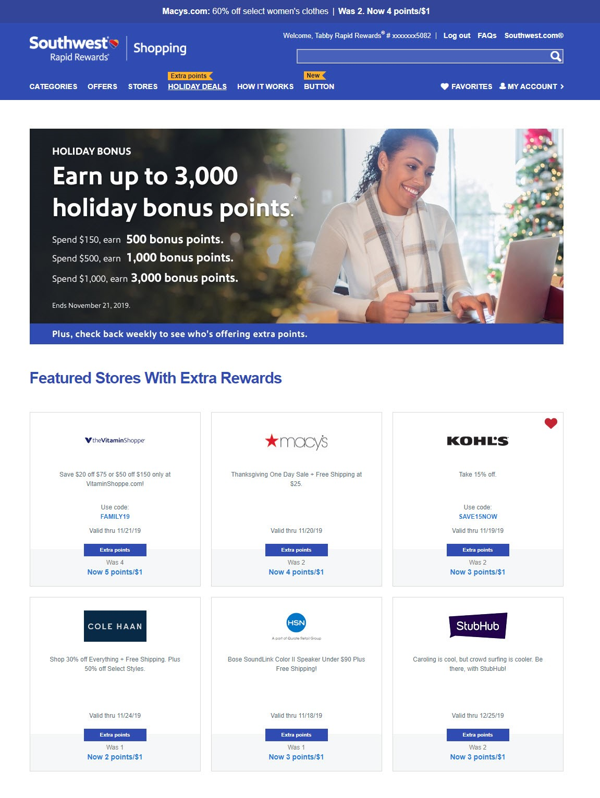
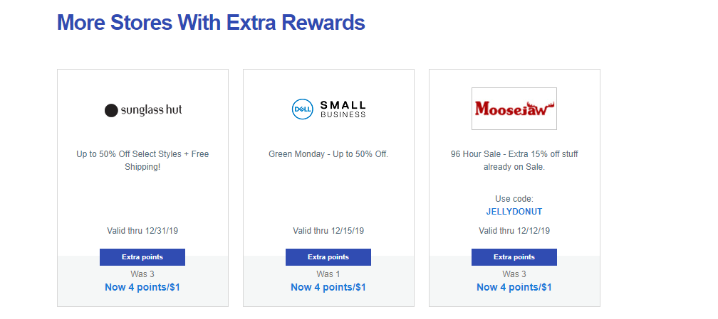
Weekly Extra Rewards Opportunities
Weekly Extra Rewards opportunities are sold across all participating programs.
Cross-program campaign placements with premier sponsors receiving email deployments across ten programs.
Participation in Weekly Extra Rewards campaigns requires at least a 50% increase in gross commission.
14
Weekly Extra Rewards
14. Premier Sponsors
15. Secondary Sponsors
15

Slide 11
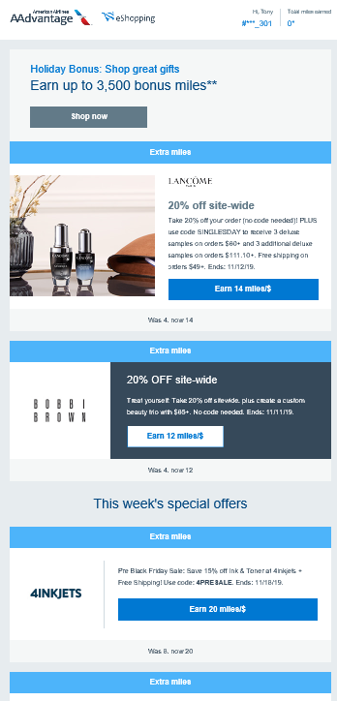
Email Opportunities
Email media opportunities are sold across all participating programs.
Email Placement
16. Marquee Placement
17. Bulletin Placement
18. Secondary Placement
16
17
18

Slide 12
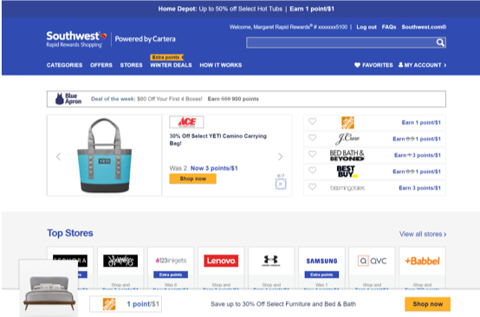
Vendor/Co-Op Marketing Opportunities
Vendor/Co-Op Marketing opportunities can be sold by client or in network-wide placements.
Cartera Commerce offers the opportunity for merchants to promote specific vendors, manufacturers, and brands through the affiliate channel.
Securing co-op dollars from internal vendor teams has proven to be a successful tactic by affiliate teams to gain internal exposure, awareness, and funding for their channel
Media placements can showcase product imagery - great branding opportunity desired by co-op advertisers — and we can send screenshots to pass along to clients.
In lieu of highlighting POS discount, we can offer alternate messaging if the co-op partner prefers, such as "earn miles" when you purchase brand X at Macy’s.

Slide 13
Client List
Alaska Airlines Mileage Plan Shopping | mileageplanshopping.com
American Airlines AAdvantage eShopping | aadvantageeshopping.com
BarclayCard Reward Boost | partners.barclaycardrewardsboost.com
Chase Ultimate Rewards | ultimaterewardspoints.chase.com
Citi Bonus Cash Center | bonuscashcenter.citicards.com
Delta SkyMiles Shopping | skymilesshopping.com
CARTERA COMMERCE
Glamour Rewards | glamourrewards.com
Navy Federal Credit Union Member Mall | membermall.navyfederal.org
Southwest Rapid Rewards Shopping | rapidrewardsshopping.southwest.com
Speedy Rewards Mall | mall.speedway.com
United MileagePlus Shopping | shopping.mileageplus.com
Upromise Shopping | shop.upromise.com
USAA MemberShop | mall.usaa.com
Notes:
Note which are public facing.

Slide 14
Contact Us
Account Manager
Categories
Todd Jirousek TJIROUSEK@CARTERA.COM 315.299.3526 | Home, Health & Office
Jeff Leczkowski JLECZKOWSKI@CARTERA.COM 412.894.7929 | Computers, Electronics, Sports & Recreation
Jessica Campbell JCAMPBELL@CARTERA.COM 781-541-6814 | Apparel, New Stores
Lindsay O’Toole LOTOOLE@CARTERA.COM 781-541-6878 | Apparel
Shannon McGill SMCGILL@CARTERA.COM 781.541.6898 | Beauty, Flowers, Gifts, Food, Gourmet
Gabe Carreras GCARRERAS@CARTERA.COM 781.541.3809 | Books, Movies, Music, Babies, Kids, Toys, Services, Pets
Eric Peck EPECK@CARTERA.COM 781.541.3853 | Shoes, Accessories, Entertainment, Jewelry, Travel, Watches, Auto
CARTERA COMMERCE
Margaret Youngers
Vice President, Merchant Development
e myoungers@cartera.com
t 781.541.6876
Tony Buglione
Sr. Director, Business Development
e TBUGLIONE@CARTERA.COM
t 781.541.3821
Notes:
Photos

Slide 15
Cartera Best Practices
What does the merchant need to do to be successful with Cartera?
TRACKING
At the center of all our client relationships, tracking transactions is key. From desktop to mobile tracking, our clients take their promise to their members very serious and it is paramount to our success.
COMMISSION PAYMENTS
Accurate and timely commission payments are critical to our success in rewarding our members and maintaining client SLAs.
PROCESSING RETURNS
To ensure accurate rewarding and commission payments, it’s important to process returns. Gamers and fraudsters are always looking to take advantage and one way to combat is to process returns in timely manner.
TIMELY OIM REVIEW
Cartera runs Customer Care for several of our clients and under specific SLAs, it’s very important to make sure to review merchant Order Inquiries and respond to customer issues.
COMMUNICATION
Across all the best practices identified, the key one that for Cartera is communication. If there is an issue or an error, we need to know about it and we can take the appropriate steps to resolve the issue or use processes internally to combat an issue.

Slide 16
Client Requirements
What requirements are needed to work with Cartera clients?
Clients have the ability to choose who is included in their shopping program. Some considerations and processes are set but Cartera works tirelessly to include all merchants.
Some client requirements or considerations:
Tracking across all devices – desktop, mobile, ITP, cross-device
No delays in transaction processes – if issues, communication is important
Brand considerations – does your brand align with theirs?
Gross commission requirement – 3% or higher is necessary to work with Cartera clients

